Slide 1







Characterization and reproductive control program of pet population in São Paulo, Brazil.
March 3rd–5th 2015
ISTANBUL, TURKEY
Garcia RCM; Amaku M, Biondo AW, Ferreira F.

Slide 2




Acknowledgment
Study funded by
  Brazilian Federal Agency for Support and Evaluation of Graduate Education (CAPES-PE/2005).
  Education and Animal Control Technical Institute (ITEC)
  São Paulo Research Foundation (FAPESP-06/52686-0)
  World Animal Protection (WPA)

Slide 3

Ethics Committee
The research was conducted within the ethical standards and approved by an ethics committee.

Slide 4
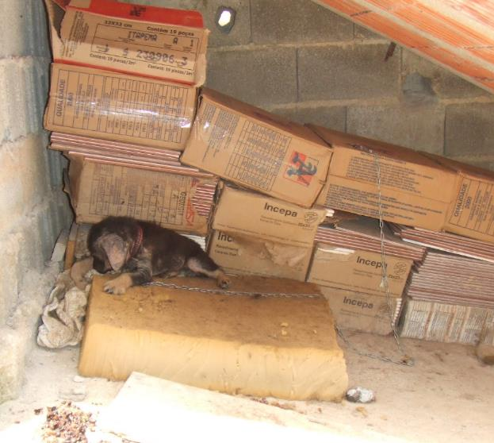
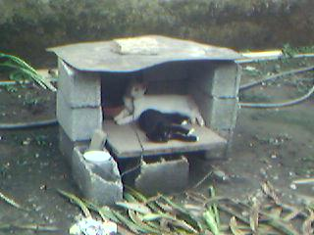
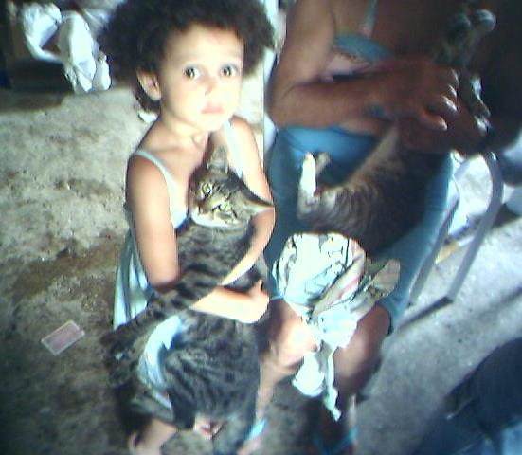
Notes:
The human-animal bond can have positive or negative repercussions on the health of individuals, families and communities depending on how animals are taked care and managed.⁷
Garcia RCM, Calderón N, Ferreira F. Consolidação de diretrizes internacionais de manejo de populações caninas em áreas urbanas e proposta de indicadores para seu gerenciamento. Rev Panam Salud Publica. 2012;32(2):140-4. DOI: 10.1590/S1020-49892012000800008

Slide 5
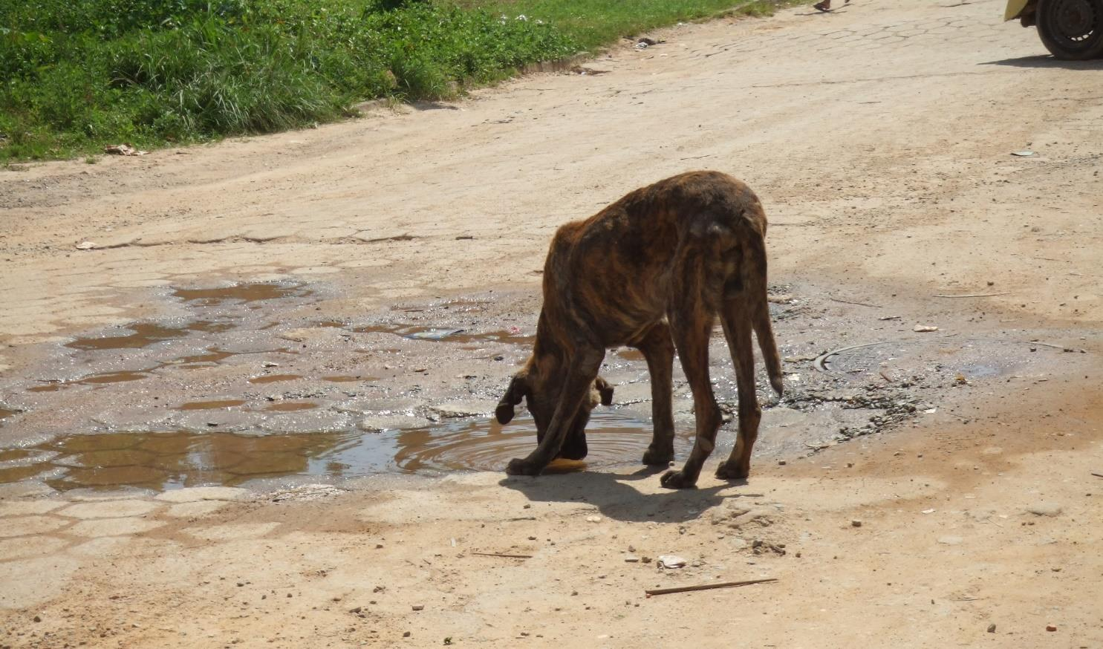
Canine and feline population management:
Garcia RCM, Calderón N, Ferreira F. Consolidation of international guidelines for the management of canine populations in urban areas and proposal of performance indicators.
Rev Panam Salud Publica. 2012;32(2):140-4.
socially accepted
environmentally sustainable
Notes:
For canine and feline population management, a set of well-developed strategies is required to prevent overpopulation and the abandonment of animals.
These strategies must be socially accepted and environmentally sustainable, and based on the perspective of:
promoting community health,
human and animal welfare and
maintenance of the environmental balance⁷.

Slide 6
Canine and feline population management:
Garcia RCM, Calderón N, Ferreira F. Consolidation of international guidelines for the management of canine populations in urban areas and proposal of performance indicators.
Rev Panam Salud Publica. 2012;32(2):140-4.
socially accepted
environmentally sustainable
promoting community health,
human and animal welfare and
maintenance of the environmental balance
Notes:
For canine and feline population management, a set of well-developed strategies is required to prevent overpopulation and the abandonment of animals.
These strategies must be socially accepted and environmentally sustainable, and based on the perspective of:
promoting community health,
human and animal welfare and
maintenance of the environmental balance⁷.

Slide 7
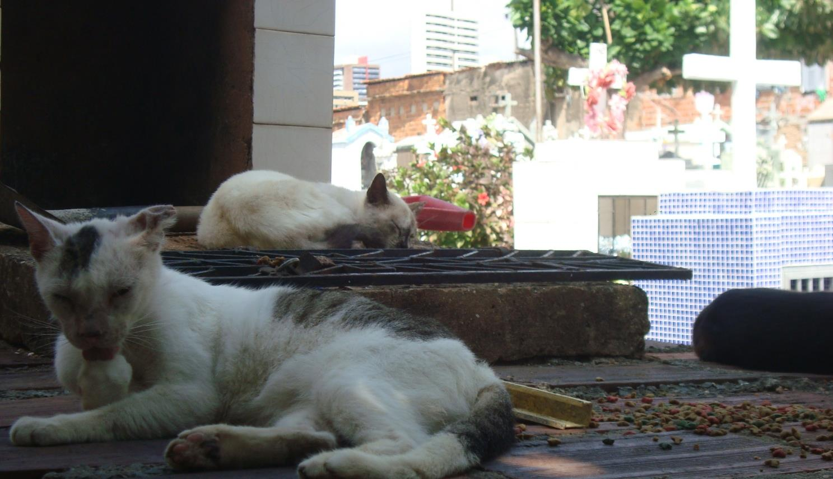
understanding of the dynamics population
Action planning
To monitor and to evaluate
To implement
Notes:
An understanding of the dynamics of these populations and a characterization of these populations are necessary for action planning⁴.
The proposed strategies should be monitored and evaluated so that canine and feline population management programs are properly implemented.⁷

Slide 8

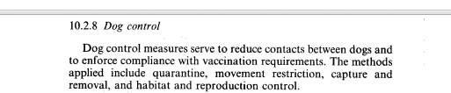
Notes:
The reproductive control strategy by spay and neuter for dog population management was introduced by the World Health Organization (WHO)²² in 1984 to reduce the birth rate and the abandonment of litters.
This strategy began to be implemented with stakeholders in Brazil and evaluated in Brazilian cities in the 1990s.²

Slide 9
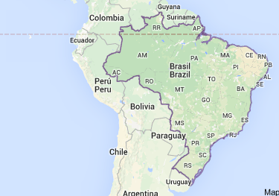
OBJECTIVE
To characterize canine and feline populations and to evaluate the impact of a canine and feline surgical reproductive control program in an area of São Paulo city, Brazil.

Slide 10
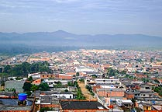
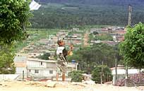
METHODS
Period: 2005 – 2008
Place: Vargem Grande, SP, Brazil,
Area: 3.15 square kilometers
Households: 4,275
Habitants: 16,946 inhabitants.
IBGE census, 2000.
Notes:
This study was conducted between 2005 and 2008 in Vargem Grande, a metropolitan region of the municipality of São Paulo, Brazil, which encompasses 3.0 square kilometers with 4,275 households and almost 17,000 inhabitants.
IBGE census, 2000.

Slide 11
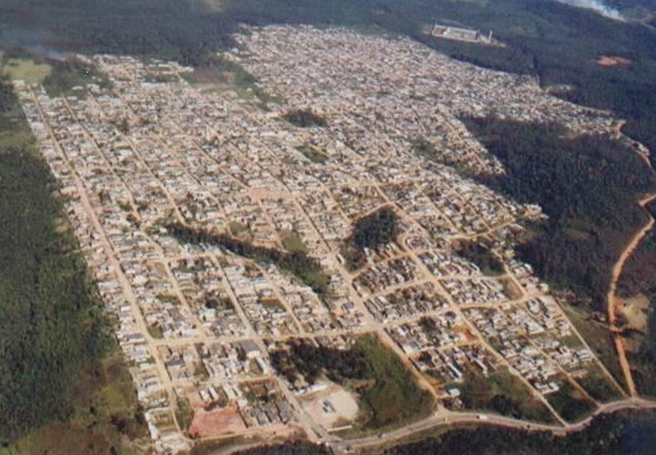
Need for management
isolated area
Social participation
Notes:
In determining the study location, three factors were considered:
the need for population management actions for dogs and cats;
the isolated characteristics of the area with low interference with respect to dog and cat migration;
and established partnerships between non-governmental organizations (NGOs), academia, the community and public sectors (since 2004).

Slide 12
2005
Census 1
2006
Census 2
2007
Reproductive Control intervention
2008
Census 3
Notes:
Three cross-sectional studies were performed using censuses:
Two of the studies were performed prior to reproductive control (in 2005 and 2006).
The third census was performed in 2008, eighteen months after the reproductive control strategy had been implemented.

Slide 13

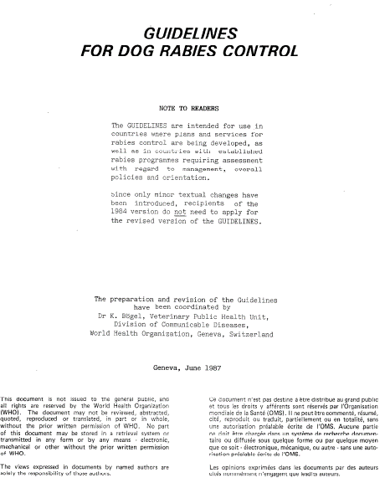
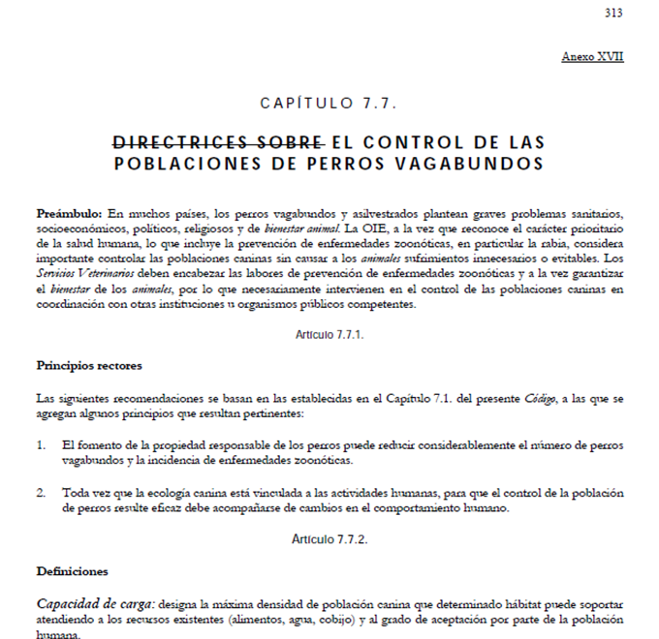

Slide 14
Census were used to:
Characterize animal population
Construct age pyramids
Compare demographic data
Notes:
The census results were used to characterize the animal population, construct the age pyramids and compare demographic data with the census following the intervention.
The census of 2006 was chosen to the characterization of dogs and cats populations.

Slide 15
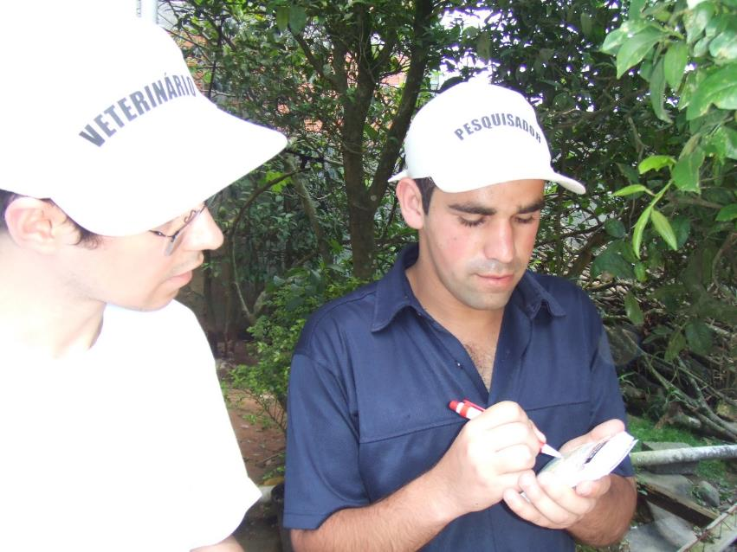
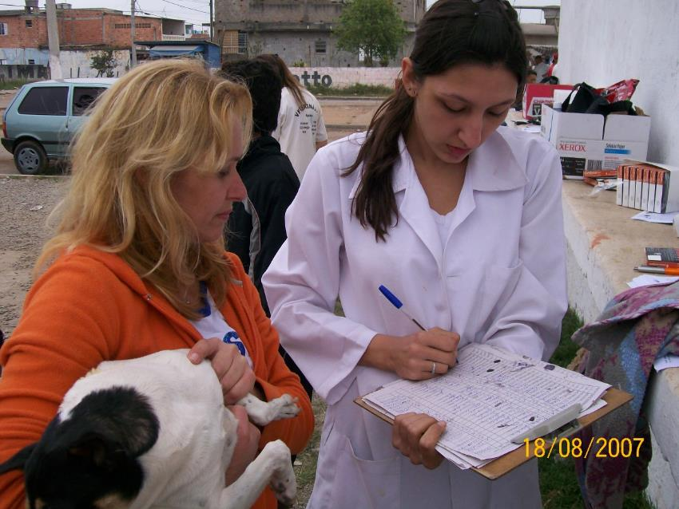
Notes:
The community’s workers of basic health unit and hired interviewers were trained to carry out the interviews.

Slide 16
SPSS 9.0 software program
To calculate the mean life expectancy at birth and the survival probability for each year for males and females, a vertical life table was constructed
(Pianka ER. Vital statistics of populations: demography. In: Pianka ER. Evolutionary Ecology. 5th edtion, Harper Collins College Publishers; 1994. p. 144-161)
Notes:
The SPSS 9.0 software program was used to perform the descriptive statistical analysis.
To calculate the mean life expectancy at birth and the survival probability for each year for males and females, a vertical life table was constructed.¹⁸

Slide 17
Results and Discussion
Table 1 - Dog and cat registrations by type and census year. São Paulo, 2015
Notes:
Between 2144 and 3190 dogs and 360 and 1077 cats were registered in each census;

Slide 18
Table 1 - Dog and cat registrations by type and census year. São Paulo, 2015
animals registered in a previous census
animals registered in the current census
Notes:
The terms "prior animals" and "new animals" were applied to animals registered in a previous census and in the current census, respectively.

Slide 19
Table 1 - Dog and cat registrations by type and census year. São Paulo, 2015
Prior= animals registered in a previous census
New=animals registered in the current census
Notes:
For the dogs, "New animals” accounted for 41.9% in 2006 and 51.3% in 2008.

Slide 20
Table 1 - Dog and cat registrations by type and census year. São Paulo, 2015
43%
Prior= animals registered in a previous census
New=animals registered in the current census
Notes:
Only 43% of the dog population in 2008 were of animals present in previous census, so more than half of the population was recently inserted animals in the area.

Slide 21
Table 1 - Dog and cat registrations by type and census year. São Paulo, 2015
Prior= animals registered in a previous census
New=animals registered in the current census
Notes:
For the cats, “new animals” accounted for 64,18% in 2006 and 83,38% in 2008.

Slide 22
Table 1 - Dog and cat registrations by type and census year. São Paulo, 2015
30,4%
Prior= animals registered in a previous census
New=animals registered in the current census
Notes:
Only 30,4% of the cat population in 2008 were of animals present in previious census, so, almost 70% of the population was recently inserted animals in the area.

Slide 23
Population turnover:
Family mobility (immigration/emigration)
Birth rates
Mortality rates
Animal acquisition rates
Notes:
This turnover is related to family mobility in the region (the immigration and emigration of families), birth rates, mortality rates and animal acquisition rates.

Slide 24
For public health, a high animal turnover represents a risk because health and sanitation control for these animals are unknown.
Notes:
For public health, a high animal turnover represents a risk because health and sanitation control for these animals are unknown.

Slide 25
Reproduction control
Table 1 - Dog and cat registrations by type and census year. São Paulo, 2015
11.7%
Notes:
The canine population increased from 2005 to 2006 and decreased from 2006 to 2008.
The increase in the canine population in 2006 may reflect the lack of reproductive control and the increase in the human population at this location, given that animal demographics are affected by human demographics.^{7,25}
The 11.7% reduction in the canine population in 2008 may be the result of the reproductive control strategy implemented in the region in 2007.

Slide 26
Reproduction control
Table 1 - Dog and cat registrations by type and census year. São Paulo, 2015
82.9%
Notes:
This was not observed in the feline population, which increased by 82.9% from 2006 to 2008. Providing spay or neuter surgery may have encouraged families in the study area to acquire new cats or to retain their existing cats. On the other hand, cat population is increasing in the city.

Slide 27
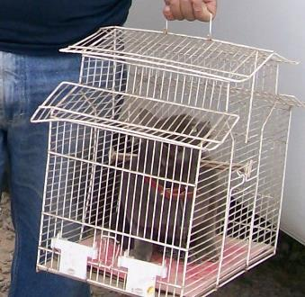
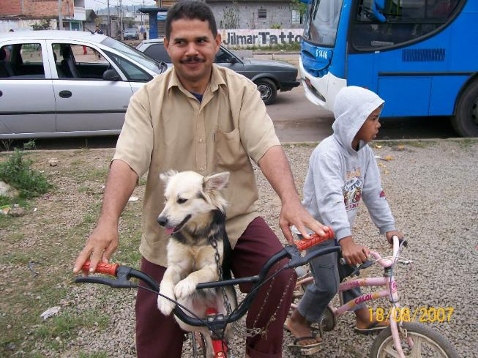
Cats mean age 1.66 years
Dogs mean age: 3.36 years
Mean life expectancy at birth:
3,9 years for male dog
5,9 years for female dog
Yes! I´m a cat!
Notes:
The mean age of the dogs was 3.36 years and 1.66 years for the feline population that is younger than the canine population.
The mean life expectancy at birth was 3.9 years for male dogs and 5.9 years for female. The higher mortality rates of males is likely associated with the behavior of these animals.

Slide 28
65% of the dogs were younger than 3 years of age
74% of the cats were 1 year of age or less
Figure 1 – Age pyramid of canine and feline population of 2006 census. São Paulo, 2015.
Notes:
65% of the dogs were younger than 3 years of age. Many studies have reported a high concentration of young animals in canine populations (10, 15, 24, 9, 24, 20, 14).
74% of the cats were 1 year of age or less; it was higher than reported other studies (^{9 ,} 1).

Slide 29
Lack of public policies
Hight turnover rates
Animals without rabies vaccination
Hight mortality rate
Hight birth rates
Low mean age
Figure 1 – Age pyramid of canine and feline population of 2006 census. São Paulo, 2015.
Notes:
The high concentration of young animals in the population may reflect the lack of public policies for better care of animals, having a direct impact on public health: animals less than one year old may not have had the opportunity to be vaccinated in vaccination campaigns against rabies .
The pyramidal shape with a wide base and an upper half that is less than half the base indicates a high mortality rate for juvenile animals aged one year or under which was more pronounced for females cats. Low proportion of individuals surviving to older age.
Dogs and cats have high reproductive potentials. In addition to the low levels of responsible ownership and the lack of public policies regarding population balance, this high reproductive potential results in high birth rates and mortality rates, low mean age and high rates of turnover (25). Consequently, it is difficult to zoonoses control and form natural barriers against disease.

Slide 30
The presence of juvenile animal populations with a large number of susceptible animals poses a public health risk.
Strategies to decrease the birth rate and increase the average lifespan of the animals will assist in promoting public health and animal welfare.

Slide 31
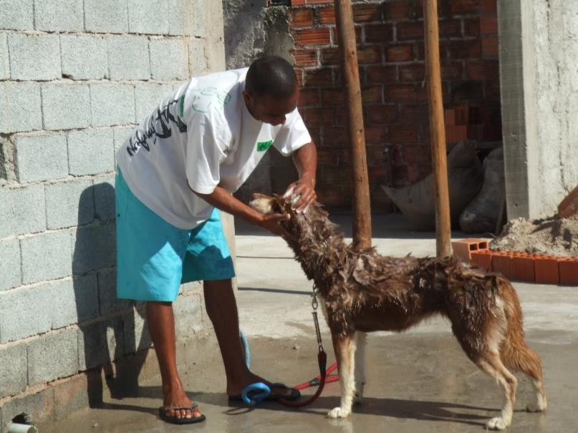
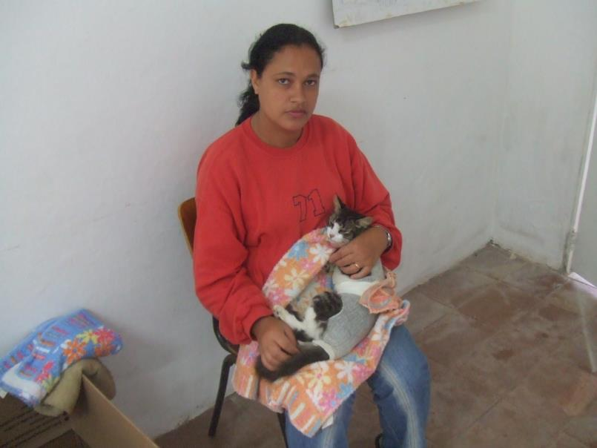
male: female ratio for dogs:
2005: 1.55:1
2008: 1.35:1
male: female ratio for cats:
2006: 1.22:1
2008: 1.1:1
Notes:
The variation in the male: female ratio for dogs in 2005 and 2008 was 1.55:1 and 1.35:1, respectively, and for the feline population was 1.22:1 in 2006 and 1.1:1 in 2008; with a reduction in these proportions following the spay or neuter intervention.
The presence of more male than female dogs indicates that there is a preference for males, which is consistent with several other studies.^{1,7,9,11,19,20, 21} Elimination of female puppies could explain this.

Slide 32
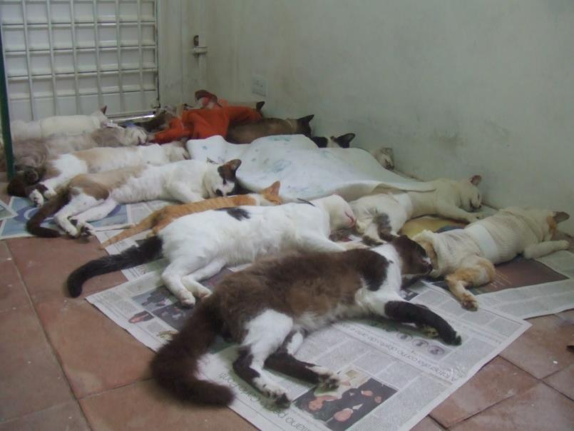
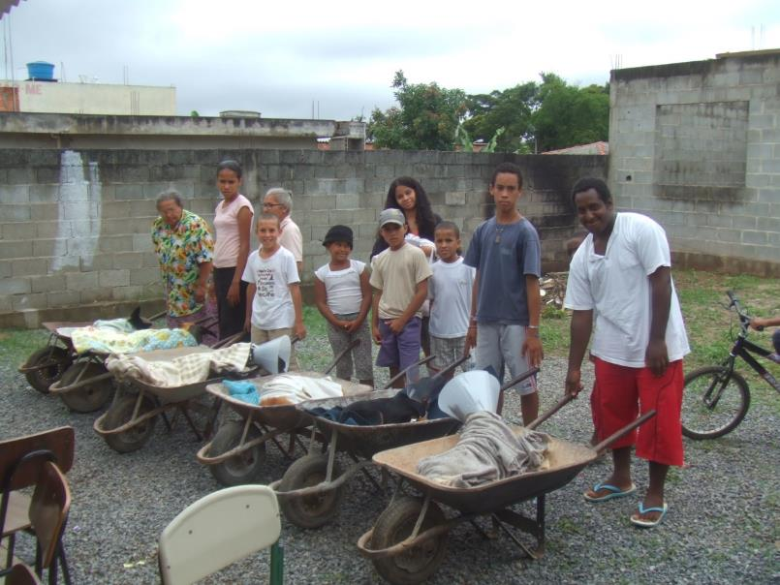
Birth rates decreases:
18% to feline
8% to canine
Notes:
After the reproductive control program had been inserted, there was an increase in the number of spayed or neutered animals and an 8% and an 18% decrease in canine and feline birth rates respectively.
The frequency of spayed or neutered animals doubled and was higher than the frequencies found in the same city.^{3,8}

Slide 33
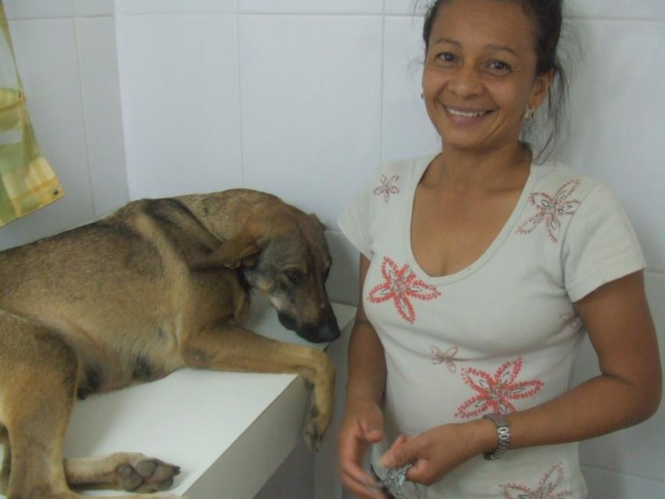
Conclusions
Canine and feline populations:
  Young
  high birth and high mortality rates Mean age of cats was low.
Reproductive control intervention:
  decreased effectively the canine and feline birth rates.
Notes:
Canine and feline populations were young and characterized by high birth and high mortality rates for juveniles under one year of age.
Mean age of cats was low.
The reproductive control intervention decreased effectively the canine and feline

Slide 34

Thanks!’ ‘ ‘
ritadecassiamariagarcia@gmail.com

