Slide 1
Second International Conference on Dog Population Management
Istanbul/ Turkey, March 3-5 2015
OIE initiatives to improve stray dog population control An example from Europe
Dr N. Leboucq – OIE sub-regional Representation in Brussels

Slide 2
Introduction the OIE Platform on AW for Europe
Objective
Governance
- Steering Group
- Secretariat (OIE SRR-Brussels)
Action Plan
- 2014-2016
- 3 priorities: transport; slaughter; stray dog population management
Funding
- European Commission, France, Germany, Switzerland, hosting countries
To serve as a regional dialogue tool

Slide 3
Introduction the OIE Platform on AW for Europe
Ultimate goal
To improve Animal Welfare in Europe
Strategic objective
To empower VS to take actions in Animal Welfare
Specific objectives
To raise awareness and achieve high level of understanding of AW in Europe
To progressively advance with the implementation of the OIE standards on AW
To encourage the participation of Member Countries from Europe in the OIE standards setting process

Slide 4
Introduction the OIE Platform on AW for Europe
Stray dog population management initiatives under the first 3-year Action Plan
❶ Regional Roadmaps
❷ Awareness campaigns
❸ E-depository of best practices on Stray Dogs
❹ OIE regional Focal Points seminars (AW, COM)
❺ Consultation meeting on AW activities in Europe

Slide 5
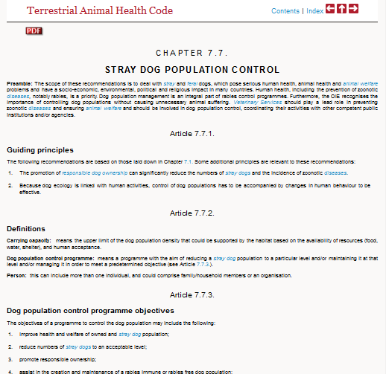
Introduction the OIE Platform on AW for Europe
Stray dog population management initiatives under the first 3-year Action Plan

Slide 6
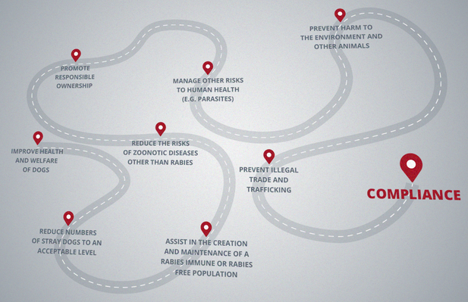
❶ Regional Stray Dog Roadmaps
SDB1
June 2014

Slide 7
❶ Regional Stray Dog Roadmaps
Regional Roadmaps - BALKANS
First Workshop on stray dog management for Balkan countries (SDB1) in Bucharest, Romania, on 17-19 June 2014
Participants
10 Balkan countries and territories
2 participants per country
- OIE NFP on Animal Welfare
- Vet working at municipal level
Main objectives
- Remind the provisions of the OIE Chapter 7.7
- Review National Control strategies on stray dog population
- Identify the key weaknesses /constraints/ challenges
- Share best practices in the region
- Exchange on a common vision at Sub-Regional level

Slide 8
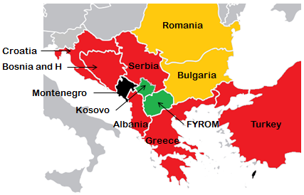
❶ Regional Stray Dog Roadmaps
Regional Roadmaps - BALKANS
First Workshop on stray dog management for Balkan countries (SDB1) in Bucharest, Romania, on 17-19 June 2014
Evolution in stray dog population over the past years: →

Slide 9
❶ Regional Stray Dog Roadmaps
Regional Roadmaps - BALKANS
First Workshop on stray dog management for Balkan countries (SDB1) in Bucharest, Romania, on 17-19 June 2014
Main outcomes:
A common vision at Sub-Regional level was agreed: “to become fully compliant with the OIE Standard on stray dog population control by 2025”, thereby implying that the stray dog population is reduced to an acceptable level and the risk of transmission of rabies and other zoonoses to humans through stray dogs is mitigated

Slide 10
❶ Regional Stray Dog Roadmaps
Regional Roadmaps - BALKANS
First Workshop on stray dog management for Balkan countries (SDB1) in Bucharest, Romania, on 17-19 June 2014
Main outcomes:
Development of National Roadmaps to achieve the Vision by addressing the identified key challenges
Organisation of follow-up (SDB) Workshops every 2 years to monitor the progress using the OIE Self-Assessment and Monitoring Tool (SAM)

Slide 11
❶ Regional Stray Dog Roadmaps
Regional Roadmaps - BALKANS
OIE stray dog self-assessment and monitoring tool (SAM Tool)
http://oiestraydogs.izs.it/limesurvey/w/p2/index.html
Online (questionnaire)
Based on OIE standard 7.7. → measure of compliance
6 sections – 32 questions (sub-questions)
Self-assessment (full / partial / insufficient)
Identification of weak areas (to facilitate the design of Roadmaps)
SAM Tool developed in collaboration with IZSAM Teramo

Slide 12
❶ Regional Stray Dog Roadmaps
OIE stray dog self-assessment and monitoring tool (SAM Tool)

Slide 13
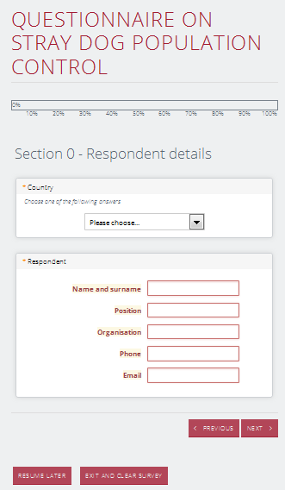
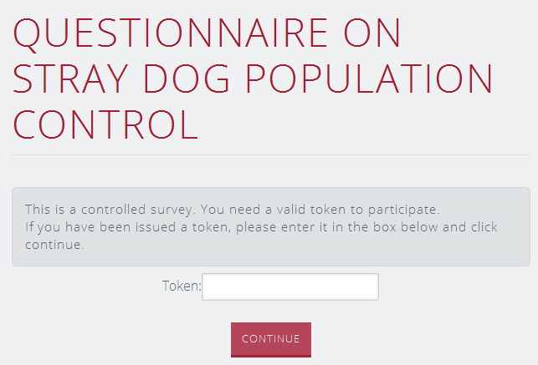
❶ Regional Stray Dog Roadmaps
OIE stray dog self-assessment and monitoring tool (SAM Tool)
Identification (Token)
→ Only people invited to carry out the assessment are given a Token and can assess the survey
Respondent details
→ Preferably the OIE national Focal Point on AW

Slide 14
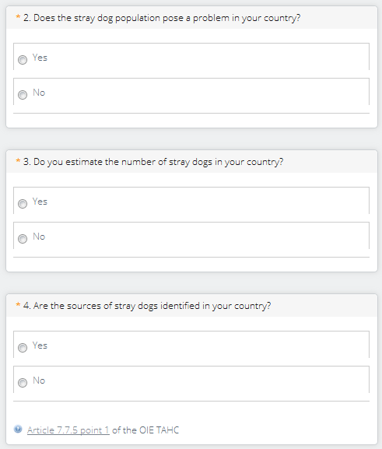
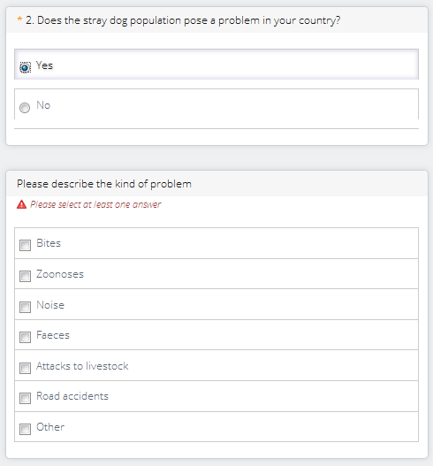
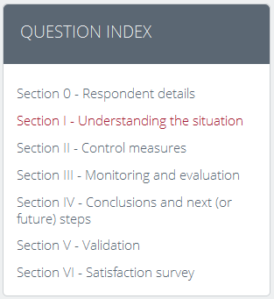
❶ Regional Stray Dog Roadmaps
OIE stray dog self-assessment and monitoring tool (SAM Tool)

Slide 15
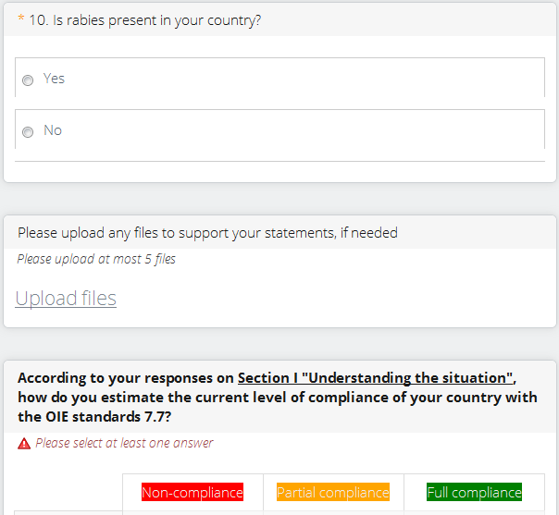
❶ Regional Stray Dog Roadmaps
OIE stray dog self-assessment and monitoring tool (SAM Tool)

Slide 16
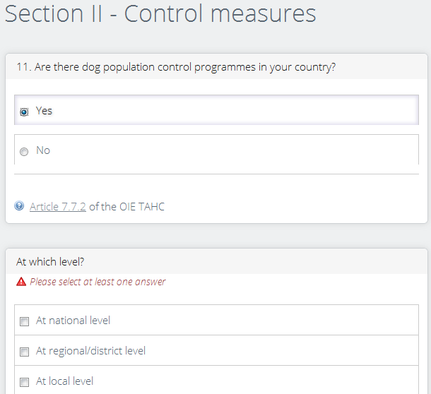
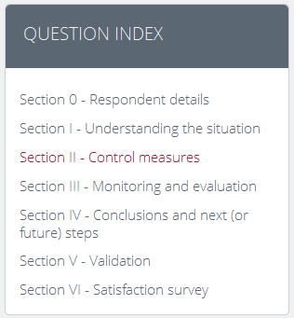
❶ Regional Stray Dog Roadmaps
OIE stray dog self-assessment and monitoring tool (SAM Tool)

Slide 17
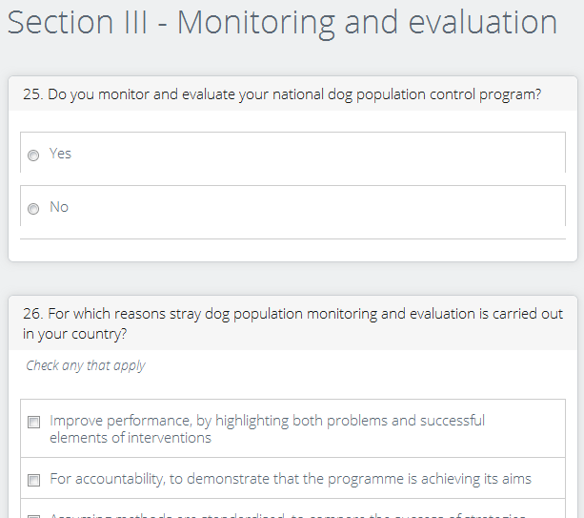
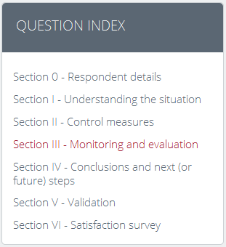
❶ Regional Stray Dog Roadmaps
OIE stray dog self-assessment and monitoring tool (SAM Tool)

Slide 18
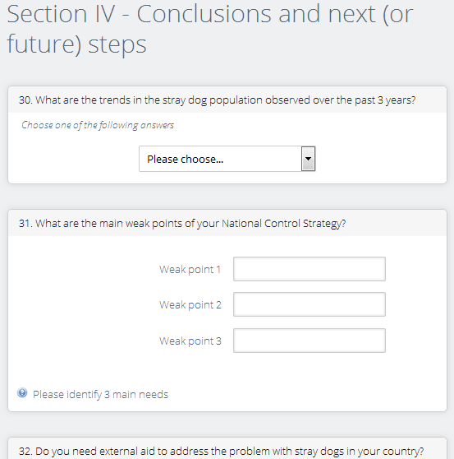
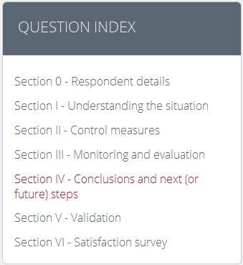
❶ Regional Stray Dog Roadmaps
OIE stray dog self-assessment and monitoring tool (SAM Tool)

Slide 19
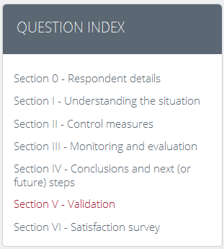
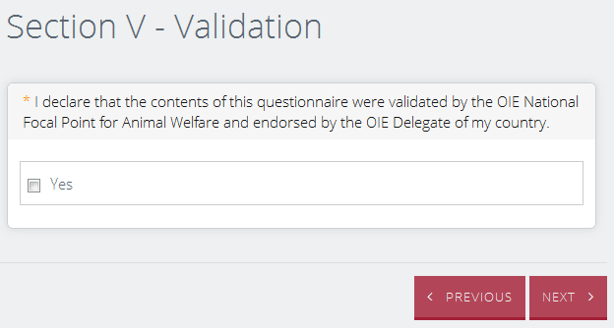
❶ Regional Stray Dog Roadmaps
OIE stray dog self-assessment and monitoring tool (SAM Tool)

Slide 20
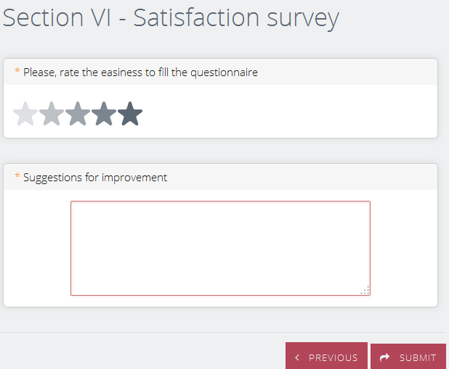
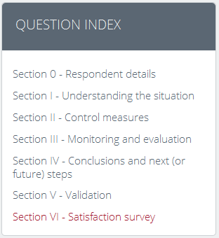
❶ Regional Stray Dog Roadmaps
OIE stray dog self-assessment and monitoring tool (SAM Tool)

Slide 21
❶ Regional Stray Dog Roadmaps
Regional Roadmaps - BALKANS
√
Vision achieved
(2025)
√
SDB1
SDB2
SAM1
June 2016
June 2014
SAM2
Feb 2015
May 2015
SDBx
Progress measurement

Slide 22
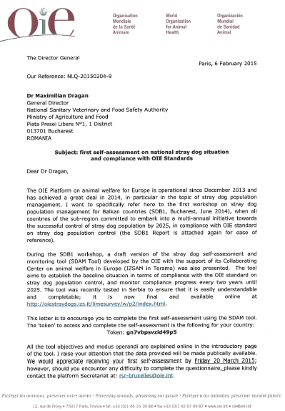
❶ Regional Stray Dog Roadmaps
Regional Roadmaps - BALKANS
Letter addressed to OIE Delegates
Letter sent on February 6
Object: First self-assessment on national stray dog situation and compliance with OIE standards
Only questions from Section I on Assessing the Situation made ‘mandatory’
Deadline for the completion of the self-assessment: March 20

Slide 23
❶ Regional Stray Dog Roadmaps
Regional Roadmaps - BALKANS
1. Do you estimate the number of owned dogs in your country?
2.Does the stray dog population pose a problem in your country?
3. Do you estimate the number of stray dogs in your country?
4. Are the sources of stray dogs identified in your country?
5. Do you organise any counting activities of the stray dog population?
6. Who are the actors responsible for the stray dog population control in your country?
7. Does your country have the necessary regulatory framework for the following key elements?
8. Assess if the Authorities in charge of stray dog control have the necessary/adequate resources
9. Rank, if available, the level of adequacy of the following resources used by the Authorities in charge of stray dog control
10. Is rabies present in your country?
Only questions from Section I on Assessing the Situation made ‘mandatory’

Slide 24
❶ Regional Stray Dog Roadmaps
Regional Roadmaps - BALKANS
2014
2016
SDB1
-----------------------
First Stray dog population management Workshop for the Balkans
Priorities:
Assessing the number of stray dogs
Identifying the sources of stray dogs
Modernizing legal framework to address the stray dog issue
Other priorities provided by SAM1
SDB2
-----------------------
Second Stray dog population management Workshop for the Balkans
First self-assessment
(baseline 2014)
Second self-assessment
(May 2016)

Slide 25
❶ Regional Stray Dog Roadmaps
Regional Roadmaps - BALKANS
2014
2016
Capacity building activities
SDB1
-----------------------
First Stray dog population management Workshop for the Balkans
SDB2
-----------------------
Second Stray dog population management Workshop for the Balkans
Dog counting surveys
Workshops / seminars
Partners / stakeholders
First self-assessment
(baseline 2014)
Second self-assessment
(May 2016)

Slide 26
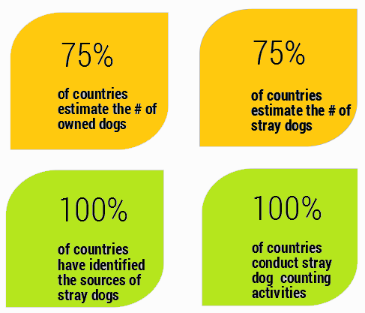
❶ Regional Stray Dog Roadmaps
Regional Roadmaps - BALKANS
SAM1 / Preliminary and partial results

Slide 27
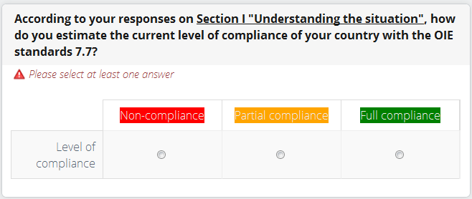
❶ Regional Stray Dog Roadmaps
Regional Roadmaps - BALKANS
SAM1 / Preliminary and partial results
100% Responding countries

Slide 28
❶ Regional Stray Dog Roadmaps
Regional Roadmaps – Other countries
SDEE
(2016?)
SDB
(2014)
SDWE
(2015)

Slide 29
❶ Regional Stray Dog Roadmaps
Regional Roadmaps – West Eurasia
First Workshop on stray dog management for West Eurasia countries (SDWE1) – 2nd semester 2015
Participants
8 West Eurasian countries 2 participants per country
- OIE NFP on Animal Welfare
- Vet working at municipal level
Main objectives
- Remind the provisions of the OIE Chapter 7.7
- Review National Control strategies on stray dog population
- Identify the key weaknesses /constraints/ challenges
- Share best practices in the region
- Exchange on a common vision at Sub-Regional level

Slide 30
❶ Regional Stray Dog Roadmaps
Regional Roadmaps – West Eurasia
First Workshop on stray dog management for West Eurasia countries (SDWE1) – 2nd semester 2015, location tbd
Same approach as for SDB1 (Bucharest, June 2014):
To assess the current situation (baseline situation)
To define a sub-regional Vision
To define national Roadmaps to achieve the vision
To monitor progress on a regular basis (every 2 years?)
The importance and diversity of the human-dog relationship

Slide 31
❶ Regional Stray Dog Roadmaps
Regional Roadmaps – West Eurasia
First Workshop on stray dog management for West Eurasia countries (SDWE1) – 2nd semester 2015, location tbd
To translate the Self-Assessment and Monitoring Tool in Russian [December 2014]
To prepare the Workshop [2nd trimester 2015]
To hold the Workshop [3rd Trimester 2015]
To ask countries to complete the online questionnaire [4th trimester 2014]

Slide 32
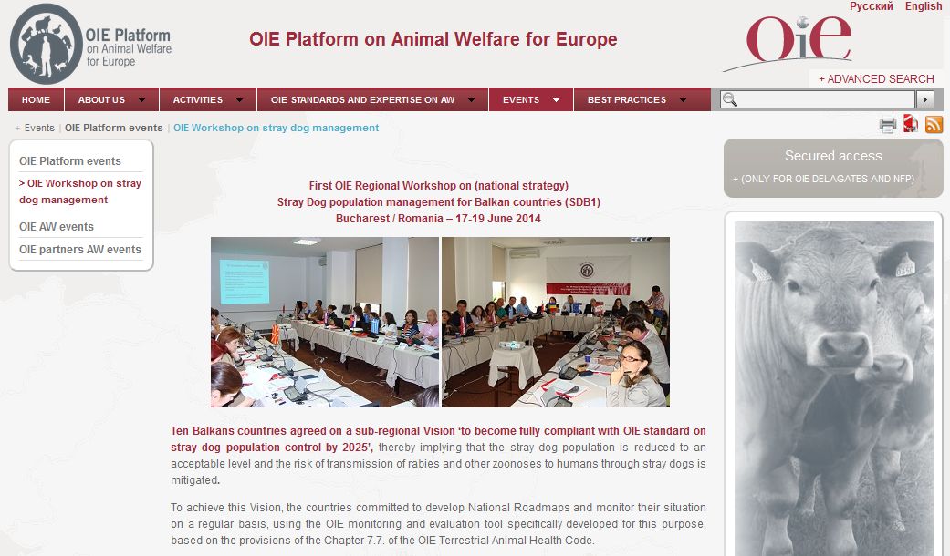
Website of the OIE Platform on AW for Europe
http://rpawe.oie.int

Slide 33
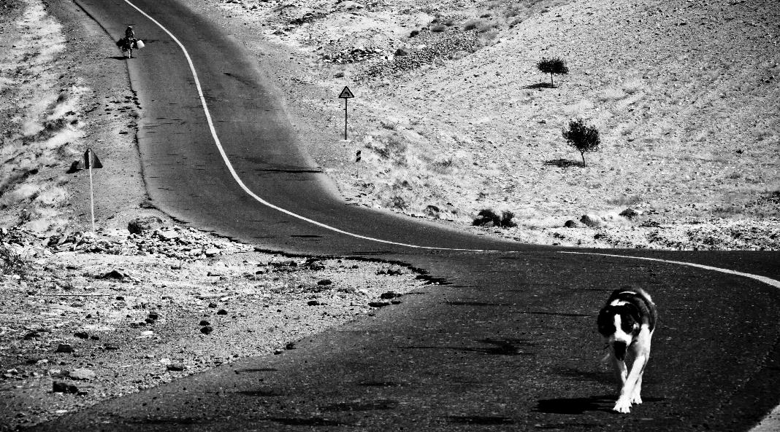
Thank you for your attention
n.leboucq@oie.int
© Iran Veterinary Organisation

