Slide 1
IMPLEMENTING RABIES CONTROL STRATEGY IN A DEVOLVED GOVERNMENT, ADOPTION OF ONE HEALTH APPROACH.
RABIES ELIMINATION STRATEGY.
Brighton Marienga

Slide 2
BACKGROUND INFORMATION.

Slide 3
BACKGROUND INFORMATION……..
Rabies is among the top five priority zoonotic diseases in Kenya. Currently estimated to be killing 2000 people in Kenya.
The profile of zoonotic diseases has risen following implementation the WHO International Health Regulations 2005 (IHR) and more so after the establishment of a National One Health office (referred to as Zoonotic Disease Unit).
The rabies elimination strategy has been developed (2014) to guide systematic reduction of the disease risk through sustained mass dog vaccinations, pre and post-exposure prophylaxis in humans and public education.

Slide 4
RABIES SITUATION IN KENYA
Kenya has become the first country in Africa to launch a national strategy for controlling and eliminating rabies.
Rabies in Kenya is 98% associated to uncontrolled dog populations within the country.
Rabies has been endemic in Kenya since the first reported case in 1912 in the outskirts of Nairobi city.
In 2012,the government of Kenya set up a zoonotic disease unit to improve the surveillance, prevention and control on zoonotic diseases in the county. Rabies was given the highest priority.

Slide 5
RABIES SITUATION IN KENYA……..
Most of the rabies cases in animals and humans in the country are caused by canine rabies virus, transmitted by domestic dogs.
In Kenya, domestic dogs maintain the rabies cycles; there is no documented evidence that wildlife maintain rabies virus.
The country is currently divided into 47 counties. The veterinary services(majority) were recently devolved to the county system, other than policy and regulatory framework.

Slide 6
CURRENT RABIES CONTROL APPROACHES.
Rabies control in animals is under the mandate of the DVS and various methods have been put in place to control the disease. The
Limited dog vaccinations and issuance of certificates is conducted by the SCVOs.
Dog vaccinations are also conducted by private Animal Health Service Provider (AHSPs) at a fee and by animal welfare organizations.
However, these efforts are largely uncoordinated and disjointed and have minimal impact on rabies control.

Slide 7
CURRENT RABIES CONTROL APPROACHES.
There are ongoing efforts to control dog populations through neutering, carried out by the private and public veterinarians.
Culling usually conducted by the SCVOs also reduces the stray dog populations.
However, these efforts are minimal and have little impact on rabies elimination.
In Humans, the MOH through the Unit of Vaccines and Immunization Services (UVIS) provides limited anti-rabies vaccines to health facilities and is in the process of developing guidelines on the management of dog bites and administration of PET.

Slide 8
CURRENT CHALLANGES
Inadequate laboratory capacity.
Inadequate Surveillance.
Inadequate inter-sectoral collaboration and partnerships.
Low awareness on rabies prevention and control.
Inadequate Research on Rabies.
Limited supply of anti-rabies vaccine.
Funding Constraints.
Lack of Integrated National Guidelines on Rabies Prevention and Control

Slide 9
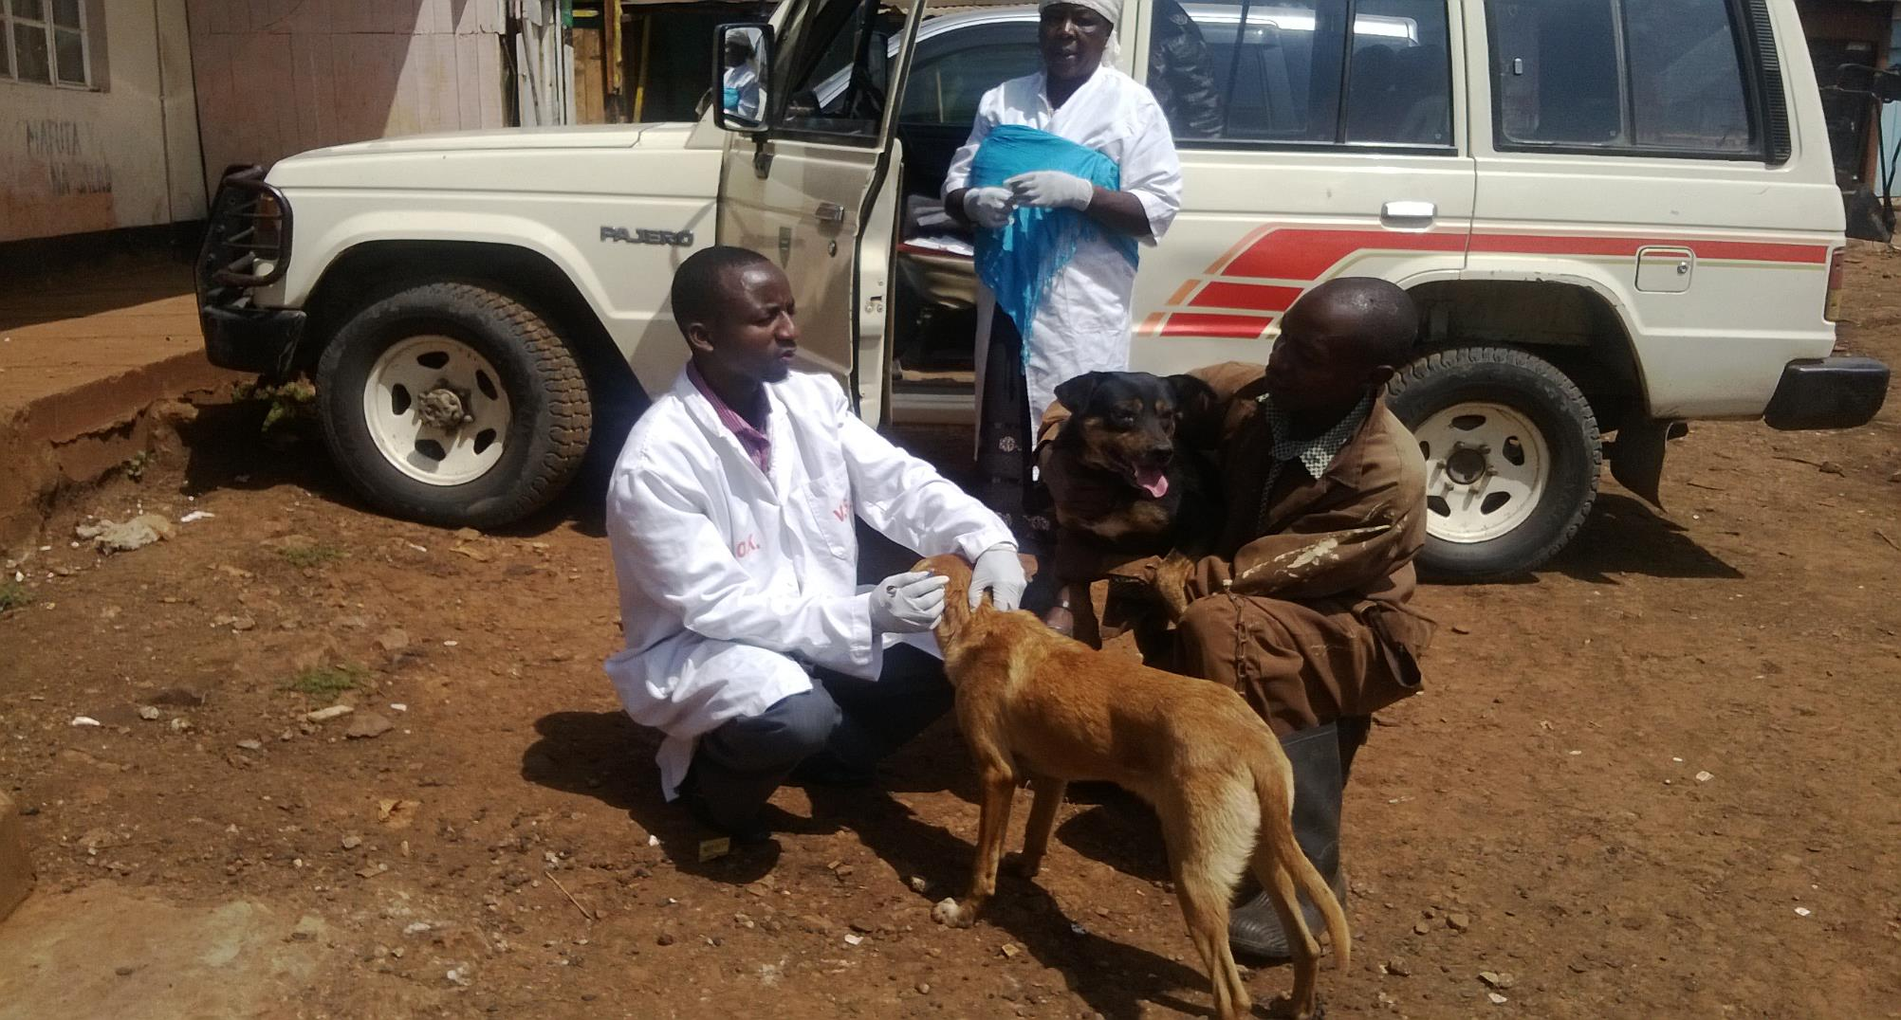
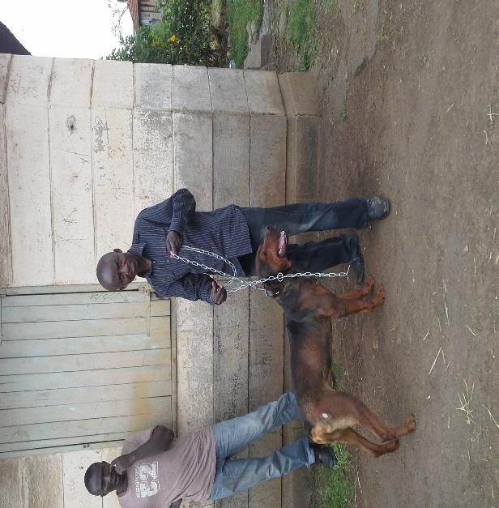

Slide 10
STRATEGY IMPLEMENTATION PLAN
This strategy is based on activities planned in accordance with the Stepwise Approach to Rabies Elimination (SARE) for the country to move from an endemic state to a disease free status.
Successful implementation of this strategy requires a multi-sectoral collaborative approach with involvement and support of many stakeholders.
Some of the key stakeholders include relevant ZDU,various universities, national government ministries,county governments,FAO,world animal protection, CDC local NGOs,community groups and many more organizations.
The strategy aims at eliminating dog mediated rabies by 2030.

Slide 11
STRATEGY IMPLEMENTATION PLAN…..
The current efforts for rabies prevention and control in Kenya are restricted to human post-exposure prophylaxis (PEP), voluntary and ad hoc dog vaccinations.
This approach has not been successful in bringing down the cases of rabies in animals and humans, owing to inadequate vaccination coverage and unavailable or unaffordable PEP for most of the affected individuals.
Rabies control is a public good (for the benefit or well-being of the public); elimination of human rabies in Kenya requires a multi-sectorial collaborative approach.

Slide 12
STRATEGY IMPLEMENTATION PLAN…..
The 3 main strategies for the control of rabies include;
Prevention in human through intensified post-exposure treatment.
Controlling the disease in the reservoir host.
Combination of the two.

Slide 13
STRATEGY IMPLEMENTATION PLAN-GUIDING PRINCIPLES.
Rabies control is a public good (for the benefit or well-being of the public); elimination of human rabies in Kenya requires a multi-sectorial collaborative approach.
Sustained annual mass dog vaccination (for at least three consecutive years) of greater than 70% of dog population eliminates rabies in domestic dogs, and subsequently in humans and other domestic animals
More than 80% of dogs in Kenya are owned and are accessible for parenteral (by injection) vaccination.
Rabies elimination through mass dog vaccination is a cost-effective strategy, saves lives and results in decline in the use of costly human post exposure prophylaxis (PEP).

Slide 14
STRATEGY IMPLEMENTATION -ACTUAL STEPS.
1.Elimination of rabies in dogs
By conducting mass dog vaccination targeting greater than 70% of dog population coverage annually for three consecutive years.
Dog population management comprising education, legislation, registration, sterilization, holding facilities, euthanasia and controlling access to garbage and left overs.
2.Prevention of rabies in humans
By Providing timely access to appropriate Post Exposure Treatment
By Increasing knowledge and skills among animal and human health workers on rabies in general and post-exposure management.

Slide 15
STRATEGY IMPLEMENTATION -ACTUAL STEPS……
3.Strengthen Surveillance and response to outbreaks.
4.Conduct and promote operational research.
5.Advocacy, communication and social mobilization
6.Enhance partnerships and coordination.
7. Resource mobilisation.

Slide 16
STRATEGY IMPLEMENTATION -ACTUAL STEPS.
Timelines | STAGES | SESCRIPTION
2030 | STAGE 5 | Maintain freedom-from-rabies status in humans and dogs
2028-2029 | STAGE 4 | Maintain freedom-from-mediated human rabies - Elimination of dog rabies
2017-2027 | STAGE 3 | Rabies risk reduction through full-scale Implementation of the control strategy
2014-2019 | STAGE 2 | Implementation of the National Rabies control strategy in pilot districts
2013-2014 | STAGE 1 | Development and adoption of the National Rabies control strategy -Preparation of its Implementation
-2013 | STAGE 0 | Rabies suspected to be present -Scanty information available

Slide 17
NAIROBI RABIES CONTROL CASE STUDIES
Nairobi is one of the counties in Kenya. The city is characterized by informal settlements which harbor huge stray dog populations.
Vicinity to Nairobi national park also implies that Wildlife including wild carnivores plays a role (although insignificant ) in maintenance of the virus.
There are recurrent programmes done by the county government, supplemented by private practitioners of rabies control capaighns.These occur on a quarterly basis or on a need to basis.
Consequently, comprehensive and sustained dog vaccination is sufficient intervention in reduction and eventual elimination of human rabies in a region.
Traditional approach involves culling(Baiting of dogs) using strychnine by the sub-county veterinary officers, neutering , public awareness and vaccination against a disease .
The county is now in the process of adopting the devolved strategy by formulating the Establishment of County Rabies Elimination Coordination Committee
(CRECC).

Slide 18
DEVOLUTION OF THE STRATEGY
Establishment of a National Rabies Elimination Coordination Committee
(NRECC).
Establishment of County Rabies Elimination Coordination Committee
(CRECC).
Establishment of Sub-County Rabies Elimination Coordination
Committee (SCRECC).

Slide 19
DEVOLUTION OF THE STRATEGY-NAIROBI COUNTY
COMPOSITION OF THE CRECC
County Executive Committee member for Health.
County Executive Committee member for Agriculture, Livestock and Fisheries.
County Secretary.
County Director for Health Services.
County Director for Veterinary Services.
County Commissioner.
County Director of Education.

Slide 20
CONCLUSION
Join and support Kenya and its current partners in rabies elimination through implementation of the Rabies elimination strategy.
We want to be free of rabies by 2030,yes vision 2030?

