Slide 1
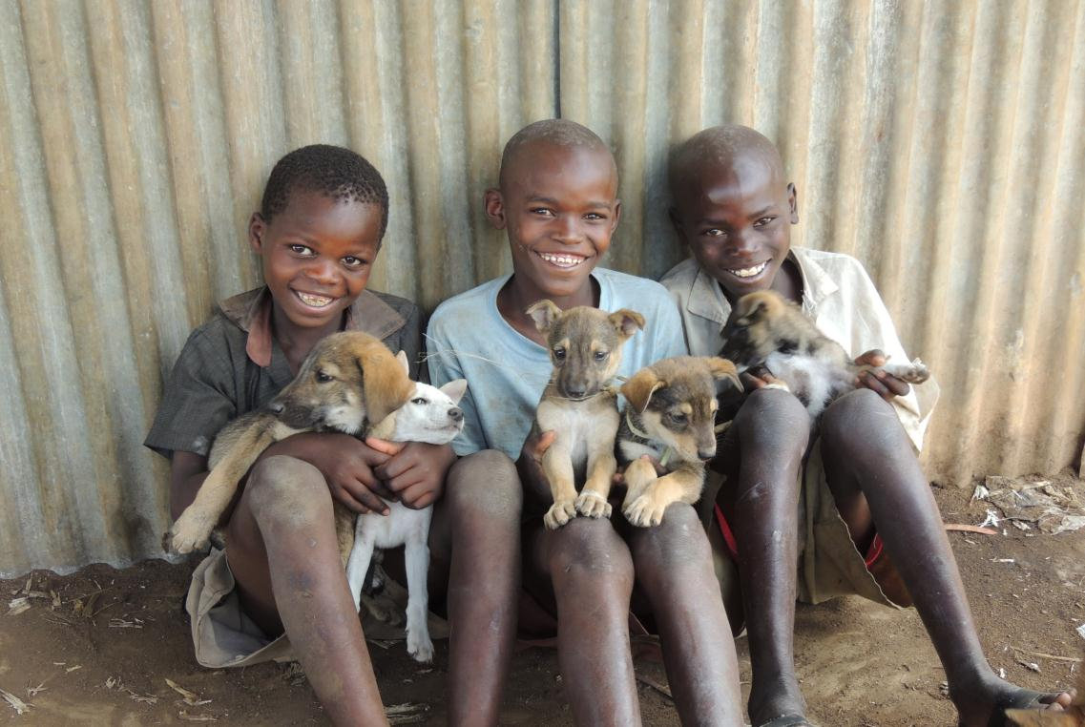
Free-roaming domestic dog demography in rural villages near Serengeti National Park, Tanzania
Anna Czupryna^{1,2}, Lisa Faust^{1,2} , Joel Brown²,
Machunde Bigambo¹, Supriya Mehta²
¹ Lincoln Park Zoo, Chicago, USA ² University of Illinois at Chicago, USA

Slide 2
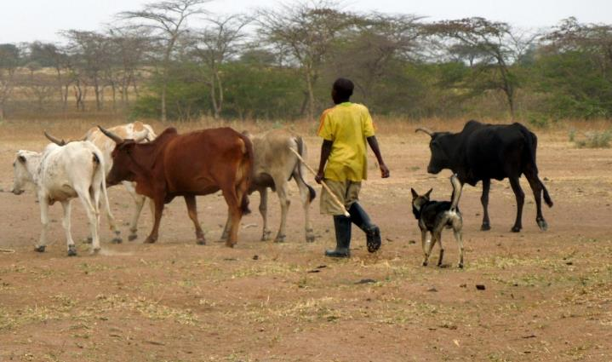
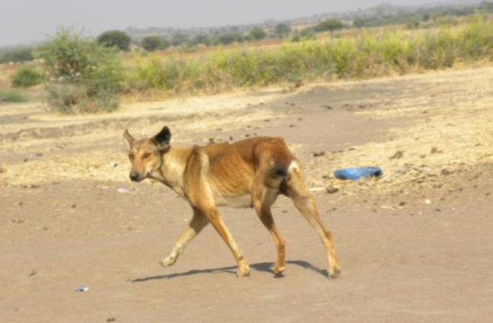
Role of Domestic Dogs
Used for livestock and household protection
Owned dogs belonging to households
Free-roaming, minimally restrained
Notes:
Domestic dogs in rural villages west of the park are free-roaming, minimally restrained, for the most part freely-breeding, and are primarily used for livestock and household protection

Slide 3
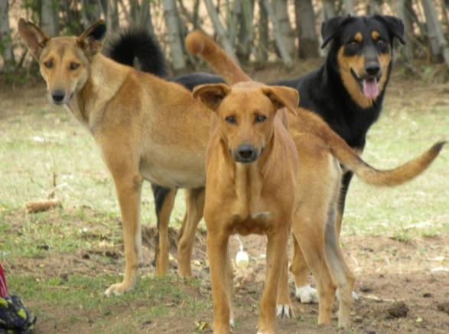
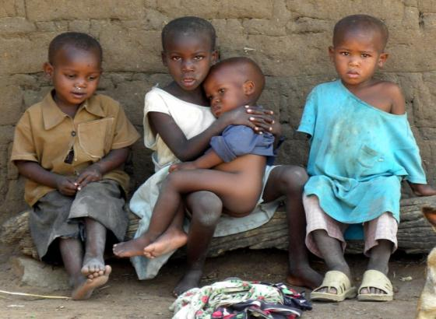
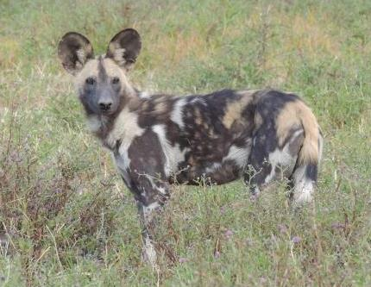
Dogs: Disease reservoir
Public health and conservation concern
Notes:
In Tanzania, domestic dogs are a disease reservoir. They are a public health concern and a conservation concern because they can transmit diseases such as Rabies and Canine distemper

Slide 4
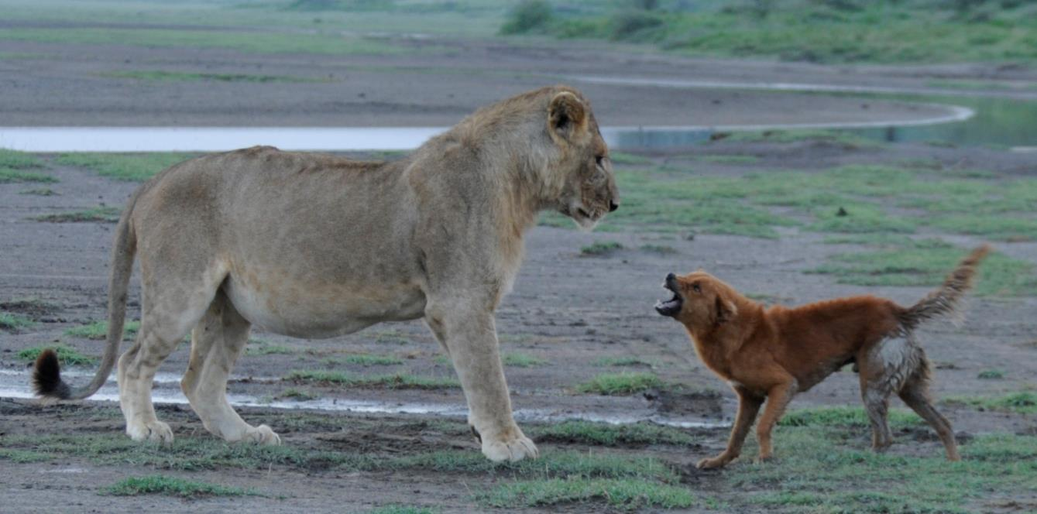
Extension of human impacts: disease transmission
Photo credit: Ingela Janssen- Lion Project NCA

Slide 5
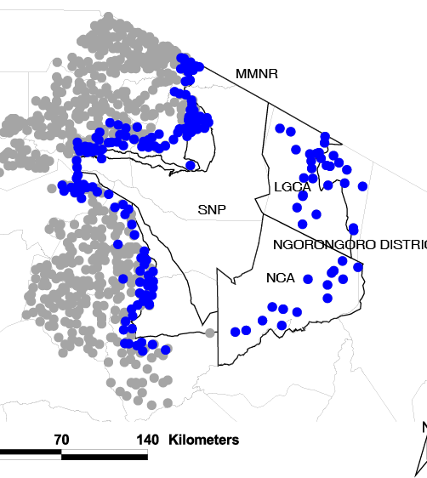
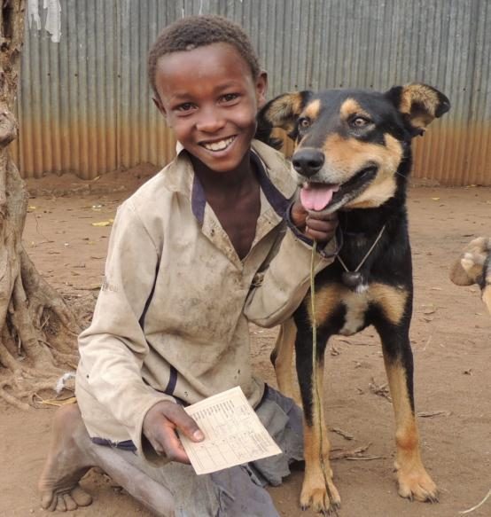
Serengeti Health Initiative
10 km rabies vaccination zone
Notes:
The serengeti health initiative began vacciating dogs in 2003 within 10 km of the national park

Slide 6
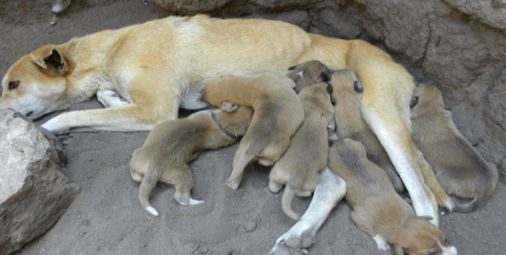
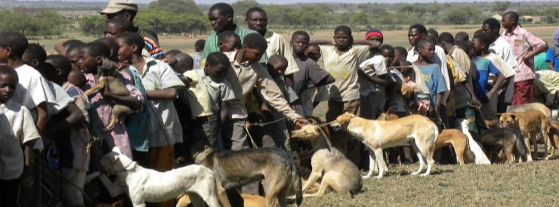
Vaccinations could potentially impact dog population dynamics
Disease
Survival
Reproduction
Population growth
?
Notes:
However, Vaccination could possibly impact pop dynamics…for example, we could assume that as disease decreases, survival increases, reproductive potential increases and perhaps population growth increases…which can impact the sustainability of current dog vaccination programs?

Slide 7
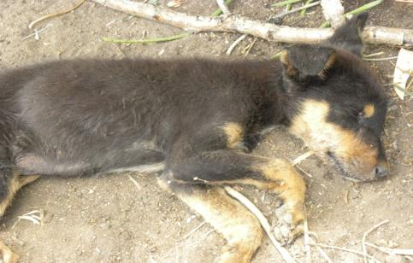
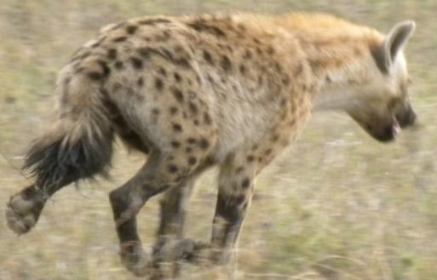
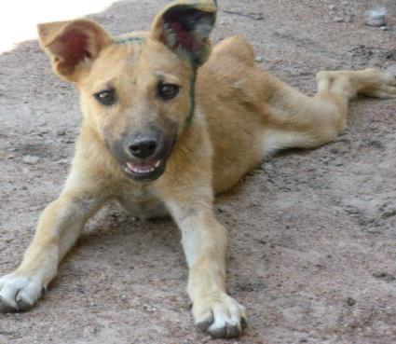
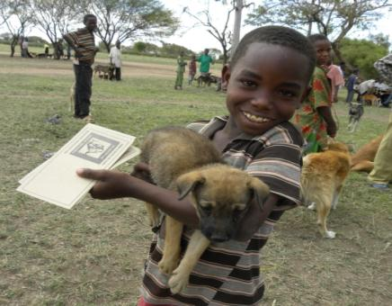
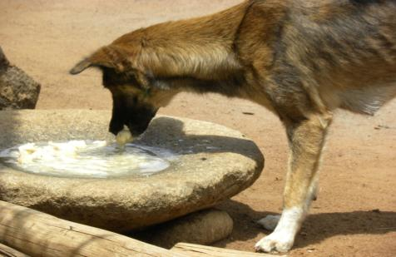
What regulates the dog population?
Disease?
Predation?
Ownership?
Resources?
Notes:
Which is why we are investigating what are the factors that regulate the dog population?

Slide 8
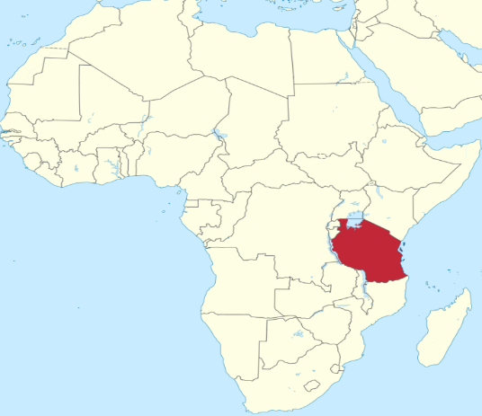
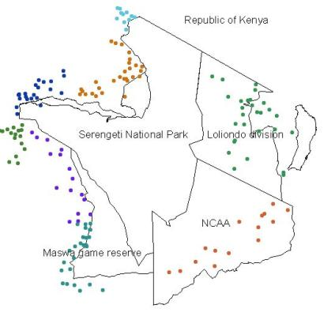
Tanzania, East Africa
Sanungu
Buyubi
Commons.wikimedia.org
Nangale
Iyogelo
Control
Vaccination
(Modified from Cleaveland et al. 2007)
Notes:
We are investigating domestic dog health and population dynamics in 4 rural, agropastoralist villages west of serengeti national park in Tanzania. Two are villages receiving annual vaccinations and two are villages without vaccination- I will get to this in the next few slides.

Slide 9
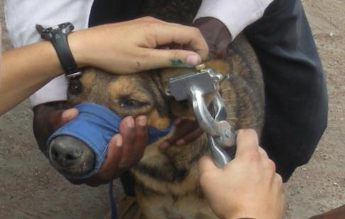
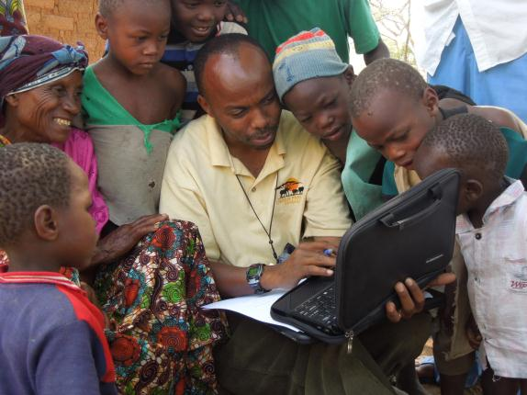
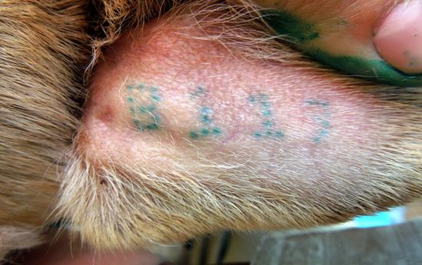
Methods: Mark-recapture
Unique ID
Photographs
Longitudinal study
Notes:
We aim to determine this using a three-pronged approach by first using mark-recapture with ear tattoos, microchips, and photographs to identify dogs for a 4-year longitudinal study to measure survival

Slide 10
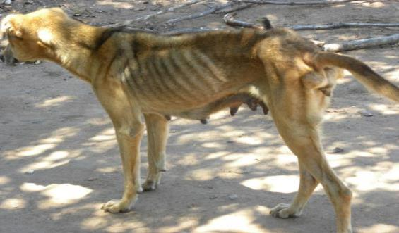
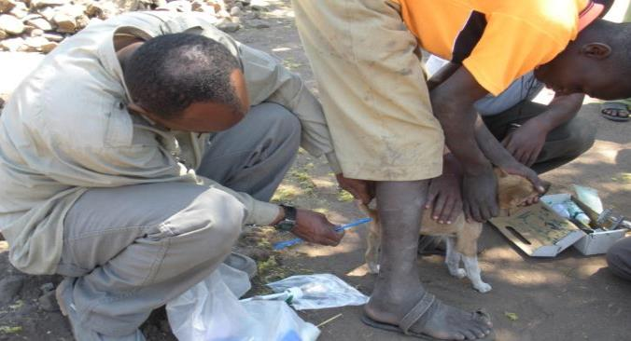
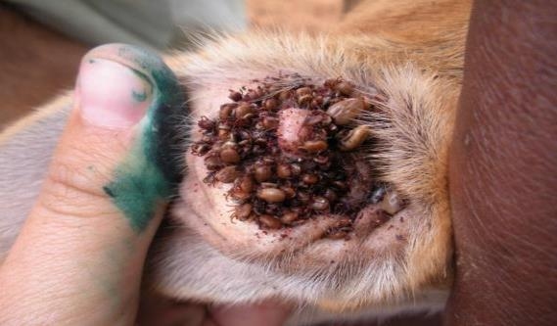
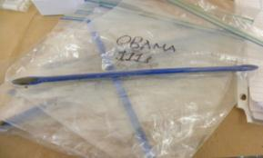
Methods: Health assessments
Body condition
Fecal endocrinology
Presence of fleas/ticks
Notes:
Second, we are assessing dogs for health and welfare through body condition, endocrine analysis of fecal corticosterone, and presence of fleas and ticks

Slide 11
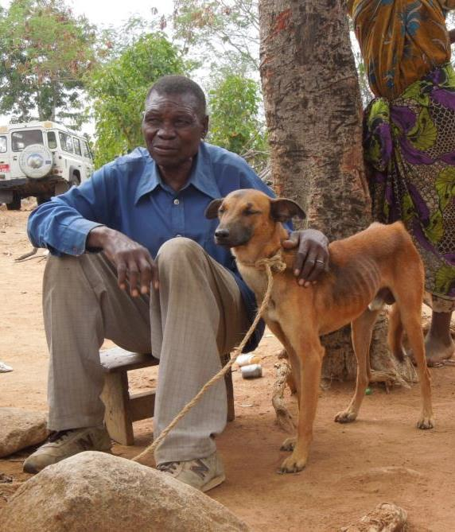
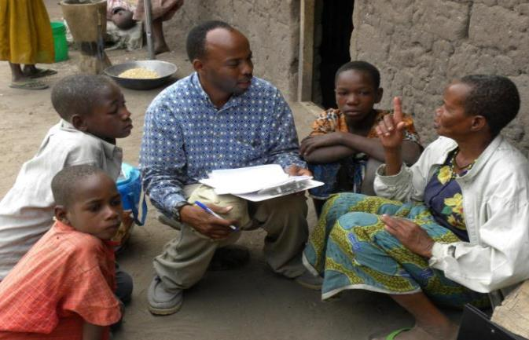
Methods: Household questionnaires
Dog demography
Household characteristics
Dog ownership practices
Village census
Notes:
Finally, we are collecting household questionnaire data pertaining to dog demography, general household characteristics such as number of people and livestock, and dog ownership practices such as participation in vaccination and bathing of dogs, and village census to estimate the total number of dogs

Slide 12
Results: Original sample size 2010
Control
Vaccination
 | Buyubi | Iyogelo | Nangale | Sanungu | Mean
Total households | 555 | 494 | 581 | 488 | 530
Total sampled | 114 | 101 | 98 | 107 | 105
% hh sampled | 21% | 20% | 17% | 22% | 20%
Total people | 4,285 | 3,077 | 5,148 | 3,760 | 4,068
Total dogs | 520 | 421 | 569 | 506 | 504
Total enrolled | 320 | 307 | 316 | 300 | 311
% dogs enrolled | 62% | 73% | 56% | 59% | 63%
Total observations over 4 years: 7,798
2013: 4,617 people and 641 dogs

Slide 13

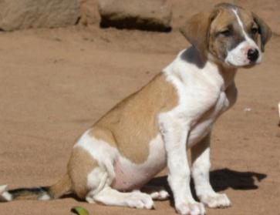
Results: Study population
2011-2013
2010
+ 1,417 New
1,243 dogs
- 363 lost to follow-up
- 1,253 dead
=
1,055 alive
Overall study population: 2,649 total dogs
Notes:
When we revisited the study households in 2011, we found that 476 dogs had died and 68 had unknown fate (disappeared, given away, or moved away). We marked 254 new dogs and collected data on 241 unmarked dogs we couldn’t catch at the households.
At the end of 211 we were following a population of 771 marked dogs and 417 unmarked dogs for a total of 1188 dogs
split this up……

Slide 14
Results: Higher proportion of males
60% Males
Pearson chi-square=45.1, df=1, p<0.001
Notes:
The proportion of males to females in our original study population was 57% males and 43% females and the age distribution was similar between males and females

Slide 15
Kaplan-Meier survival estimates- Sex
Overall lower female survival
HR: Male 0.90 [0.84-0.96] p=0.026
Notes:
Adult males had an annual survival rate of about 74% whereas females had 63%

Slide 16
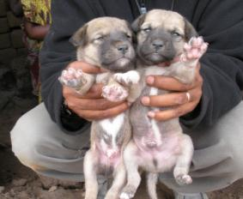
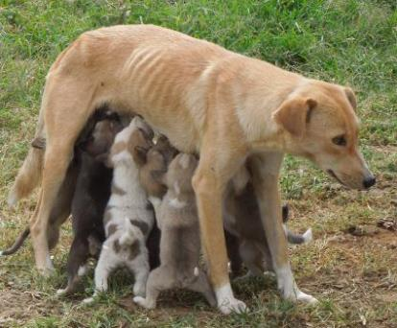
Results: Reproduction
Mean litter size: 5 pups (1-9pups)
1-2 litters per lifetime (1-6 litters)
Age: 1-3 yrs (6mo-8yrs)
Seasonal effects:
Notes:
We observed 716 total litters from 1017 total females

Slide 17
Results: Lower survival in Iyogelo Village 2011
Control
*
Adults: Likelihood chi-square=27.4,
df=1, p<0.001
Pups: Likelihood chi-square=8.5,
df=1, p<0.001
Notes:
One year adult dog survival was about 70%. There was a significant difference between dog survival in one our control villages-Iyogelo and the other 3 villages. Puppy survival, regardless of village and zone, was significantly different from adult survival. Interestingly enough, when we excluded Iyogelo village from the analysis, there was no difference between survival in Buyubi, Nangale and Sanungu villages

Slide 18
Results: Higher survival in Nangale into 2012
Control
Vaccination
*
*
Overall survival: Likelihood chi-square=10.2,
df=3, p=0.02, N=677
Without Nangale: Likelihood chi-square=2.7,
df=2, p=0.26, N=488

Slide 19
KM Survival Estimates- Village by Village
Similar survival in Buyubi (control), Nangale and Sanungu (vaccination)
Overall lower survival in Iyogelo (control)
Cox Hazard Ratios:
Buyubi: Ref
Iyogelo: 1.24 [1.11-1.39] p=0.00*
Nangale: 1.07 [0.94-1.21] p=0.17
Sanungu: 1.09 [0.96-1.23] p=0.17

Slide 20
KM survival estimates- Age Class
Overall mean age at death: 2.4 yrs
Adult (>6mos) mean age at death: 3.98 yrs
Notes:
Overall pup survival was between 30-50% where as overall adult survival was 70%

Slide 21
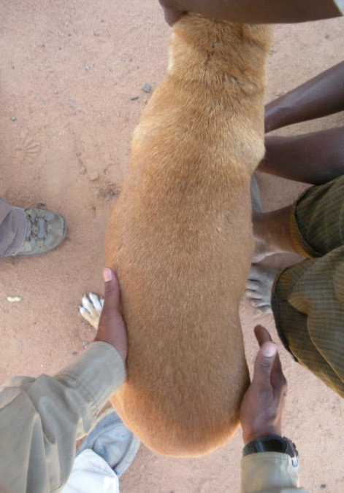
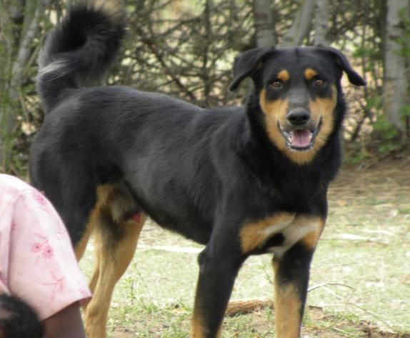
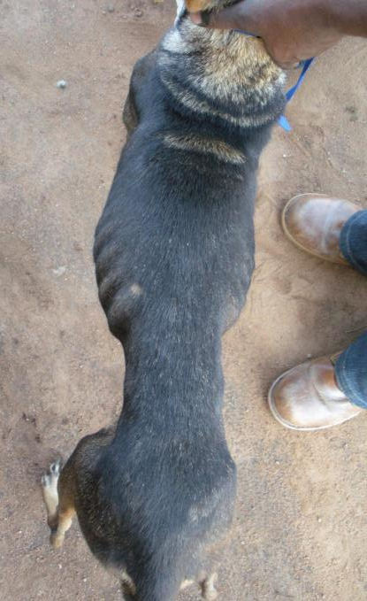
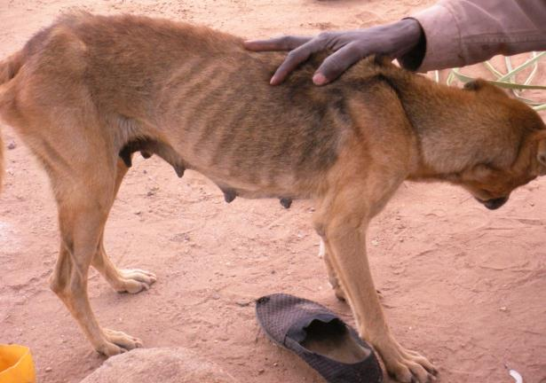
Body Condition Score
BCS 2
BCS 5
Notes:
We are also scoring body condition score on a 1-9 scale. Some examples include this dog on your left which has a poor bcs of 2 compared to this dog on the right which would be a 5 or ideal
And this what these guys would look like from the side

Slide 22
Results: Similar mean body condition in 2013
Poor
Ideal
Obese
Mean= 3.2
F _{1,936}=0.53, p=0.46
Notes:
Body condition score did not differ significantly between the villages or when pooled together between the vaccination and control zones. The mean was 3.4 and you can imagine that this distribution is a little skewed considering compared to what typical companion dogs in the US might be….

Slide 23
Results: Body condition matters for adults!
Notes:
Interestingly enough, Body condition matters for adult dogs! Dogs with a very poor body condition of 1 had about a 33% chance of surviving into 2011, while dogs in an ideal body condition of 5, had an 85% chance of surviving into 2011. This did not matter for pups which had an equal probability of survival regardless of body condition

Slide 24
KM survival estimates: Body Condition Score 2010-2013
Cox Hazard Ratios:
BCS 1-2: Ref
BCS 3: 0.79 [0.71-0.88] p=0.00
BCS 4: 0.73 [0.64-0.82] p=0.00
BCS 5-7: 0.73 [0.63-0.84] p=0.00

Slide 25
Sickness and hyenas main causes of death
F _{1,254}=14.73, p<0.001
Notes:
We found that causes of death differed between the control and vaccination villages, but that sickness and hyenas were the top two causes of death in both areas, followed by people, road accidents, other dogs, and other which included snakebites, a leopard, and kicked by a cow.

Slide 26
Results: Village Dog Census 2010-2013

Slide 27
Results: Human:Dog ratio
Control
Vaccination
Notes:
Human: Dog ratio varied year to year between 6 – 9 people per dog in the village

Slide 28
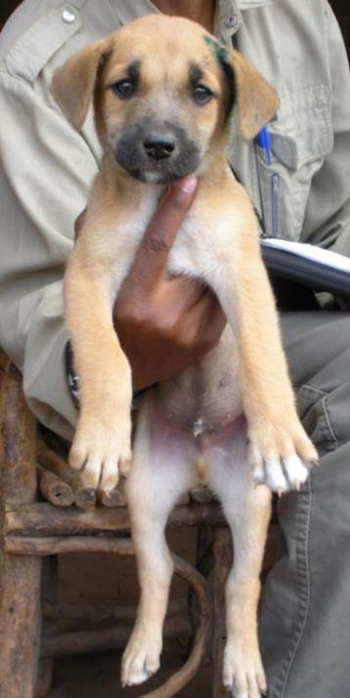
Summary:
4 Field Seasons completed
2,649 dogs enrolled in study
Higher adult male survival
Body condition influences survival
Village effects
Vaccination appears to affect survival…
…but other factors may contribute
Notes:
In summary, we have completed 2 field seasons and are actually in the middle of season 3 as I will be returning to Tanzania after this conference. We are following a currently living population of 1225 dogs and are noticing overall higher adult survival, higher adult male survival, hyenas frequently being cited for cause of death, and that body condition score strongly anticipated survival into 2011.

Slide 29
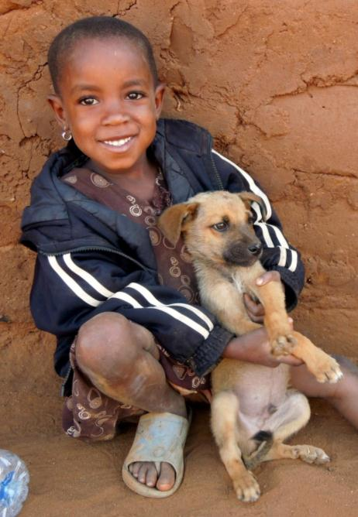
Future directions of analysis:
Ownership practices
Household characteristics
Vaccination coverage
Reproductive rates
Dog spatial distribution
Wildlife interactions

Slide 30
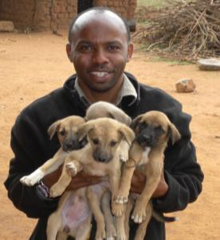






Acknowledgements
Field assistant: Chunde Bigambo
Dissertation committee: Joel Brown, Lisa Faust,
Rachel Santymire, Supriya Mehta, Chris Whelan,
Miquel Gonzalez-Meler
LPZoo Tanzania coordinator: Felix Lankester
SHI team: Imam, Paulo, Isra, and Geoffrey
Buyubi, Iyogelo, Nangale, Sanungu village leaders and dog owners
TAWIRI, COSTECH, and TANAPA
Funding Sources: Lincoln Park Zoo, American Society of Mammalogists, University of Illinois at Chicago, MSD Animal Health, International Fund for Animal Welfare (IFAW)
Notes:
Of course none of this would be possible without help from LOTS Of people but specifically Chunde my field assistant and funding sources…
And the WSPA which made my pariticipation in this conference possible…

Slide 31
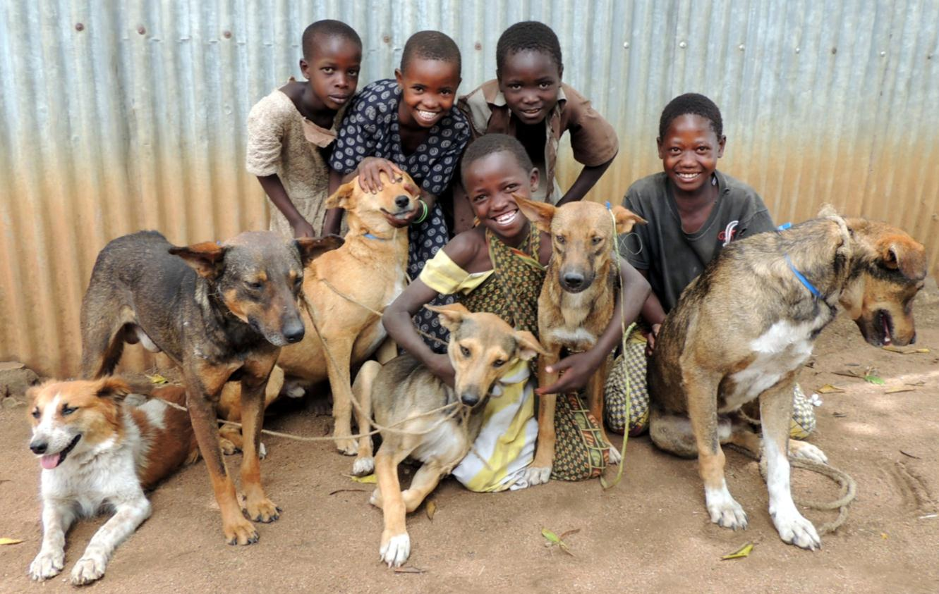
Thank You!
Contact: aniaczup@gmail.com

Slide 32
KM survival estimates-
Vaccination status in Vaccination Zone
HR: 0.73 [0.61-0.81] p=0.00

