Slide 1
Comprehensive holistic approach to Dog Population Management in Asia Pacific
Dananjaya Karunaratna
World Animal Protection
Notes:
It is estimated that there 500m stray or free-roaming dogs globally presenting global animal welfare and public health challenges.
For example, overpopulation, aggressive behaviour, nuisance, livestock predation and death or injury from dogs bites.
Governments often tackle the problem by culling dogs or applying scattered management techniques.
Even where there is political will, many countries have limited technical knowledge of the most effective measures to improve the problems associated with dogs.
As part of this cycle, dogs are often mistreated and neglected in communities, due to a poor understanding of responsible ownership
There are many examples around the world where countries have implemented this culling cycle but failed to resolve their problem, Romania is one example of this.
So it’s clear to us that we need to act, but why are we tackling this now, at this point in the strategic cycle?
We need to drive a more robust approach to this problem, focusing on all culling drivers.
We have a chance to leverage a full solution to the culling cycle, on the back of the progress in Red Collar.
Since launch in 2011, the campaign opened doors to government and infrastructure and helped us understand what else is needed to improve policy.
We now need to tackle the other culling drivers, and not just rabies, and enable local campaigns that reflect local drivers and cultures.
We are not new to DPM. It’s our heritage and expertise. We co-authored the first DPM guidelines with the WHO in 1990, leading to more recent guidelines.
We are ready to take the next bold step towards achieving our 30 year vision and emphasize World Animal Protection’s new way of working, which focuses on a combination of an insider / outsider / service delivery approach.

Slide 2
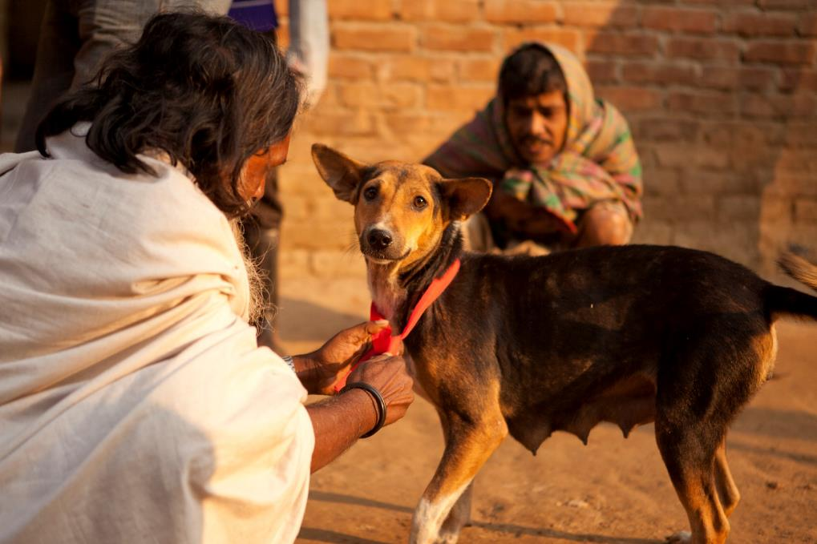
What is the Red Collar campaign?
Why did World Animal Protection launch the Red Collar campaign?
How is the Red Collar campaign being delivered in Asia Pacific?

Slide 3
What we have achieved so far?
Working with inter-governmental organisations, governments, NGOs and UN organizations in the region
Assisting with the development of regional rabies control strategies (eg ASEAN’s Rabies Elimination Strategy)
Providing policy input to national strategies and action plans
Providing resources and technical expertise
Providing ground level training to carry out mass dog vaccination (MDV), developing capacities of the countries

Slide 4
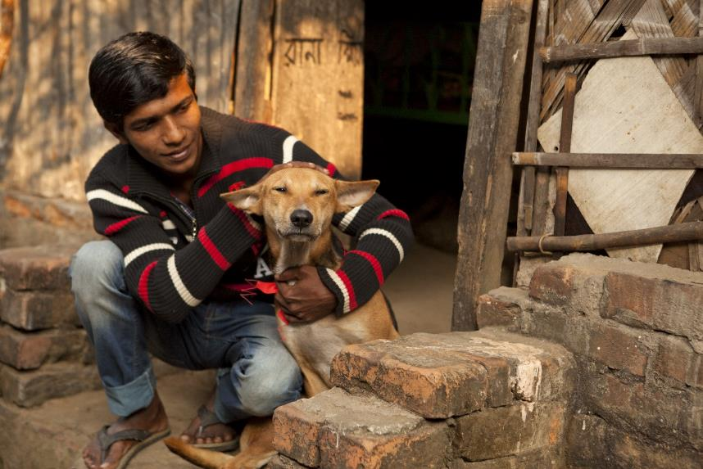
What we have achieved so far
Comprehensive MDV guides for countries
Supporting pilot projects in key countries
Key partnerships with different governments of countries
No cull agreements with local governments

Slide 5
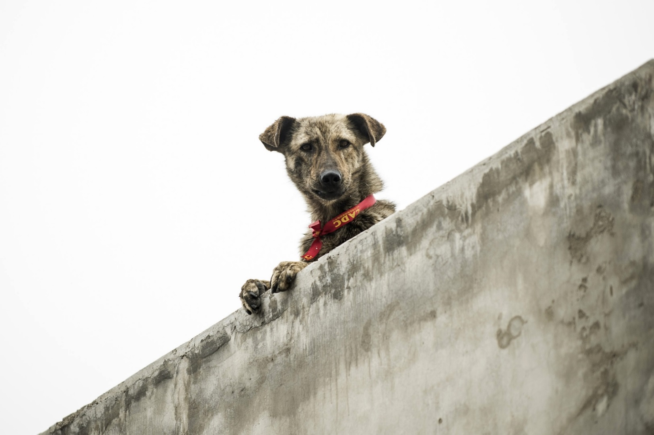
To where will the Red Collar Campaign lead?

Slide 6
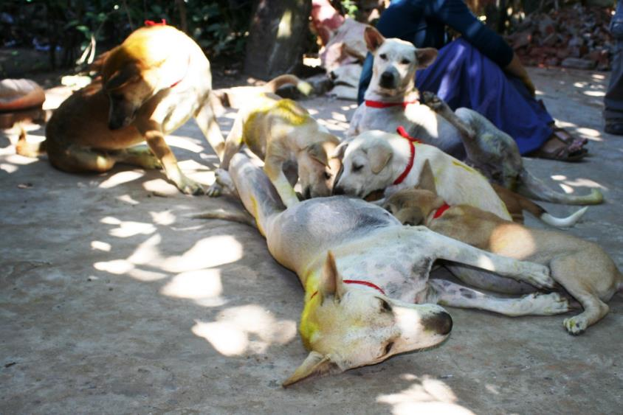
What are the main objectives of World Animal
Protection`s new dog population management (DPM) Campaign?
To manage canine overpopulation and improve responsible ownership to create an environment where dogs and humans can co-exist harmoniously.

Slide 7
With whom are we going to work?
Directly with governments
Inter governmental organizations
Other competent authorities and individuals
To implement full ICAM cycle
Components of a Comprehensive DPM programme
Education (for authorities, communities, dog owners, youth, etc.)
Euthanasia (of sick or dying animals)
Vaccination and treatment (e.g. rabies or parasites)
Controlling access to resources (e.g. street waste management)
Legislation
Registration and identification
Sterilisation and contraception
Holding facilities and rehoming centres

Slide 8
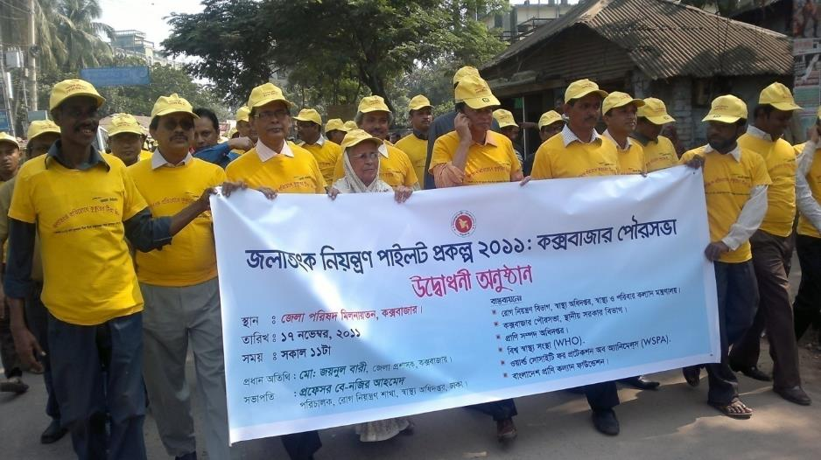
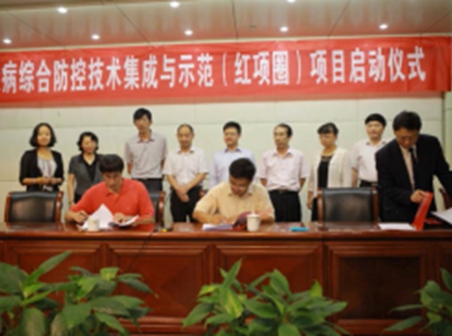
What is the approach?
Lobby and advocacy
Catalyse and connect
Practical solutions with technical expertise
Engage and mobilize public

Slide 9
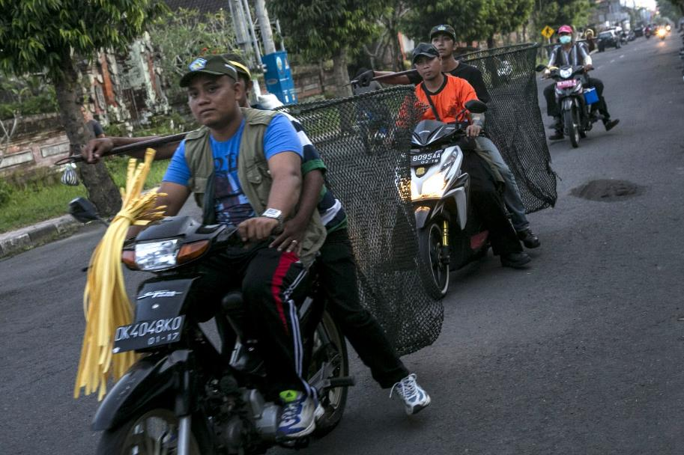
What are the key areas?
Regional and national policies
Multi-sectoral collaboration
Inter-ministerial collaboration
Working with UN agencies in the region
Development of capacity and skills
Public mobilization

Slide 10
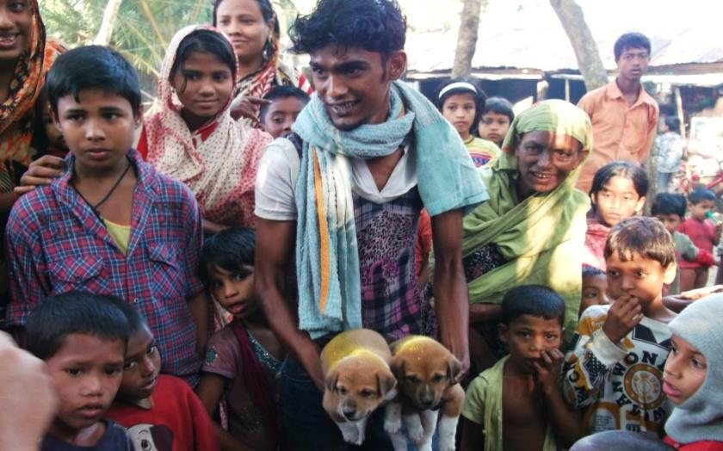
What are the challenges?
Resources
Political will and commitment
Skill levels and knowledge
Diversity among the countries in the region

Slide 11
How rabies elimination programs develop favorable
platform to DPM campaign
Regional and national policies already recognize DPM as a key component
Healthy regional and national relationships
Political will and commitment to deliver program continuously
Trust and recognition at community level
Already developed skills and capacity

Slide 12
What we believe?
Environment built for rabies eradication by our Red Collar Campaign will serve as a very desirable platform for dog population management in countries and in the region
In Asia Pacific, World Animal Protection will transition from its Red Collar campaign to the new DPM campaign from 2016

Slide 13
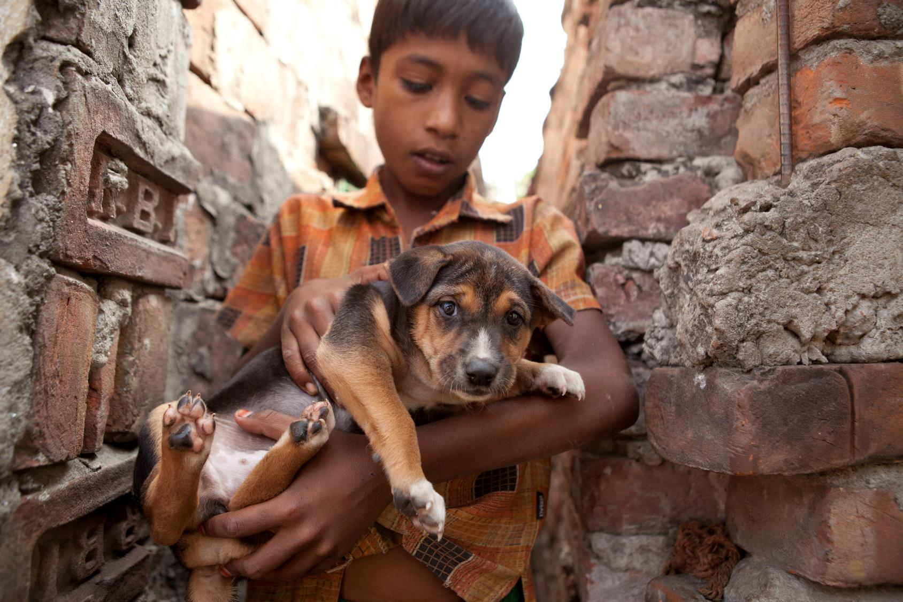
Thank You

