Slide 1
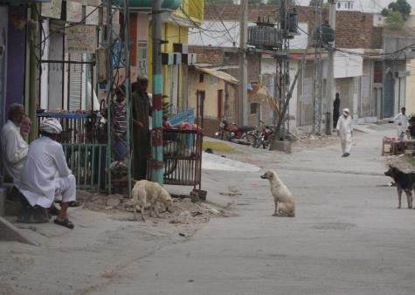
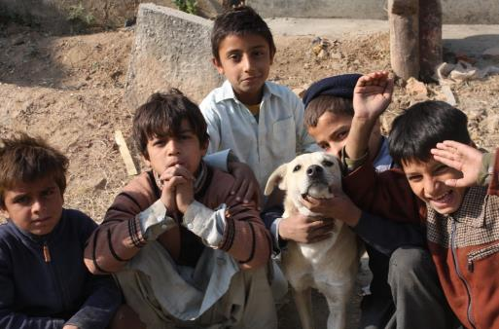
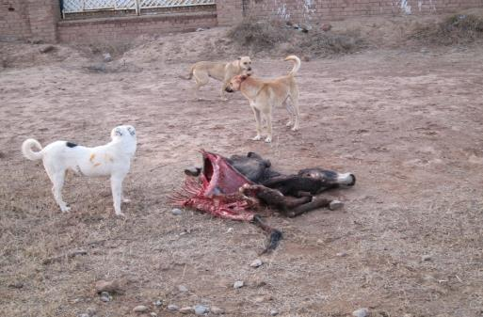
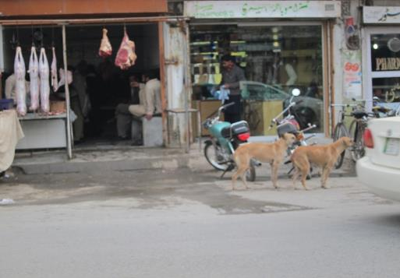
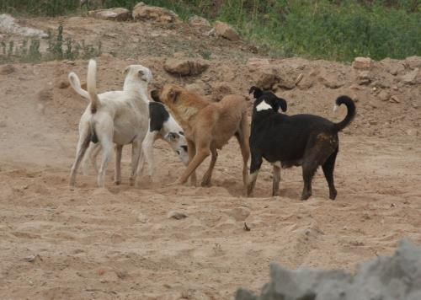
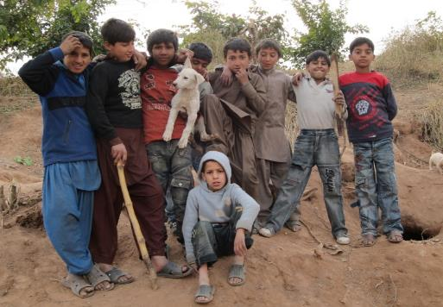
Abundance of pet dogs in Rawalpindi district of Pakistan
S.I. Shah, M. A. Beg, M. S. Nadeem, A. R. Kayani and N. Rashid
Department of Zoology, PMAS, Rawalpindi ,Pakistan

Slide 2
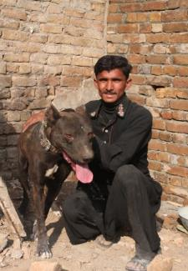
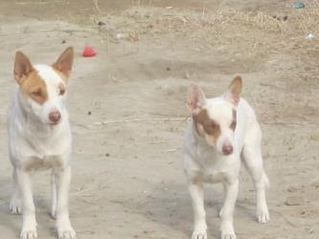
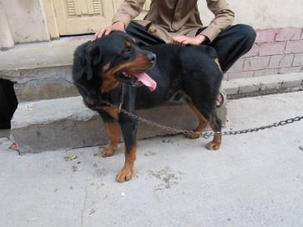
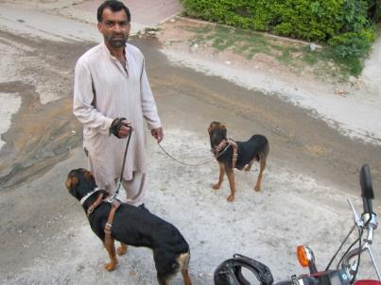
Contents
Introduction
Materials and Methods
Results and discussion
Recommendations
Acknowledgment

Slide 3
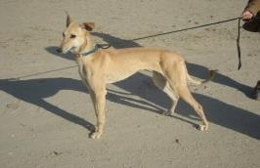
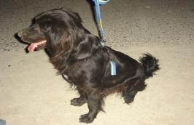
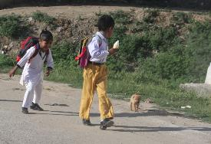
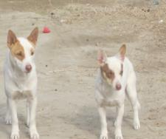
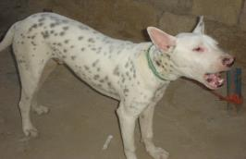
Introduction
Annually, 2000-5000 rabies deaths have been estimated for Pakistan
55-60 cases of dog bites per day occur in Karachi city and nearly 150000 dog-bite cases in Pakistan each year
Rabies incidence was estimated to range between 7.0 to 9.8 cases per million annually in Karachi. This is only peer-reviewed published literature on the occurrence of rabies in Pakistan
75% of Govt. hospitals still using obsolete rabies vaccine
There is no information available on dog population in Pakistan and this is first ever study on dog from Pakistan
(Ali, 2003, Parviz et al., 2004, Salahuddin, 2009)

Slide 4
Materials and Methods
Study Area-District Rawalpindi, Pakistan
Area 5285 Km²
Population (1998) 3.3 millions
Est. population (2011) 4.5 millions
Population density 851.3/km²
Urban population 53%
Rural population 47%
Average household 6.5 person size
Total housing units 521507
Administrative units
Tehsils 07
Union Councils 170
Villages 1164
Census units
Census block : 200-250 households
Census circle: 5 to 7 blocks
Census charge: 5 to 7 circles
Population census organization, Pakistan

Slide 5
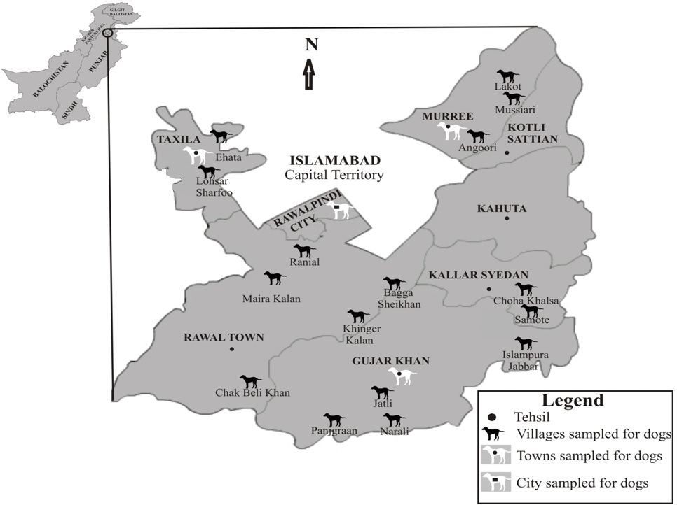

Slide 6
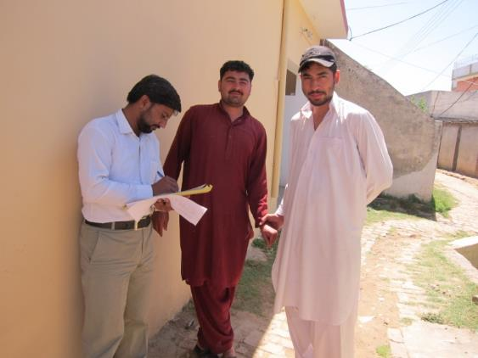
Methodology
Four Rawalpindi city census circles, seven town census circles and 16 villages were surveyed through questionnaire and interviews.
The questionnaire was in Urdu language
Questionnaire included information about the
Owner’s name, age and sex
Number of people lived in household
Number of dogs in the household
Age of dog at adoption
Rabies deaths in area
Dog bites in household and its treatments
Number of dog rabid in the area
What people do after touching or handling dogs
The information thus, collected was compiled and analyzed using Microsoft Access database and SPSS-16 software

Slide 7
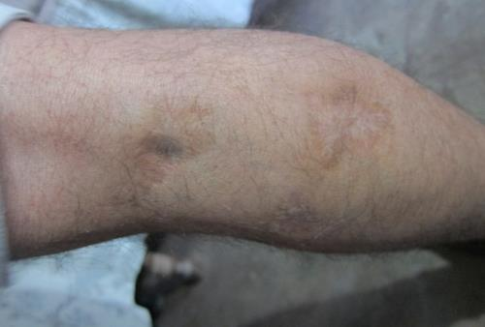
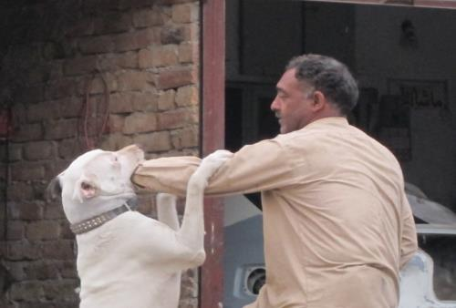
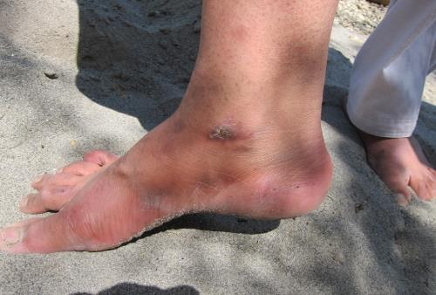
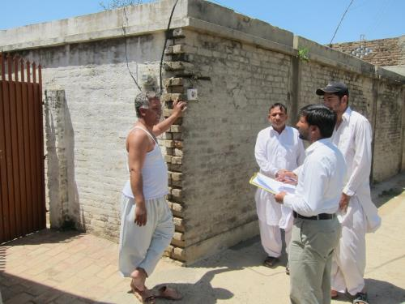
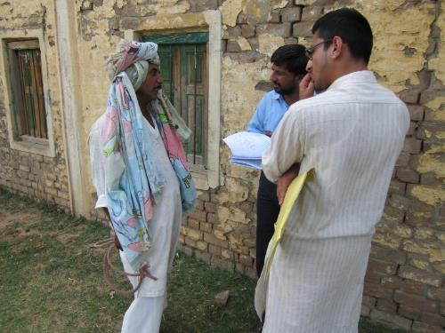
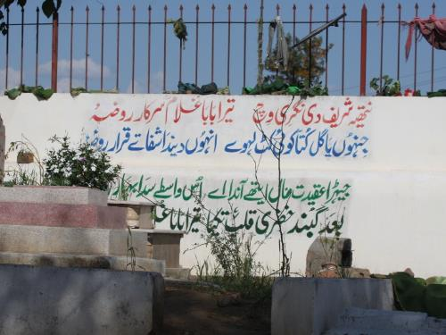
RESULTS AND DISCUSSION

Slide 8
Respondents’ general information

Slide 9
Table: Detail of areas selected for questionnaire survey in Rawalpindi district
Habitats | No./Name | No. of households surveyed | People lived in households | People per household | Households that had dog/s |  | % Ownership | No. of dogs | Dog to human ratio 1 dog: n
 |  |  |  |  | No | Yes
Rawalpindi city’ circles | 3/22 | 82 | 676 | 8.24 | 78 | 4 | 4.88 | 5 | 135
 | 4/18 | 51 | 357 | 7.00 | 50 | 1 | 1.96 | 1 | 357
 | 4/26 | 82 | 571 | 6.96 | 78 | 4 | 4.88 | 5 | 114
 | 6/12 | 69 | 478 | 6.93 | 53 | 16 | 23.19 | 24 | 20
 | Total | 284 | 2082 | 7.33 | 259 | 25 | 8.80 | 35 | 59
Gujar Khan Town’ circles | 007/1211 | 29 | 237 | 8.17 | 14 | 15 | 51.72 | 24 | 10
 | 902/1180 | 16 | 114 | 7.13 | 8 | 8 | 50.00 | 9 | 13
 | 906/1180 | 56 | 391 | 6.98 | 36 | 20 | 35.71 | 31 | 13
Taxila town’ circles | 301/1130 | 26 | 191 | 7.35 | 18 | 8 | 30.77 | 9 | 21
 | 403/1130 | 34 | 270 | 7.94 | 17 | 17 | 50.00 | 25 | 11
Murree town 'circles | 902/1210 | 32 | 233 | 7.28 | 19 | 13 | 40.63 | 14 | 17
 | 906/1210 | 47 | 311 | 6.62 | 31 | 16 | 34.04 | 21 | 15
 | Total | 240 | 1747 | 7.28 | 143 | 97 | 40.42 | 133 | 13
Villages of Rawalpindi district | Angrooi | 72 | 598 | 8.31 | 40 | 32 | 44.44 | 47 | 13
 | Bagha Shiekha | 72 | 540 | 7.50 | 44 | 28 | 38.89 | 37 | 15
 | Chak Beli Khan | 104 | 765 | 7.36 | 58 | 46 | 44.23 | 65 | 12
 | Ehata | 70 | 480 | 6.86 | 43 | 27 | 38.57 | 38 | 13
 | Islampur Jabbar | 87 | 595 | 6.84 | 54 | 33 | 37.93 | 47 | 13
 | Jatli | 85 | 625 | 7.35 | 44 | 41 | 48.24 | 51 | 12
 | Choha Khalsa | 73 | 517 | 7.08 | 37 | 36 | 49.32 | 41 | 13
 | Khinger Kalan | 72 | 611 | 8.49 | 40 | 32 | 44.44 | 50 | 12
 | Lohsar Sharfoo | 87 | 662 | 7.61 | 44 | 43 | 49.43 | 61 | 11
 | Lokot | 79 | 579 | 7.33 | 37 | 42 | 53.16 | 52 | 11
 | Maira Kalan | 92 | 619 | 6.73 | 49 | 43 | 46.74 | 55 | 11
 | Mussiari | 83 | 565 | 6.81 | 54 | 29 | 34.94 | 36 | 16
 | Narali | 94 | 697 | 7.41 | 53 | 41 | 43.62 | 53 | 13
 | Panjgraan | 85 | 676 | 7.95 | 50 | 35 | 41.18 | 57 | 12
 | Ranial | 98 | 731 | 7.46 | 53 | 45 | 45.92 | 59 | 12
 | Smote | 83 | 637 | 7.67 | 49 | 34 | 40.96 | 52 | 12
 | Total | 1336 | 9897 | 7.41 | 749 | 587 | 43.94 | 801 | 12
 | Overall total | 1860 | 13726 | 7.38 | 1151 | 709 | 38.12 | 969 | 14

Slide 10
Figure: Dog ownership pattern in urban and rural settlements of different countries
(Source: Davlin and VonVille, 2012)

Slide 11
Figure: Dog to human ratio (1:n) reported in different countries
(Source: Davlin and VonVille, 2012)

Slide 13
Table: Rabies deaths and dog bite cases reported in selected areas of Rawalpindi district
Locality | Name/No. | Rabies death cases |  |  | Dog rabid |  |  | Dog bite in household member
 |  | NA | No | Yes | NA | No | Yes | NA | No | Yes | Total
Rawalpindi city 'circles | 3/22 | 5 | 77 | 0 | 10 | 69 | 3 | 10 | 70 | 2 | 82
 | 4/18 | 2 | 49 | 0 | 2 | 49 | 0 | 0 | 51 | 0 | 51
 | 4/26 | 0 | 82 | 0 | 9 | 67 | 6 | 7 | 73 | 2 | 82
 | 6/12 | 1 | 65 | 3 | 0 | 64 | 5 | 8 | 58 | 3 | 69
 |  | 8 | 273 | 3 | 21 | 249 | 14 | 25 | 252 | 7 | 284
Gujar Khan’ town circles | 007/1211 | 0 | 23 | 6 | 0 | 5 | 24 | 0 | 20 | 9 | 29
 | 301/1130 | 0 | 20 | 6 | 0 | 12 | 14 | 0 | 18 | 8 | 26
 | 403/1130 | 0 | 23 | 11 | 0 | 6 | 28 | 0 | 23 | 11 | 34
Taxila town’ circles | 306/1180 | 0 | 50 | 6 | 1 | 31 | 24 | 0 | 48 | 8 | 56
 | 301/1180 | 0 | 12 | 4 | 0 | 12 | 4 | 2 | 10 | 4 | 16
Murree town’ circles | 902/1210 | 0 | 20 | 12 | 0 | 17 | 15 | 1 | 21 | 10 | 32
 | 906/1210 | 2 | 35 | 10 | 4 | 20 | 23 | 2 | 33 | 12 | 47
 |  | 2 | 183 | 55 | 5 | 103 | 132 | 5 | 173 | 62 | 240
Villages of Rawalpindi district | Angroo | 0 | 60 | 12 | 0 | 20 | 52 | 0 | 47 | 25 | 72
 | Bagha Shiekha | 0 | 59 | 13 | 0 | 27 | 45 | 0 | 46 | 26 | 72
 | Chak Beli Khan | 1 | 88 | 15 | 0 | 52 | 52 | 3 | 78 | 23 | 104
 | Eihata | 0 | 49 | 21 | 0 | 27 | 43 | 0 | 47 | 23 | 70
 | Jabbar | 0 | 65 | 22 | 0 | 44 | 43 | 1 | 64 | 22 | 87
 | Jatli | 1 | 64 | 20 | 0 | 18 | 67 | 0 | 59 | 26 | 85
 | Juda Khalsa | 3 | 61 | 9 | 2 | 29 | 42 | 3 | 55 | 15 | 73
 | Khinger Kalan | 1 | 59 | 12 | 0 | 17 | 55 | 1 | 48 | 23 | 72
 | Lohsar Sharfoo | 0 | 70 | 17 | 1 | 33 | 53 | 3 | 60 | 24 | 87
 | Lokhot | 0 | 54 | 25 | 1 | 31 | 47 | 0 | 54 | 25 | 79
 | Maira Kalan | 0 | 67 | 25 | 0 | 43 | 49 | 0 | 70 | 22 | 92
 | Mesyari | 0 | 60 | 23 | 1 | 37 | 45 | 0 | 60 | 23 | 83
 | Narali | 1 | 77 | 16 | 5 | 35 | 54 | 0 | 65 | 29 | 94
 | Panjgraan | 1 | 60 | 24 | 0 | 21 | 64 | 1 | 51 | 33 | 85
 | Ranial | 3 | 72 | 23 | 1 | 45 | 52 | 4 | 69 | 25 | 98
 | Smoot | 0 | 62 | 21 | 3 | 34 | 46 | 4 | 53 | 26 | 83
 | Total | 11 | 1027 | 298 | 14 | 513 | 809 | 20 | 926 | 390 | 1336
 | Grand total | 21 | 1483 | 356 | 40 | 865 | 955 | 50 | 1351 | 459 | 1860

Slide 14
Rabies cases in Rawalpindi district

Slide 15
Dog bite in Rawalpindi district

Slide 16
Summary
356/1860 households reported only 26 rabies deaths in all human settlements
My study indicated 89% rabies deaths due to dog bite in Rawalpindi, Pakistan
459/1860 household respondents reported dog bites and it was associated with males (332 cases)
After dog bites, 24% people got spiritual treatments only and 40% go to hospitals only and 25% did both while 11% did nothing about treatment
Only 38.12% households were positive for pet dogs
The overall dog to human ratio (1:n) was 1:14

Slide 17
Suggestions and recommendations
ABC program is in practice in many countries of the world and should immediately start in Pakistan
Vaccination of pet dogs should be carried out in villages as large number of pet dogs and dog bites are reported in the villages
Rawalpindi district is a hilly tract of land with relatively little agriculture. Hence the rural population of the district is small. So is also case with dog population. To know exact scenario of dog population, the similar studies should be conducted in other area of Pakistan.
Rabies caused deaths are more common in rural areas. Here good number of the people depend on spiritual treatments or local medicine men. Awareness programs for the villagers should be started.
Hopefully, WHO may help to start dog management program in Pakistan

Slide 18
Acknowledgements
My PhD supervisor Prof. Dr. Mirza Azhar Beg
Higher Education Commission to give me scholarship for PhD studies
Population census organization , Pakistan to give me data on Rawalpindi district
Authors (Davlin and VonVille, 2012) and Elsevier team to allow me to use the research article

Slide 19
References
Study No | Author and publication year | Location
1 | Acosta-Jamett et al., 2010 | Chile
2 | Awoyomi et al., 2007 | Nigeria
3 | Beran, 1982 | Philippines
4 | Beran and Frith, 1988 | Ecuador
5 | Brooks, 1990 | Zimbabwe
6 | Butler and Bingham, 2000 | Zimbabwe
7 | Cleaveland et al., 2003 | Tanzania
8 | De Balogh et al., 1993 | Zambia
9 | Durr et al., 2009 | Chad
10 | Estrada et al., 2001 | Philippines
11 | Faleke, 2003 | Nigeria
12 | Fishbein et al., 1992 | Mexico
13 | Flores-Ibarra and Estrella-Valenzuela, 2004 | Mexico
14 | Hatch et al., 2004 | Sierra Leone
15 | Kaare et al., 2009 | Tanzania
16 | Kayali et al., 2003 | Chad
17 | Kitala et al., 2001 | Kenya
18 | Knobel et al., 2008 | Tanzania
19 | Kongkaew et al., 2004 | Thailand
20 | Matter et al., 2000 | Sri Lanka
21 | Ortega-Pacheco et al., 2007 | Mexico
22 | Perera et al., 2007 | Sri Lanka
23 | Ratsitorahina et al., 2009 | Madagascar
24 | Rautenbach et al., 1991 | South Africa
25 | Robinson et al.,1996 | Philippines
26 | Sudarshan et al., 2001 | India
27 | Sudarshan et al., 2006 | India
28 | Suzuki et al., 2008 | Bolivia
29 | Touihri et al., 2009 | Tunisia

Slide 20
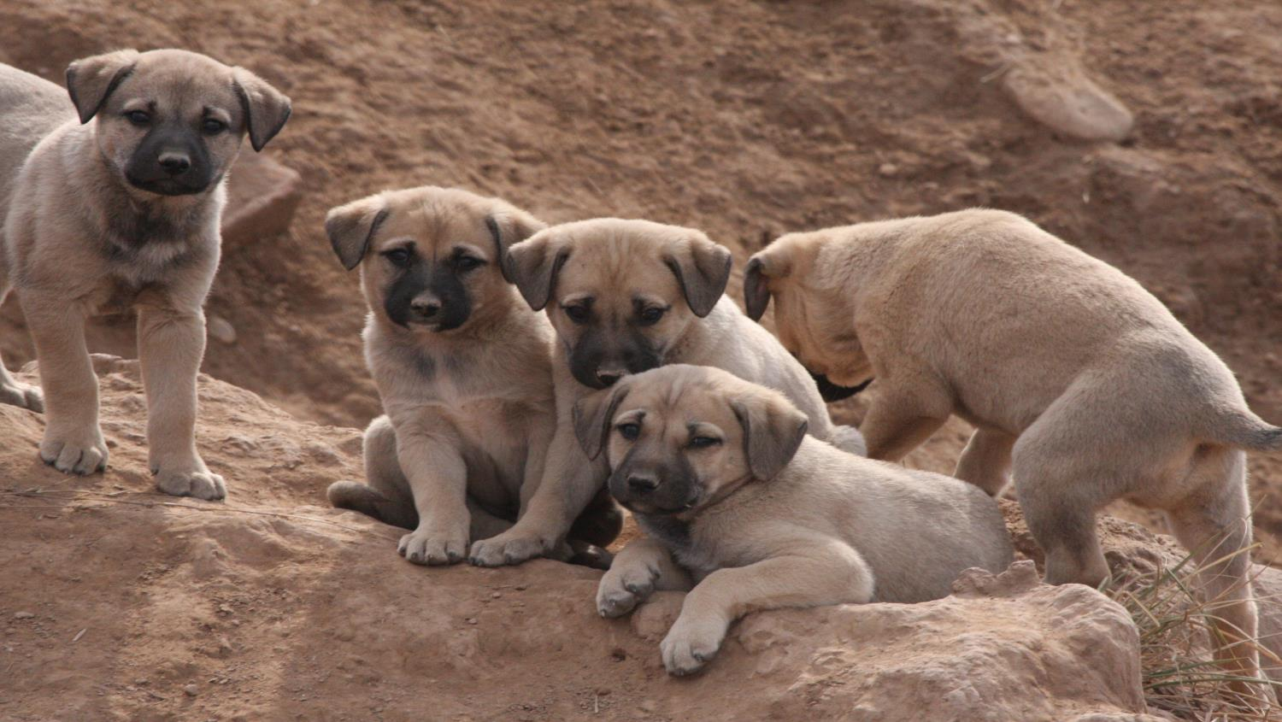
THANKS
SUGGESTIONS AND QUESTIONS

