Slide 1


Rabies and the Rural Thai Community:
Combatting Myths through Education
Lanta Animal Welfare
Koh Lanta Island, Thailand
Notes:
●Welcome
●Focusing on rabies educational work within a very specific area of Thailand
●Rural community, small island,
●Edu material very location-specific , taking into account
- location,
- target demographic,
- cultural considerations
- and resources where the actual campaign began in late 2014
● Principles are transferable for other locations.

Slide 2

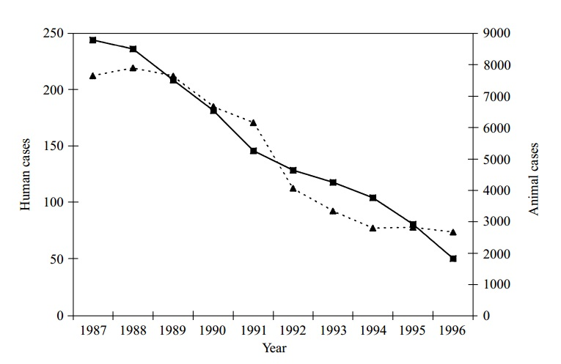
Introduction – Rabies Within Thailand
● Dramatic decline in human and animal rabies cases
● 2011 study – highest MR Central / Southern Thailand 2
● MR → 0.12 per million 3
● Cost – $45 US/PEP 4
US$ 563 million 5
● Cases underestimated 6
1
Notes:
● Rabies endemic in all regions of Thailand, cases highest within cities, where both owned and stray companion animal populations are high, and other resource rich area, such as tourist destinations
● dramatic decline in both human + canine rabies cases over the past 20+ years,
● WHO notes there were 170 human rabies mortalities in 1991, dropped to 8 in 2011
● thought to be partially due to higher availability and lower cost of both human PEP and canine rabies vaccinations.
● In 2011, Central and Southern areas had the highest human mortality rate – Koh Lanta is in far south
● The annual rabies mortality rate in Thailand is 0.12 per million people, isn’t a huge figure BUT is still too high considering preventable
● Also economic situation to consider – study found that using the Thai Red Cross schedule of 5 PEP injections, each course costs a minimum of $45 = around 5 days work at Thai minimum wage, poorest don’t even MEET minimum wage.
● The most vulnerable can’t meet these costs
● On a larger scale, rabies cost the governments in Asia an estimated 563 million US dollars.
● Accurate vaccination information → reduce the economic cost at a national level + encourage larger provision of free/ heavily subsidised vaxes
● Reported figure for human cases known BUT exact numbers of rabid dog cases underestimated
● Many cases of suspected canine rabies will go uncounted if post-mortem brain tissue testing isn’t possible.

Slide 3
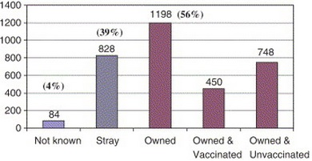
Introduction – Rabies Within Thailand
● Highest rabies reservoir = dogs (45% pups < 12 wks) 2
● Majority of human cases: owned, unvaccinated pets 2
● Previous studies –
strays found responsible1
● Misconceptions
→ violent animal deaths
7
Notes:
● A 2011 study confirmed dogs still main rabies reservoir,
● highest percentage of infection = pups under 12 weeks, before the first vaccination.
● 1 other significant finding = the majority of human rabies cases in Thailand were not due to strays, but to owned, unvaccinated pets.
● Big change since a 1998 study = community and stray animals mainly responsible.
● Break it down further to focus on bites in children - owned animals were responsible for more bites than strays, + unvaccinated owned animals were almost as likely to bite as strays.
● Owned, unvaccinated dogs might not be the main rabies-risk in other countries, but for an educational program in Thailand, encouraging vaccination of owned pets is a priority there, as is pup management.
●Despite these findings, concern about transmission of rabies from street dogs is far higher than concern about owned pets.
● Local reaction to an aggressive dog = extremely negative, particularly if child-related
● a lack of understanding of the cause of aggression -> jump to conclusions, -> inhumane killing of the dog.
●1 study also showed districts with a higher proportion of Muslims than Buddhists = a lower number of rabies cases –relevant for Koh Lanta, high traditional Muslim population, one of the cultural aspects I’ll talk about shortly…

Slide 4
Rabies Myths – Thailand (2006)8
● Rabies is only spread in the hot seasons
● Bites can be treated with balm or tobacco
● Slapping bite wounds / holy water cures rabies
● Eating the biting dog’s liver prevents transmission
● Cutting off of dogs' ears and tails prevents infection
● Pregnant women cannot be treated for rabies
● Overestimate of post-exposure vaccines needed
Notes:
● A number of cultural myths surrounding rabies are present in Thailand
● these are the main myths as identified by the Thai Public Health Permanent Secretary back in 2006.
● Needed to ID whether these myths still present on Koh Lanta, 8 years later,
● survey of the local community.
● a simple list of statements about rabies in Thai, about rabies transmission, how it can be prevented, action after bites etc,
● asked those surveyed to tick whether true, false or if they were unsure.

Slide 5
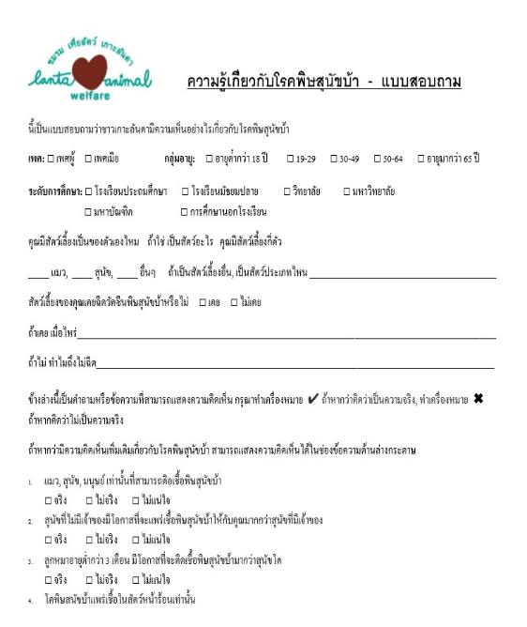
Rabies Myths – Findings on Koh Lanta (2014)
– Poor behavioural knowledge (bite = rabid)
– Vaccinated animals still a risk
– Spread only in hot seasons
– Post-exposure vaccines over-estimated
Notes:
● Unsurprisingly, the findings indicated a poor knowledge of rabies and canine behaviour
● 45% of those surveyed thought that a bite from an animal meant that it must be rabid,
● 40% thought that even if their animal was correctly vaccinated against rabies, it could still catch and transmit the disease.
● The hot weather myth is still prevalent and a knock on effect of this myth is that many Thai vets are unwilling to do TNVR clinics in the hot months, as they believe they are more at risk of encountering a rabid dog.
● 20% of locals thought that up to 20 PEP vaccinations were needed after being bitten.
● Some of the 2006 myths are not applicable on Koh Lanta.
● Predominantly Muslim = the locals would never consume dog liver, most wouldn’t touch a dog in the attempt to cut its ears or tails off.
● Although, those myths aren’t present here, they may still apply on the mainland.

Slide 6
Key Issues to Address
● Vaccination of owned pets and stray animals
● Community Education to correct misconceptions:
– Responsible behaviour around dogs – DO/DON’T
– Rabies background, symptoms
– What to do if…
● Majority of bite victims – children
→ TARGET AUDIENCE
Notes:
● So, with previous information in mind → 1st key issue to tackle = the vaccination of owned pets and stray animals.
● on Koh Lanta, owner uptake of rabies vaccination for pets is good, free alongside sterilization. FREE = POPULAR
● In other rural areas where access to rabies vaccinations may NOT be as readily available, this should be a key target point, but for this particular, specific community, more a reminder than main message.
● The key points for THIS campaign centre = correcting misconceptions + bite avoidance.
● Responsible behaviour around dogs, e.g. not disturbing a mother with pups, etc = really lacking on the island.
● Some accurate background on rabies is essential, as health knowledge is poor on island (about humans and pets).
● Advising people what to do if they come across suspected rabid animal = very important.
● Encouraging contacting exports, rather than DIY, is essential.
● giving accurate advice on how to deal with bites is crucial.
● From a study by Chuxnum, the data showed that almost none of the humans who died from rabies had any post-exposure vaccination,
● Lanta = has hospital and clinics, assess to post exposure vaccination is possible, but urging immediate washing of the wound + hospital asap needed reiterating.
● As 1 study showed, 55% of animal bite victims were children, = why target audience, + prevention of bites is key message.
● Children pass on info to parents

Slide 7

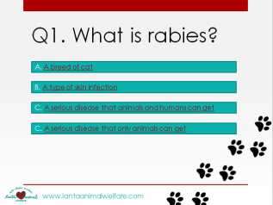
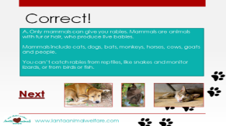
School Group Education & Barriers
● 1 of key activities - INTERACTIVE QUIZ
● Practical Barriers
– Need for specialist equipment? No
– Need for Internet connection? No
– Low cost? Yes
● Cultural Barriers – religious sensitivity,
language
Notes:
●1 key activity was interactive quiz → fun, interactive, plays to love of techno, while being educational.
●Quiz part of wider educational campaign.
● Both cultural and practical issues to deal with.
● No point building a state of the art multimedia quiz → unstable internet, power cuts, → the quiz is an offline activity, which will work on old Powerpoint versions, old PCs, accompanied by hard copies of accompanying material
● Muslim population is extremely high on Koh Lanta, around 95% → understanding and tolerance already limited, although gradually improving , less outright cruelty now than in previous years.
● Program had to be careful to be factual (dogs = main reservoir, bite culprit) but without demonising further.
● For this reason, though dogs are focused on in the interactive quiz, particularly in questions about behaviour around dogs, they are not ‘blamed’ as being responsible for rabies, other animals are mentioned and more importantly, the quiz describes how HUMAN actions can prevent the spread of rabies, through vaccination and stopping their pets from free-roaming, and bite avoidance is a key theme
● Languages are also important, as we’ll see in a second.

Slide 8

Educational Information - Interactive Quiz
Notes:
● quiz 1 part of the campaign.
● As well as a Thai version, there’s an English version → substantial ex-pat community, also limited rabies knowledge

Slide 9
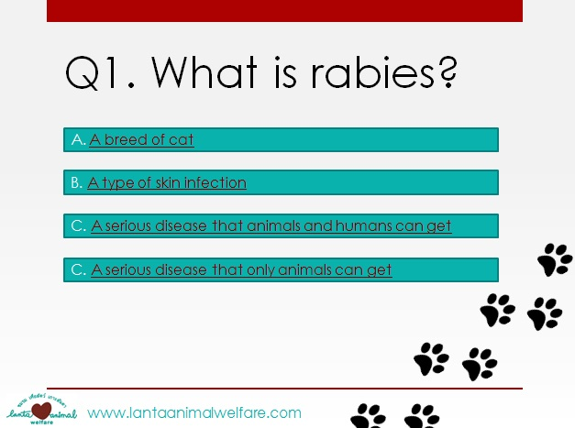
Educational Information - Interactive Quiz
Notes:
● Simple questions – age ranges vary in school, so made intermediate.

Slide 10
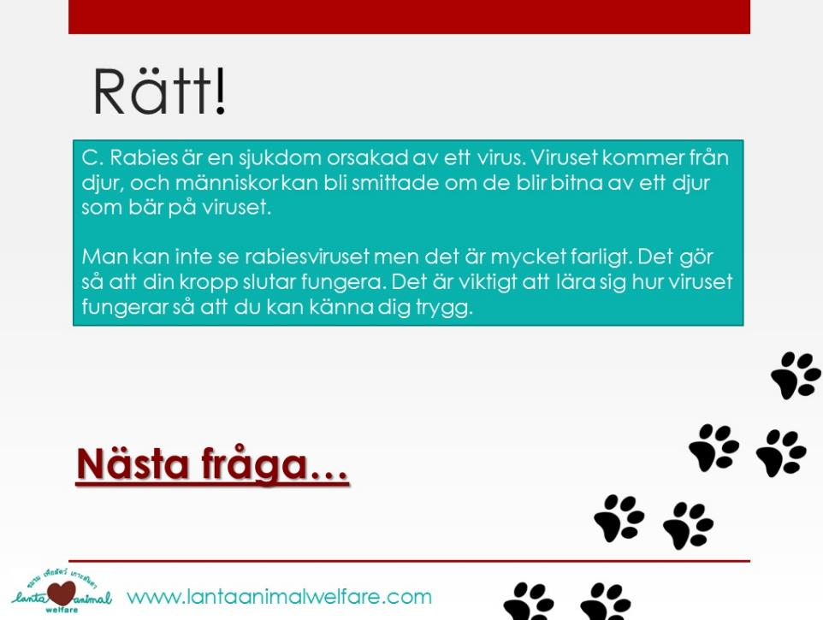
Educational Information - Interactive Quiz
Notes:
● The Swedish speakers also outnumber the English speakers on Lanta, so again, have a Swedish version
● Several Swedish schools and day care centres on Lanta.

Slide 11
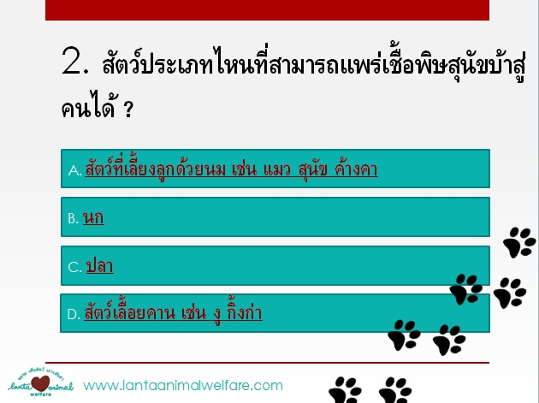
Educational Information - Interactive Quiz
Notes:
● And of course, Thai language

Slide 12
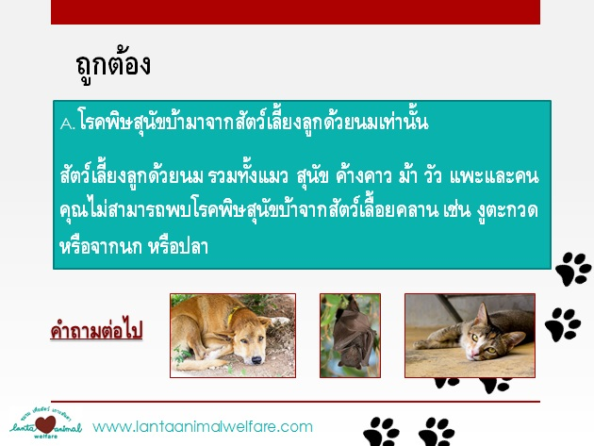
Educational Information - Interactive Quiz
Notes:
● We also have a version without photos of dogs – most of the schools are mixed religion but there are a few where we were asked to not have dog photos.
● Better to have education where the word ‘animal’ is used instead of ‘dog’ than no relevant edu.

Slide 13
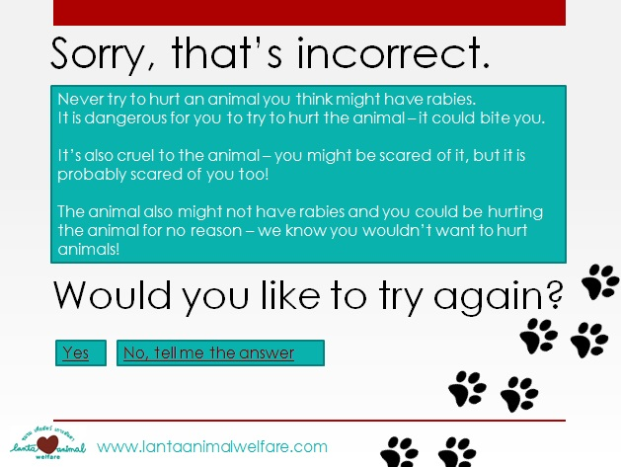
Educational Information - Interactive Quiz
Notes:
● One main feature -> can never go through it without finding correct answer
● On specific questions, custom slides to explain WHY their answer = wrong

Slide 14

Educational Information - Interactive Quiz
● Material covered includes:
What is rabies?
Affected species, symptoms
Transmission
Prevention in animals
How to behave around unknown dogs
What to do if…
Notes:
● Material covered includes:
What is rabies?
Affected species, symptoms
Transmission
Prevention in animals
Behaviour around unknown animals
What to do in a range of circumstances, e.g. if approached by unfriendly dog, if bitten etc.

Slide 15

Implementation
● Schedule: 1-2 weeks before October vacation
LAW staff going into schools
Rescue centre visits (dependent on religion)
Hard copies of quiz and other educational material
→ parents
Notes:
● A study on bites in children -> bite rate peaked during 2 periods corresponding to school vacations, → highest peak was during the month long vacation in October.
● maximise impact → it was first used in schools 1-2 weeks before the start of the October break.
● Accompanied by hard copies of the quiz, colourful work sheets, and dramatic presentations and workshops
● encourage fun, allow them to express what they have learned in a physical manner.
● information made to take home -> spread info further.
● Visits to LAW rescue centre (religion permitting) to observe different dog behavioural states, practice responsible behaviour around safe dogs.
● For children who couldn’t visit the dogs, they still had cat access, so that in itself = educational, responsible pet ownership
● we also did street-side dog behavioural observations.

Slide 16
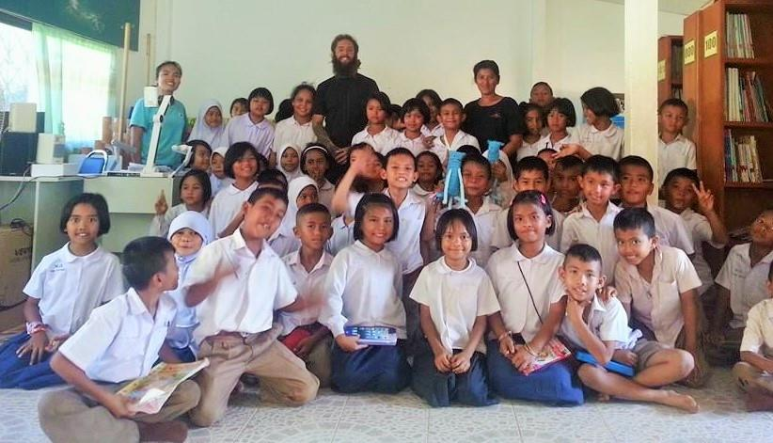
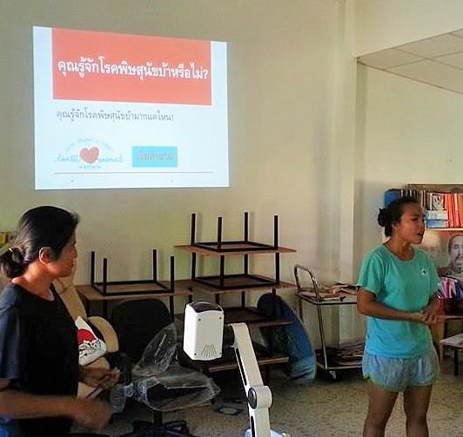

Slide 17
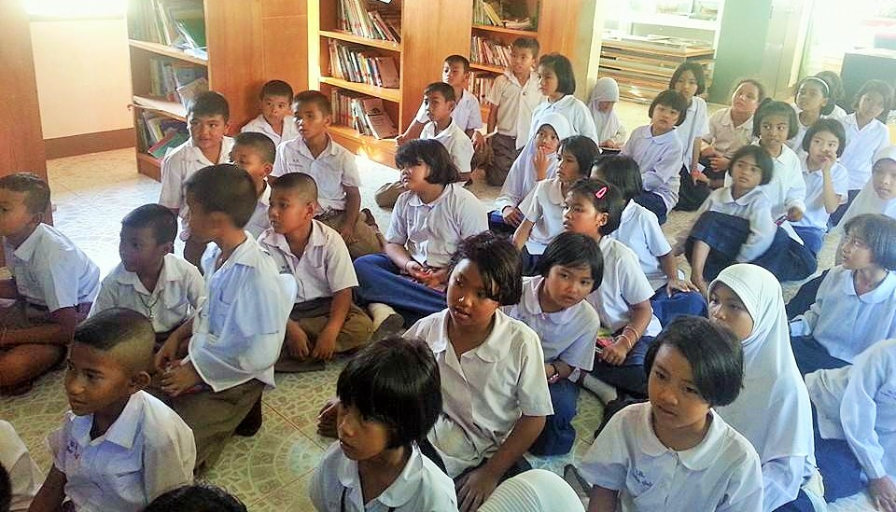
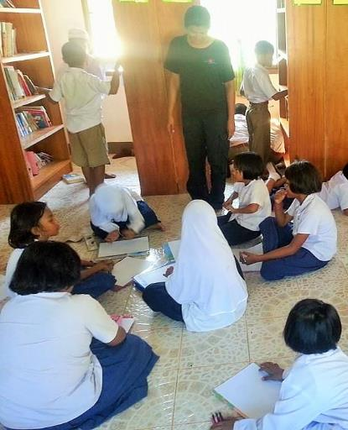

Slide 18
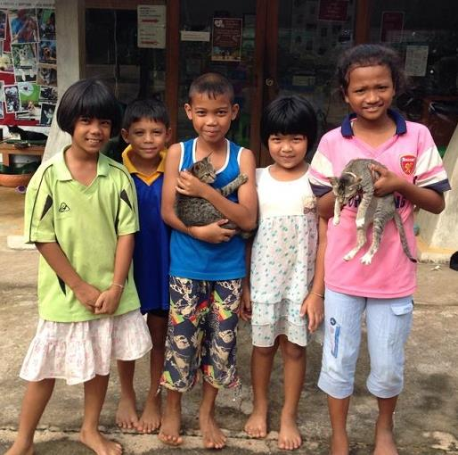
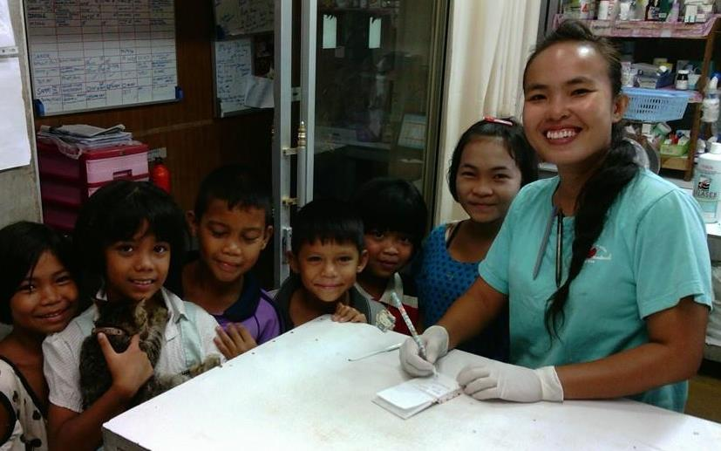
Notes:
● Kids story – after edu, started visiting regularly, bringing their animals in for treatment
● Getting autographs

Slide 19
Evaluation
● Test → Teach → Test
Re-survey at clinic – myth reduction
Biting = rabid: reduced 16% (45% to 29%)
Vaccination won’t stop rabies: reduced 19% (46% to 27%)
Spread only in hot seasons: reduced 16% (38% to 22%)
Wrong PEP : reduced 10% (28% to 18%)
Notes:
● Used trusted Test Teach Test method
● From class observation and teacher reports, general knowledge and positive attitude towards animals in children increased, definite increase in kids visiting LAW
● wanted to assess if info filtered down to the parents → RE-SURVEY, the original rabies beliefs survey which was used to identify the current myths on Koh Lanta in mid-2014 was distributed again last month.
● February results showed (read from slide)
● Has had an impact on rabies myth reduction on the island in adults.

Slide 20

Evaluation
COST:
1000 THB or $30 US
Notes:
● Extremely low budget
● Total cost was 1000 Baht or around $30 US – print costs and petrol costs
● Everything else was done during working hours, so normal staff salary, free illustrations by a volunteer
● IS possible to create an effective, measurable rabies education campaign on a low budget, targeted at specific rabies myths.
Thank you.

Slide 21

References
Mitmoonpitak, C.; Tepsumethanon, V.; Wilde, H. (1998) 'Rabies in Thailand‘, Epidemio. Infect. Vol. 120, No. 2 (Mar., 1998), pp. 165-169
Chuxnum et al (2011) ‘Epidemiology of Human Rabies in Thailand, B.E.2546-2550 (2003-2007 AD)’ Siriraj Med. J. Vol 63, No 3, 2011.
WHO SEARO (2014) 'Rabies in the South-East Asia Region‘ http://www.searo.who.int/about/administration_structure/cds/CDS_rabies.pdf.pdf
Hampson, K.; Cleaveland, S.; Briggs, D. (2011) ‘Evaluation of Cost-Effective Strategies for Rabies Post-Exposure Vaccination in Low-Income Countries’. PLoS Negl Trop Dis 5(3): e982 doi:10.1371/journal.pntd.0000982
Gongal, G.; Wright, A.E. (2011) ‘Human Rabies in the WHO Southeast Asia Region: Forward Steps for Elimination’, Advances in Preventive Medicine, vol. 2011, Article ID 383870, 5 pages, 2011. doi:10.4061/2011/383870
OIE (2013) Terrestrial Manual 2013 Available online: http://www.oie.int/fileadmin/Home/fr/Health_standards/tahm/2.01.13_RABIES.pdf
Sriaroon, C.; Sriaroon, P.; Daviratanasilpa, S.; Khawplod, P.; Wilde, H. (2005) Retrospective: Animal attacks and rabies exposures in Thai children’, Travel Medicine and Infectious Disease, Volume 4, Issue 5, September 2006, Pages 270-274
Boonyawongvirot, P. (2006) Public Health Permanent Secretary, ‘Doctor Debunks Rabies Myths’, The Nation, 12 December 2006

