Slide 1
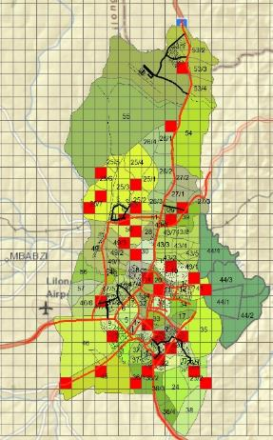
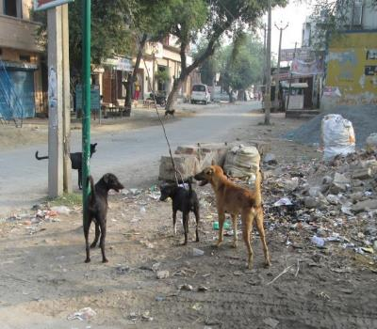



Population Size Estimates for Street Dogs:
The Good, the Bad, and the Shortcuts
John D. Boone, PhD
&
Andrew Rowan, PhD

Slide 2
Goals
Types of population metrics
Uses and limitations of population size estimates
Efforts to make estimates easier and more reliable
Hopes
More informed program decisions
Importance of better standardization in methods
Collaborations
Notes:
When people discuss street dogs quantitatively, the question almost always arises “how many are there?”
My goals, therefore, in this very short talk are to…….

Slide 3
Monitoring “Currency”
 | Dog Numbers | Dog Attributes
Relative | Dogs counted / km road Dogs counted / hour Dogs counted on standardized route | Percent sterilized Percent undernourished Percent puppies Percent pregnant/lactating
Absolute | Population size estimate of dogs within a defined area | Percentages x population estimate
Notes:
Good Monitoring a given

Slide 4
Comparison: Relative vs. Absolute
 | Relative | Absolute
Trends | X
Course corrections (adaptive management) | X
Impact assessment | X
Setting goals |  | X
Initial budgeting |  | X
Timeline to goal |  | X
Correcting misperceptions |  | X
Relative data are FUNDAMENTAL
Absolute estimates are OPTIONAL
Notes:
Good Monitoring a given
Relative are FUNDAMENTAL: also conceptually fairly simple, fairly low cost, but acquire most of their value upon repetition over time.
Absolute is OPTIONAL, usually up front, to facilitate planning and even to satisfy curiosity, also more complex

Slide 5
Population Size Estimation
Representative sampling
Detectability corrections
Coverage corrections
Extrapolation
Notes:
Huge interest and precedent in wildlife, but “doing it right” is complicated
Among other things, requires…

Slide 6



Population Size Estimates for Street Dogs
Notes:
In the worst case, fundamental errors are made, producing badly misleading estimates
Nobody argues this kind of misinformation is good

Slide 7

Making Estimates Easier and Better
Mark-resight estimates
  Assumptions
  Standardization
Detectability rules
  Different environments
  Effective area of sampling
  Effects of route configuration
Human proxy variables
  Type(s) of relationship
  Effects of scale
Notes:
In the best case, generating reliable estimates is an involved process, and a stretch for a typical dog management project
In the rest of the talk give a short taste of what we’re trying to do to simplify the process, IF YOU WANT AN ESTIMATE
GOAL is to streamline the process of arriving at believable estimate

Slide 8
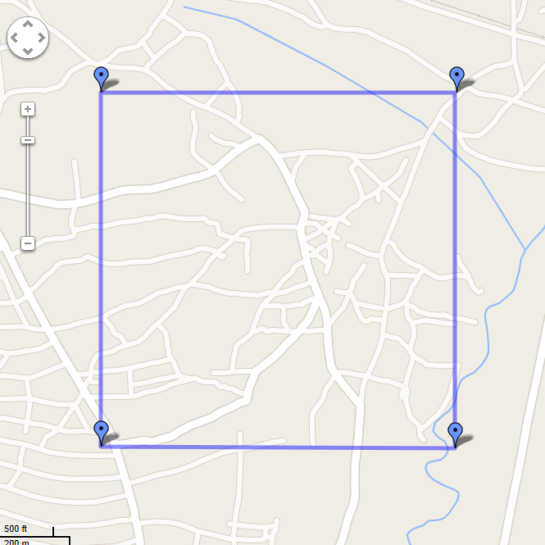
Mark-Resight
  Effective Area
?
?
Day 1: Mark
Day 2: Resight
Notes:
One of main methods for absolute estimate
Practice is not STANDARDIZED
Take a linear route for example

Slide 9
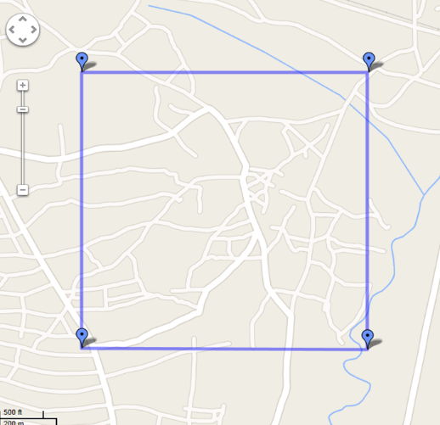
Mark-Resight
 | Day 1 / Day 2 Duplicated? | Day 1 / Day 2 Not Duplicated?
Day 1: “Saturated”*** | OK | OK
Day 2: “Linear” | Not OK? | Not OK?
Any Day 2 Route OK
Notes:
Several assumptions, including unbiased distribution of marked animals
Dog home range in relation to area of inference.
Tentative conclusion… address with GIS animation using some rough movement and home range data
Need to STANDARDIZE

Slide 10
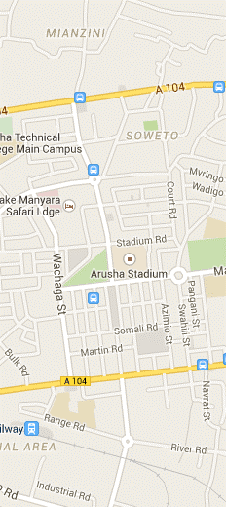
Detectability
Specific to:
  Survey method
  Time of day
  Location (?)
Meta-analysis
Simulations of spatial issues
?
?
Notes:
Typically will not use M-R everywhere, but a quicker method (and one that inherently produced a relative estimate)
With a good detectability estimate, can do double duty for population size estimation
Detectability is relative to a METHOD (simple dog survey) and probably a setting, and a time of day.
Detectability obtained by double sampling with mark-resight, or with estimated values from meta-analysis
We also need to know the effective RANGE within which the detectability applies
Given what we can reasonably assume about dog activity and movement patterns, can we generate an optimized route spacing?

Slide 11
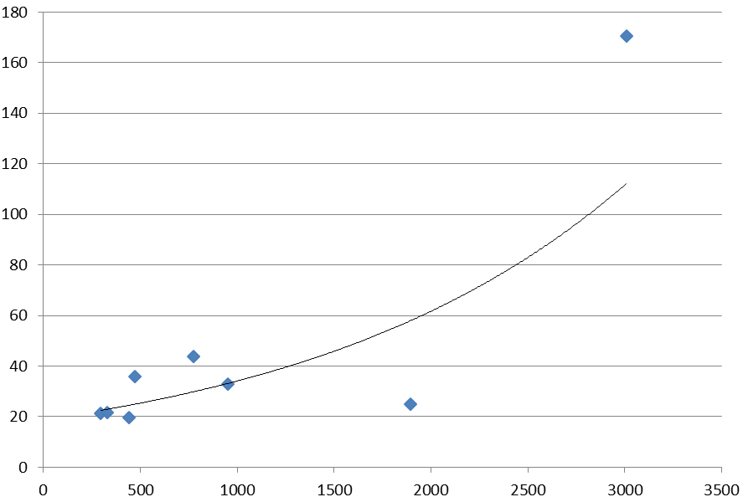
Human – Dog Relationships
Typical Relationship
Dogs / km²
Humans / km²
Notes:
Very Promising
Tends to vary at large (continental?) scale
Meta-analysis

Slide 12
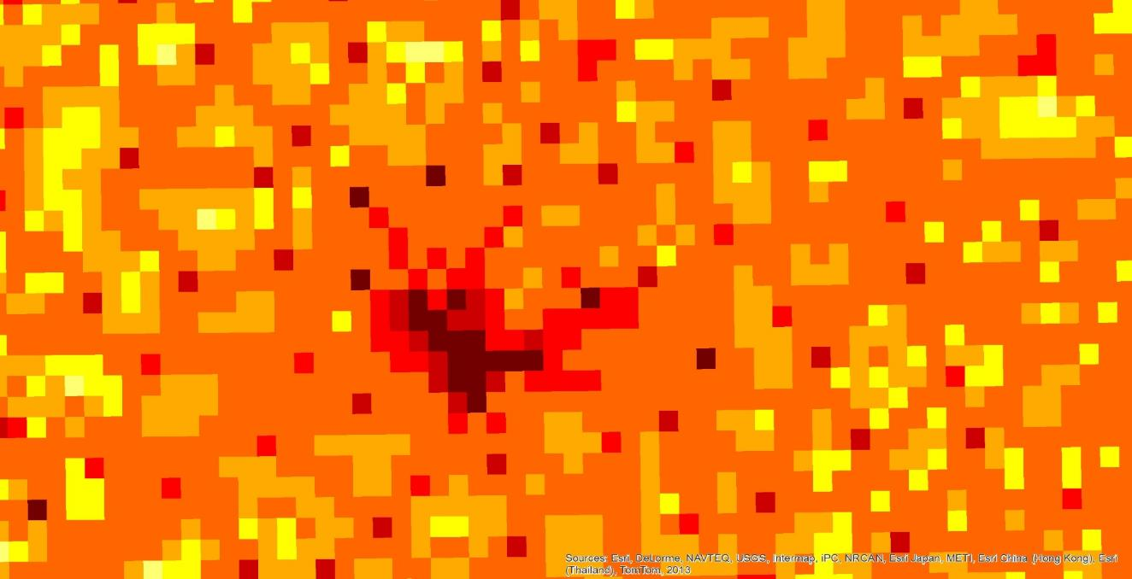
Human – Dog Relationships
Spatial Issues
Big Town: 25,000 people
Village: 1,000 people
Notes:
But current data is very messy I think because of this..
GIS based Meta-analysis

Slide 13

In Conclusion…
Relative population metrics are fundamental
Repeating standardized monitoring for relative density at periodic intervals is fundamental
Population size estimates can be useful but have many caveats
With proper analysis, the process of generating dog population estimates can be more efficient and the results improved
Human proxy variables have strong promise

