Slide 1
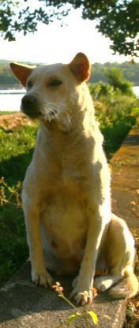
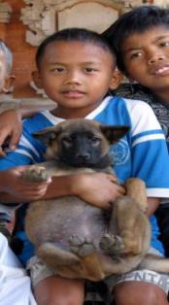
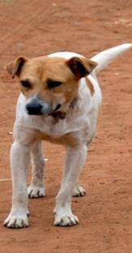
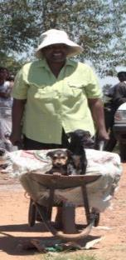
Community Regulation of the Ecology of Four Owned, Free-Roaming Dog Populations
Presented by:
Hanna Lentz Global Program Officer

Slide 2
Overview
Context
General Overview of Research
Methods
Summary of Results
Application at the Project Level
Broader Implications for Dog Population Management

Slide 4
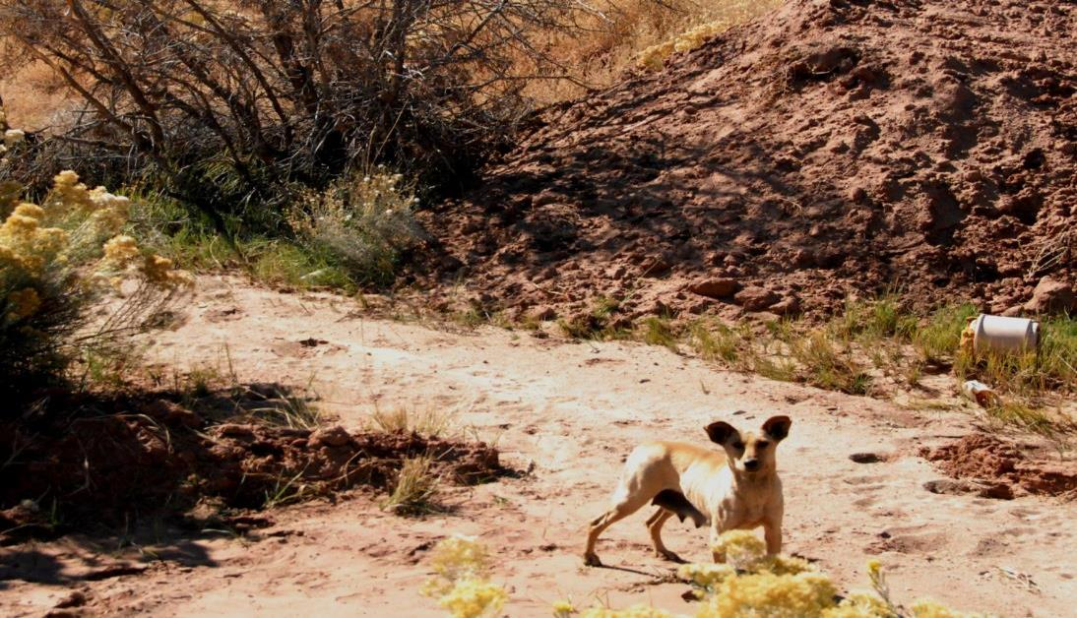

Slide 5
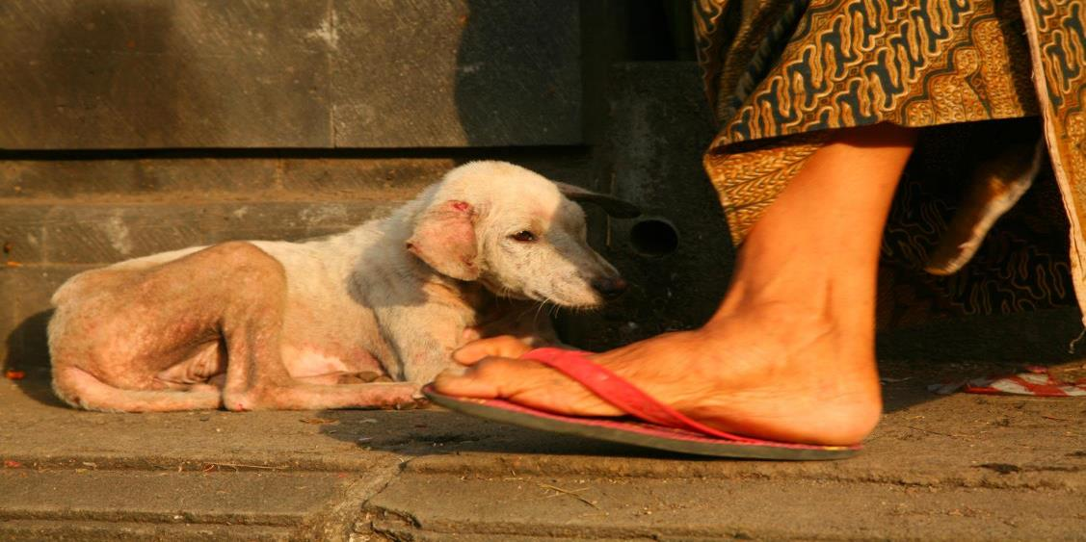

Slide 6
Roaming DOG
Owned?

Slide 7
Where are dogs coming from?
Where are they going?
What role do humans play?

Slide 8
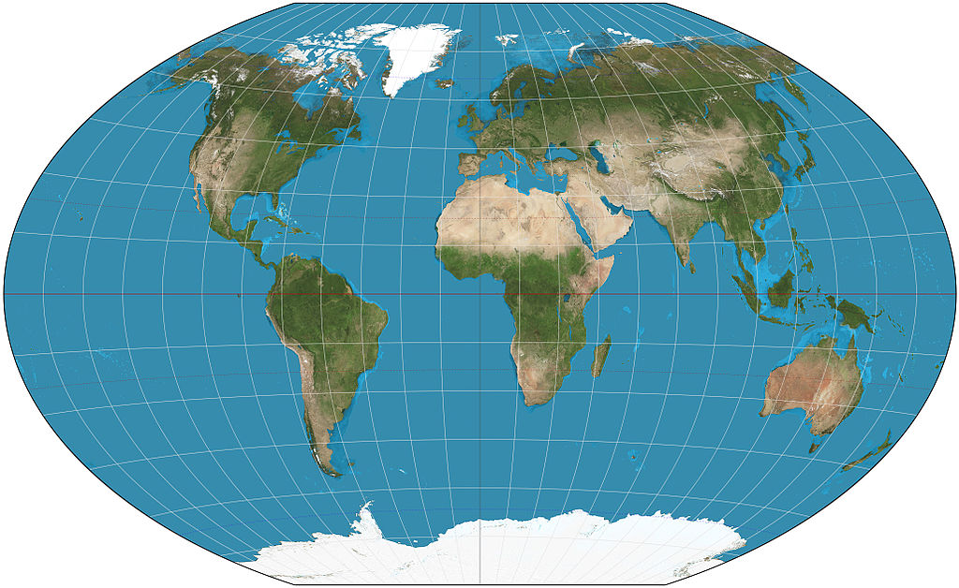
Bali
Indonesia
Antiga
Kelusa
Johannesburg
South Africa
Zenzele
Braamfischerville

Slide 9
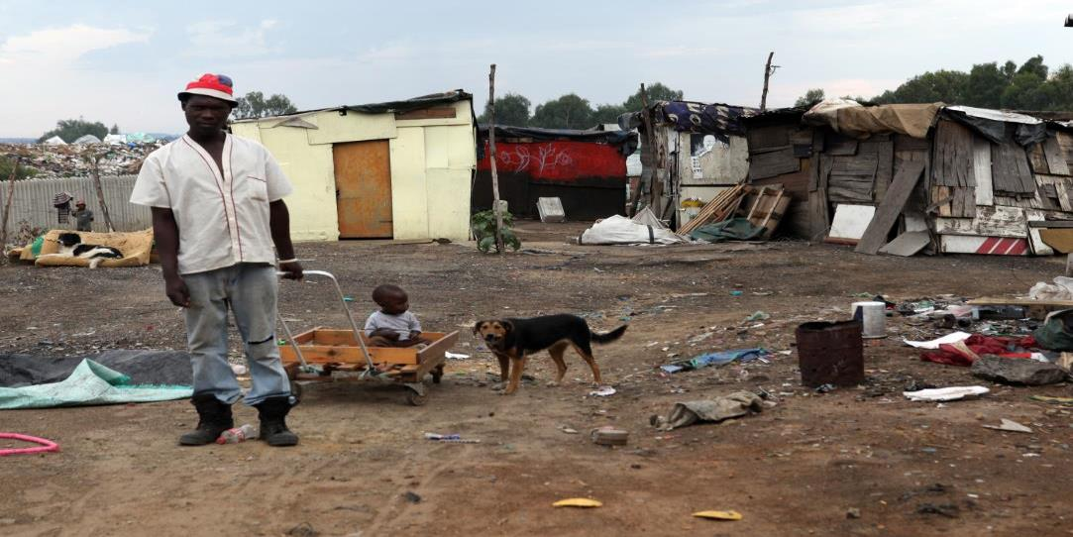
Zenzele & Braamfischerville

Slide 10
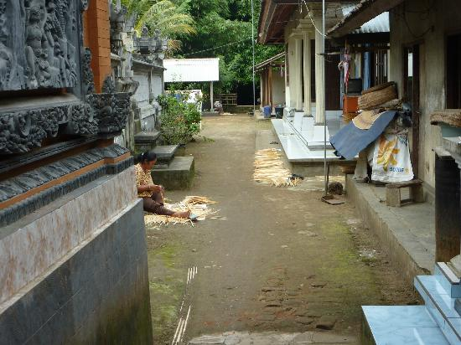
Antiga & Kelusa

Slide 11
Methods Overview
March 2008 – April 2011
Households visited door-to-door every 3-4 months
Individual-level data for every identified dog in study area.
Direct observation and owner questionnaire
Focus groups, including PRA tools

Slide 12
Methods Overview
Every owned dog
Pups assessed and documented, recorded by questionnaire after 3 months of age
Each dog recognized and monitored for duration of study or until gone
Dogs in a yard not their own or in the street and not recognized - classified as unowned
Other than rabies vaccination, there were no “interventions” during this period

Slide 13
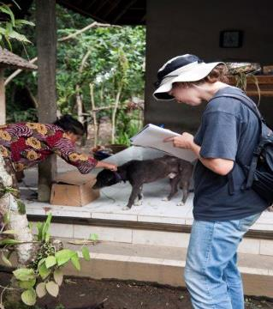
General Numbers
Total No. of dog observations: ~13,600
Total No. dogs >12 weeks age tracked: ~3,300
Total number litters tracked: ~625
Total No. households
Johannesburg ~5,600
Bali ~560

Slide 14
Population Braamfischerville
Constant
Dog-owning households constant: 7.5% → 7.8%
~1.3 dogs/house

Slide 15
Population Zenzele
Decline
Dog-owning households constant:
10% → 12%
~1.3 dogs/house

Slide 16
Population Kelusa
Constant
Dog-owning households constant:
71.9% → 72.9%
~1.7 dogs/house

Slide 17
Population Antiga
Decline
Dog-owning households decline: 49% → 41.6%
~1.3 dogs/house

Slide 18
In Summary
Two communities had a constant population – Kelusa and Braamfischerville
Two communities had a decline in population – Antiga and Zenzele
Approximately 1.3 dogs/household in all communities except Kelusa where there was 1.7
18 dogs in Bali and 2 dogs in Johannesburg identified unowned by community
→ The dogs are owned!

Slide 19
Unowned DOGS
What does 10 dogs in Antiga – 1.5% - look like?

Slide 20
Unowned DoGS
What does 8 dogs in Kelusa – 1.1% - look like?

Slide 21
Unowned DOGS
The number of unowned dogs in Zenzele and Braamfischerville?
.1%

Slide 22
Dogs Coming…
At least 1/3 of the population was sourced from outside of the area.
Zenzele – 40.8%
Braamfischerville – 59.5%
Kelusa – 36.5%
Antiga – 43%

Slide 23
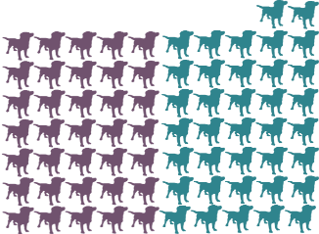
…and Going
At least 20% of the dogs registered during the starting censuses were present 3 years later at the end of the study.
Zenzele – 28.2%
Braamfischerville – 23.9%
Kelusa – 39.6%
Antiga – 51.7%

Slide 24
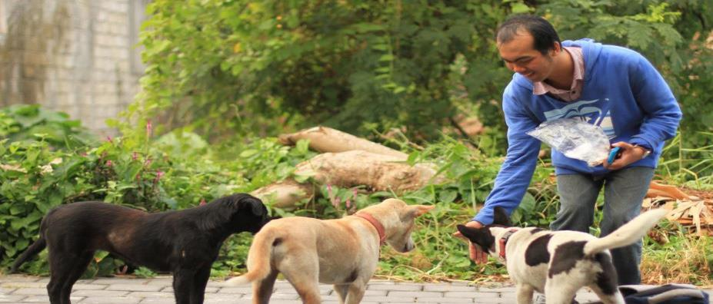
Food
Notes:
Almost all owned dogs had been reportedly fed by their owner
Most the rubbish in the areas consisted of inedible, organic matter.
None of the sites were within 5km of alternative food sources such as rubbish dumps or abattoirs.

Slide 25
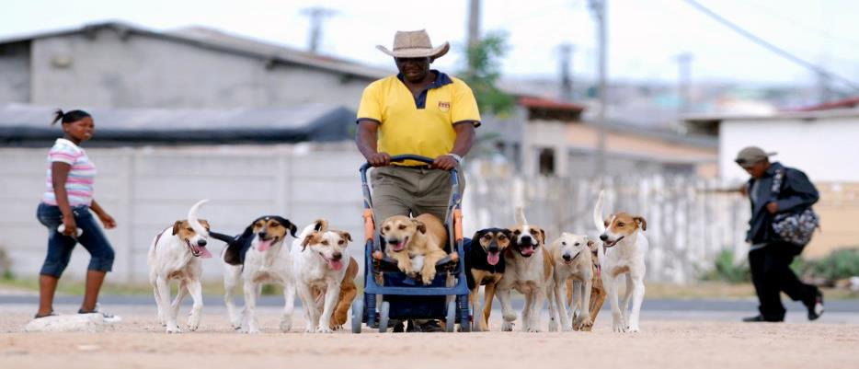
So what does it all mean?
Dog population regulated by human demand

Slide 26
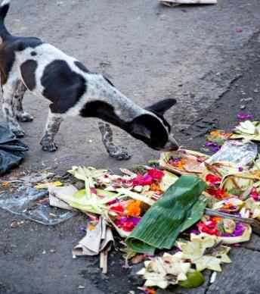
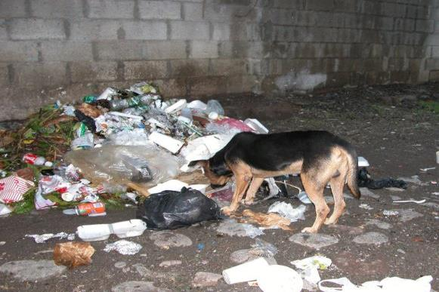
So what does it all mean?
Environmental resources probably inadequate for dogs not fed properly by their owners

Slide 27
So what does it all mean?
Mass sterilization alone won’t change number of dogs
Communities choose how many dogs they want to have.
Sterilization is still important for individual animals.
Reduction in dogs may increase movement of dogs by people.

Slide 28
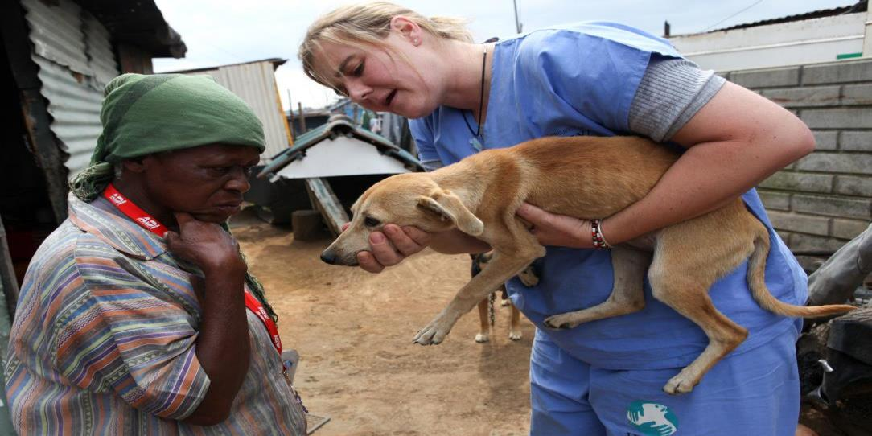

Slide 29
In Bali
Focus on efforts at the Banjar level
Utilize PRA/PLA tools during community meetings
Community members better understand the needs of their dogs and how to provide them.
Reaching the owner so they can reach the dog.
Owners and their communities request the services.

Slide 30
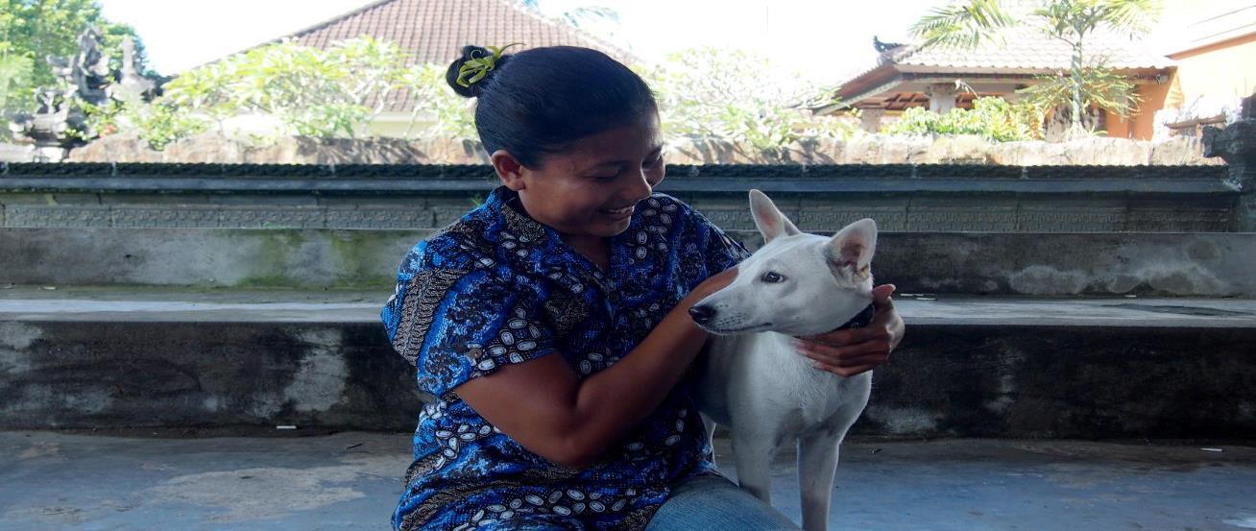

Slide 31
Bukit

Slide 32
Blaphane Kaja

Slide 33
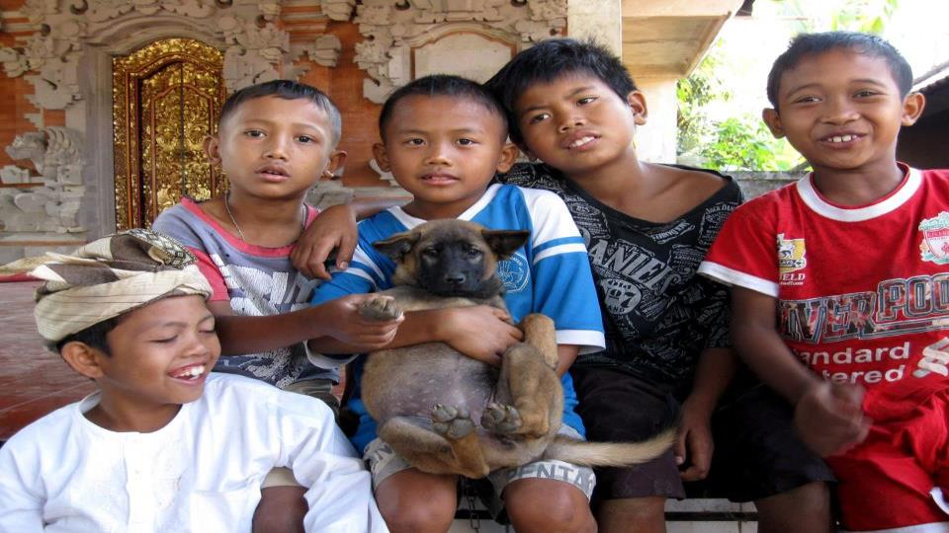

Slide 34
South Africa
Mobile clinics
Provide services – type and timing – based on need
Health and well-being of people is inherently connected

Slide 35
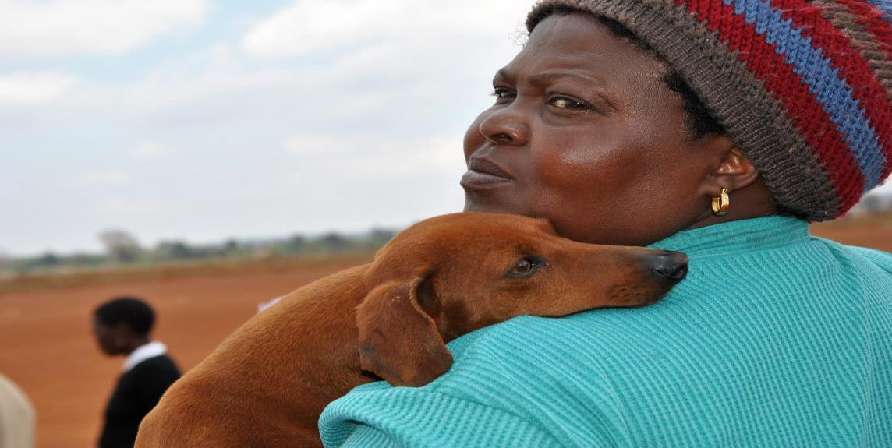

Slide 36
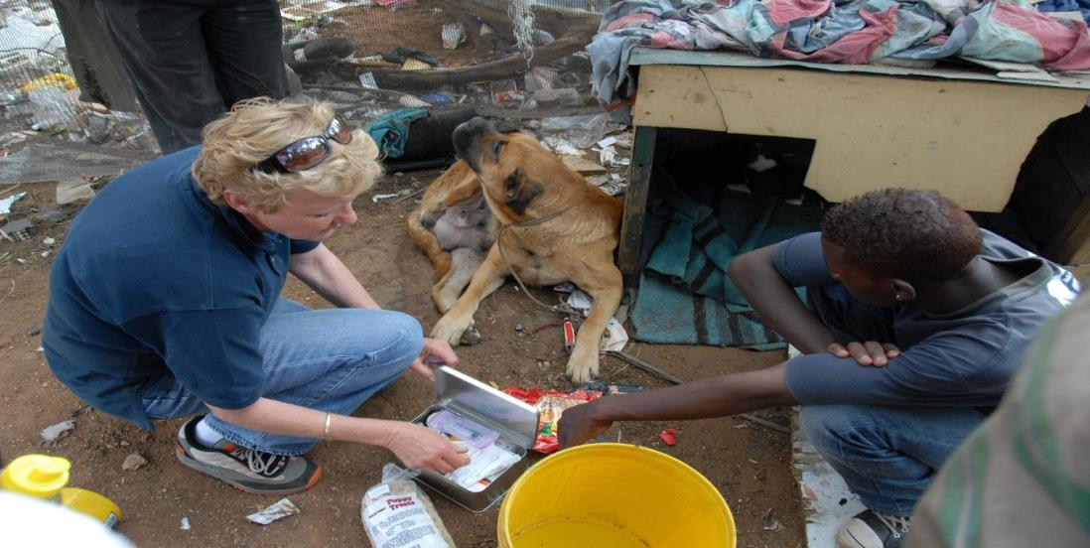
Insert picture of person with dog

Slide 37
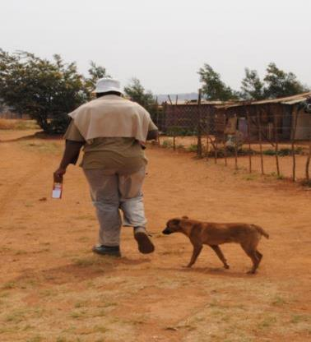
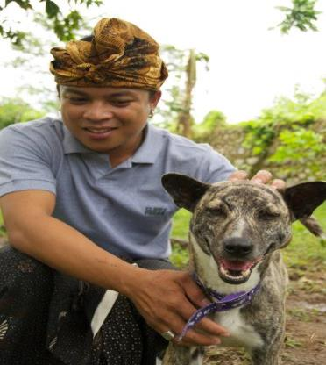
Roaming DOG

Slide 38
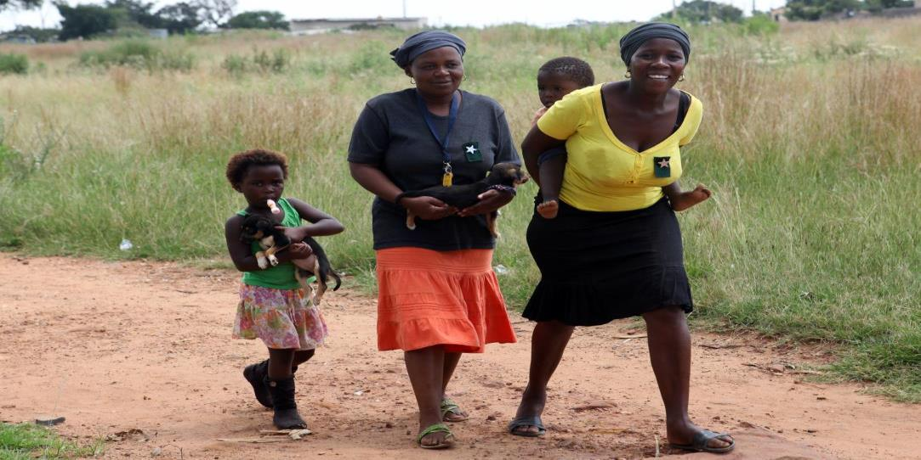

Slide 39
THANK YOU!
Dr. Michelle Morters
Morters, Michelle K., et al. (2014) The demography of free-roaming dog populations and applications to disease and population control. Journal of Applied Ecology, 1-10.
Morters, Michelle K., et a. (2014) Participatory methods for the assessment of the ownership status of free-roaming dogs in Bali, Indonesia, for disease control and animal welfare. Preventive Veterinary Medicine, 116, 203-208.
Community Led Animal Welfare (CLAW) in Johannesburg, South Africa
Bali Animal Welfare Association (BAWA) in Bali, Indonesia

