Slide 1

Recommendations for using behavioural indicators to assess animal welfare impact of dog population management (DPM) interventions
Lou Tasker¹ & Elly Hiby²
¹ Independent Research Consultant
² International Companion Animal Management Coalition (ICAM)

Slide 2
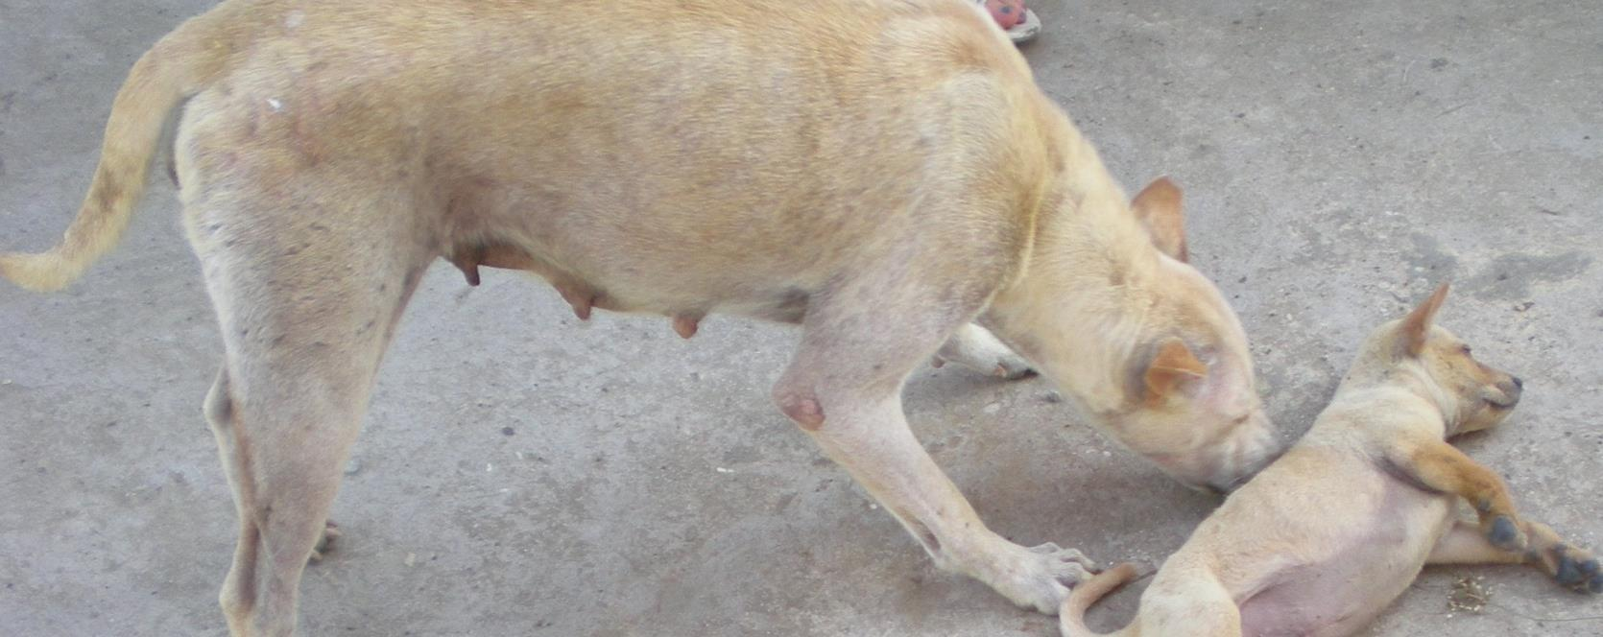
Impact of dog population management interventions
Are we making a difference?
(Tasker 2012)
Impacts - the changes we hope to make through interventions (ICAM 2015)

Slide 3
8 Common impacts
Improve dog welfare
Improve care provided to dogs
Reduce dog density/stabilise turnover
Reduce risks to public health
Improve public perception
Improve rehoming centre performance
Reduce negative impacts of dogs on wildlife
Reduce negative impacts of dogs on livestock
(ICAM 2015)

Slide 4
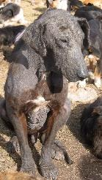
Dog welfare
State within the animal
3 approaches:
natural living
affective state
biological functioning
(Fraser 2003)
Unified > Integrated biological functioning & affective state
(Hemsworth et al 2015)
Physical health, biological functioning & psychological well-being
(Tasker 2005)
The state of an animal as regards its attempts to cope with its environment
(Broom 1986)

Slide 5
Measures of welfare
Behaviour & emotions
repertoire & activity budgets
facial expressions, vocalizations, postures
abnormal behaviour,
challenge tests, subjective ratings
anticipatory behaviour & judgement tests,
fractal analysis
Mind
Body
Physical
Coat, skin & body condition, body weight fluctuation, longevity, growth rate, susceptibility to disease, reproduction & infant care, wound healing, post-mortem indicators
Clinical
heart rate, blood pressure, haematology, biochemistry, body temperature, cortisol,
immunological functions,
telomere length,
allostatic load
(Buchanan-Smith)

Slide 6
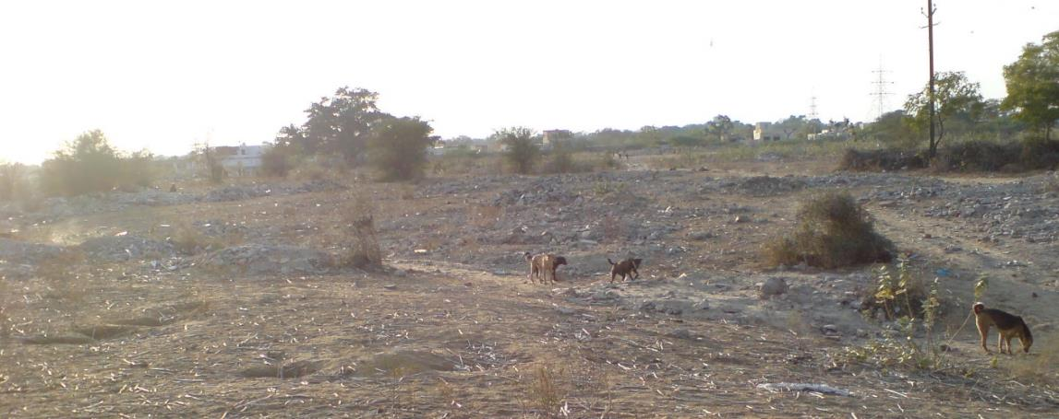
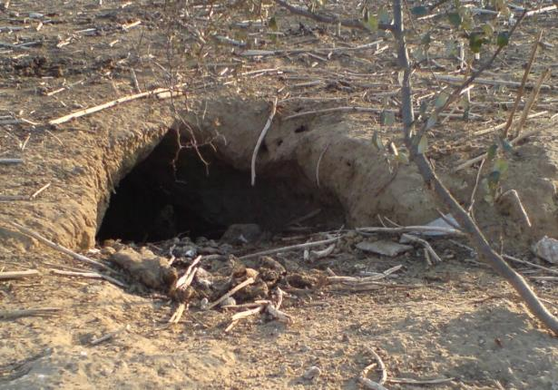
Using behaviour to measure welfare
Accessible
Practical
Feasible
Non-invasive
Non-intrusive
Low cost
Ultimate phenotype
Result of animal’s own decision-making process
Expression of emotions
Photo: Lex Hiby
(Dawkins 2004)
Photo: Lex Hiby
Notes:
Quantifiable
Reflects relationships, motivational state, emotions

Slide 7
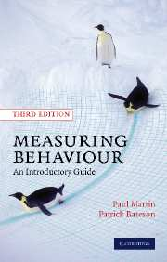
Measuring behaviour
The ultimate guide!
Quantifiable – monitor changes over time
Valid – reflect welfare, sensitive to detect changes in welfare state
Reliable – between observers & over time
Feasible – for measurement in the field
Martin P & Bateson P 2007 Measuring Behaviour An Introductory Guide Cambridge University Press: Cambridge, UK

Slide 8
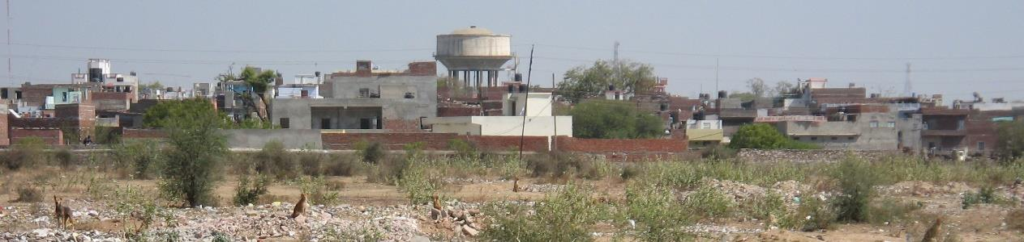
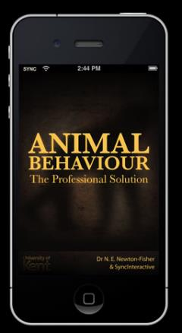

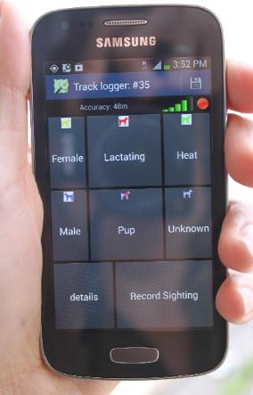
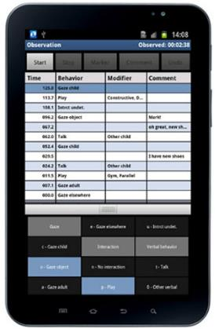
Recording behaviour
Photo: Lex Hiby
Event recorder
Apps – phone, tablet
Bespoke app?
Interface other parameters
Check sheet
Hannah Buchanan-Smith
Noldus Observer
Animal behaviour Pro
Prim8
Conservation Research Ltd.

Slide 9
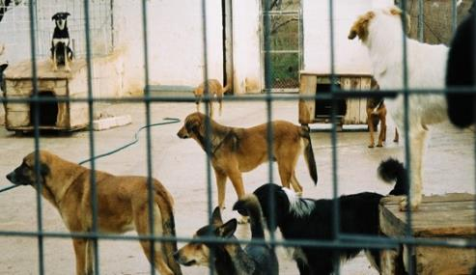
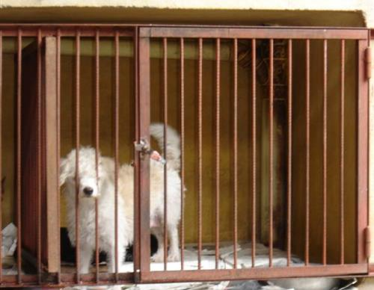
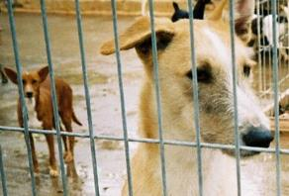
Behavioural indicators of welfare
Indicator | Welfare interpretation* Kennel/Laboratory
 | + ve | - ve
Repertoire | Broad | Narrow
Activity budgets | Exploration | Inactivity, sleep, autogroom, exploration, hiding
Abnormal behaviour |  | Locomotory, self-directed, polydipsia, polyphagia, oral, excessive barking
Posture, facial expression, vocalization | Alert, confident, relaxed | Fearful, extreme submission, cower, defensive aggression, yelp, howl, whine
Other | Play | Panting, lip & nose licking, tongue flicking, paw lifting, yawning, sighing, body-shake, salivating, air sniffing, vigilance
Human-dog interaction | Affiliative, friendly, confident, relaxed, playful | Defensive, fearful aggression, extreme submission, approach-avoidance, escape
Dog-dog interaction | Stable hierarchy, aggression, play | Unstable, aggression
(Tasker 2005)
(Tasker 2005)
* Context, qualitative, quantitative differences. JWGR (2004); Tasker (2005); Taylor (2005); Barnard (2014)
(Tasker 2005)

Slide 10
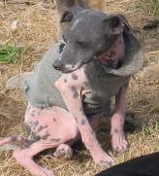
Behavioural indicators of welfare
DPM Intervention – considerations
Indicators
within project (repeated measures)
change over time (direction, quantitative, qualitative)
feasible for project staff (resources)
direct observation (not remote)
recording methods (transcription time, error)
(Tasker 2005)
(ICAM 2015)

Slide 11
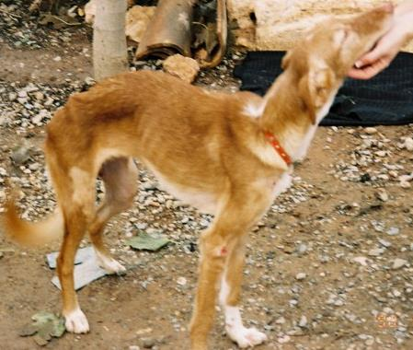
Behavioural indicators of welfare
DPM Intervention – considerations
Categories – observe dogs in their
‘natural environment’
dog-dog interactions
dog-human interactions
activity budgets
response to challenges
‘Piggy-back’ on monitoring & evaluation activities
(Hiby et al in prep)
(Tasker 2005)

Slide 12
Dog-dog interaction
Observational - at sites with high frequency of interactions between dogs (ICAM 2015)
Behaviour category | Descriptions of behaviours (Garde et al 2012)
Amicable interaction | Licks, paws, nudges with nose, or grooming between dog, often with tails wagging. Play behavior including charges with bouncing gait, play faces (mouth relaxed, slightly open, teeth covered), wrestles and play chases.
Neutral interaction | Approach and retreat, often including sniffing, limited body language, non-demonstrative. Not aggressive but also not friendly. Includes non-reproduction related mounting, unless this is clearly part of play or ends in aggression.
Mating interaction | Copulation (not only mounting where one dog stands with forepaws on another), usually ending in a ‘tie’.
Aggressive interaction | Growling, teeth visible, barking, biting, fighting. One dog flees with tail tucked to avoid other dog, cowers or rolls over.

Slide 13
Dog-dog interaction
Neutering had differing effects * sex, on contact between dogs
Sparkes et al 2014
Notes:
Effects of sex, reproductive state on interactions between free roaming domestic dogs: Contacts are frequent, neutering had differing effects on contact, most frequent contacts were FE, and MN with other dogs

Slide 14
Agonistic & submissive, encounters by season & location
Site of aggressive encounters
-feeding > other > sexual > territorial boundary
Intragroup
- non-aggressive
- posture, vocalization
- not severe
Intergroup
- aggressive (feeding sites)
Seasonal variation
Welfare implications
Stable, healthy groups
- less aggression
- more affiliative behaviours
Pal et al 1998
Aggressive encounters
Submissive encounters

Slide 15
Dog-human interaction
Observational – dogs in the presence of people
Dogs: Friendly or submissive, retreat (flight response), aggression (Rubin & Beck 1982)
Humans: Extremes of +/- ‘ve human behaviour towards dogs (ICAM 2015)
Standardized - human-response test
Dogs:
Estimate flight distance
Latency to approach
Friendly, retreat, aggressive response
to humans
Reflects quality & quantity of human-dog interactions
Human behaviour (ICAM 2015)
+’ve
Feed, pet, call dog
-’ve
Hit, kick, throw object, shout at dog
Relaxed dog & human behaviour (ICAM 2015)
Human: within 1 dog body length
Dog: does not move
Dog: friendly approach
Human: does not avoid approach

Slide 16
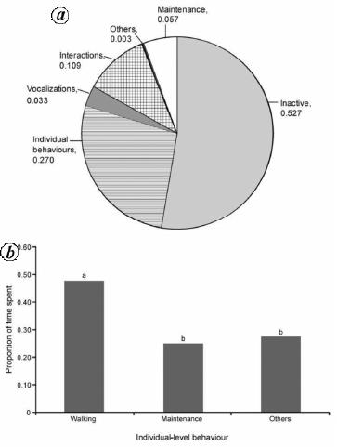
Activity budgets
Daily follow, focal sampling
‘Piggy back’ on recording population survey
Rest
Foraging
Exploration
Grooming (auto)
Active (other)
Social conspecific – play, reproduction, aggression,
allogroom
Human-directed – aggression, friendly, avoidance
Vigilance
Vocalization
Out of sight
Free-ranging dogs India, Majumder et al 2015
Changes in relation to welfare, intervention?

Slide 17
Response to challenge
Capture, handling, restraint - vaccination, mobile clinic (intervention)
Behavioural response (capture, handling, restraint, return)
- Capture, handling
Latency to approach
Approach-avoidance, fearful, confident, aggressive
Subjective score ‘handleability’ (numerical rating scale)
- Restraint examination/vaccination
Posture, facial expression, vocalization, etc.
Accept/refuse food reward
- Upon return
Accept/refuse food reward
Approach-avoidance, escape
Reflects quality & quantity of human-dog interactions
Coping style in response to stressor

Slide 18
Good welfare
Good animal welfare
‘one (animal) which is alert and busy (shows a wide repertoire of behaviour), is able to rest in a relaxed manner, is confident (outward going and does not display fear towards trivial nonthreatening stimuli) and does not show abnormal behaviour’
Poole 1997, p 116.
Absence of sickness & injury

Slide 19
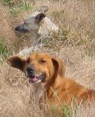
Recommendations
Assess animal welfare impact of DPM interventions
Behaviour
valid welfare indicator
multidimensional assessment
Advantages
accessible, practical, feasible, valid (kennel)
Disadvantages
validity not established for DPM monitoring
Collaboration (academia + practitioners)
pilot testing, validation, method development
establish behavioural indicators
(Tasker 2005)

Slide 20



Acknowledgements
Financial support - IFAW
Conference organisers & reviewers
Collaborators – ICAM Coalition
Prof Hannah M Buchanan-Smith, University of Stirling
Images - Lex Hiby, Conservation Research Ltd.
Tasker (2005)

