Slide 1



Towards a scientific-based assessment of dogs’ welfare in shelters
Istanbul 3-5 March 2015
Shanis Barnard, Cecilia Pedernera, Nicola Ferri, AntonioVelarde, Paolo Dalla Villa

Slide 2

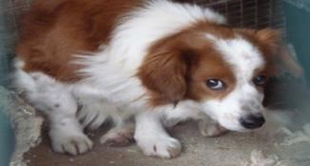
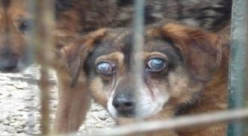
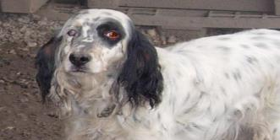
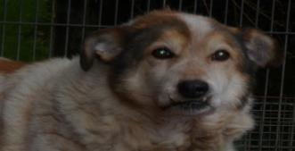
Why shelter dog welfare is at risk?
HAZARDS | ADVERSE EFFECTS
Overpopulation | Direct consequences on the animal health and welfare (health and welfare impairments) on public health (zoonosis transmission, bite events)
Inadequate housing conditions
Social deprivation
Poor health surveillance
Absence of minimum requirement for shelters

Slide 3
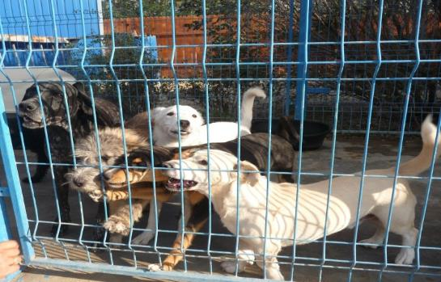
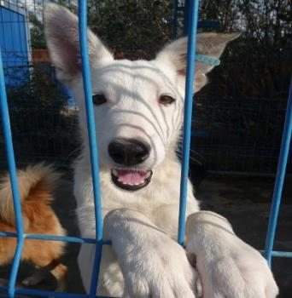
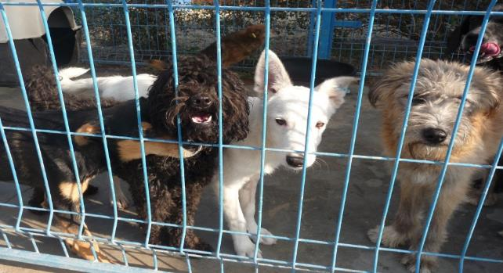
Lack of easy-to-implement and
validated tools to assess dog welfare in shelters
Difficult to compare shelters with very different management systems and facilties
Very high individual variability and different cooping abilities of dogs
Previous studies rely on indirect measures (e.g. cortisol levels), time consuming experimental procedures

Slide 4






EC (2012) European Union Strategy for the Protection and Welfare of Animals 2012-2015. Brussels
OIE (World Organisation for Animal Health) (2013) Guiding principles on animal welfare of the Terrestrial Animal Health Code.www.oie.int
Animal-based measures
In the past, focus was on welfare inputs (e.g. minimum standard requirements for housing conditions)
Recently, both the EC and the OIE recognised the potentials of assessing farm animal welfare through scientifically validated indicators based on animal welfare outcomes, properly reflecting the welfare conditions of animals
Largest initiative for the use of animal-based measures to assess the welfare of animals: Welfare Quality® project

Slide 5



A Welfare Quality® approach
  Our protocol was inspired from the Welfare Quality® assessment systems
  Welfare Quality® projects were successfully designed and applied to livestock animals
WQ based their scientifically validated measures on 12 criteria grouped into four main principles

Slide 6
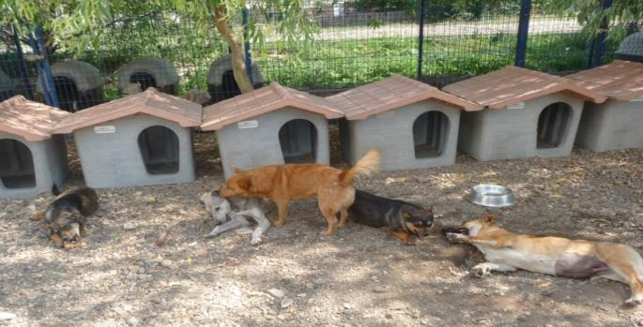



The Shelter Quality project
Aim:
develop a dog welfare assessment protocol for long-term shelters using animal-based indicators
Funded by the Italian Ministry of Health

Slide 7
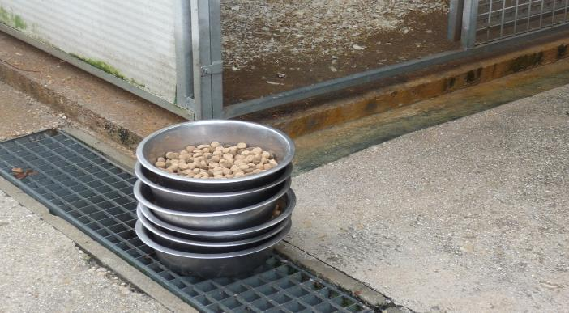
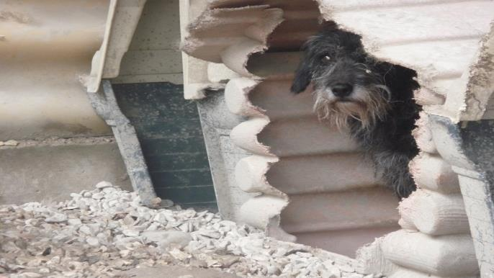
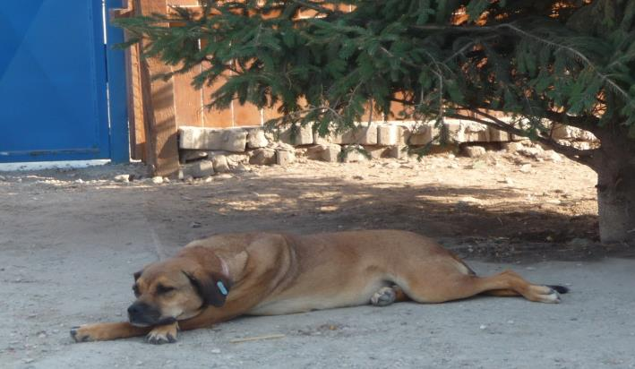
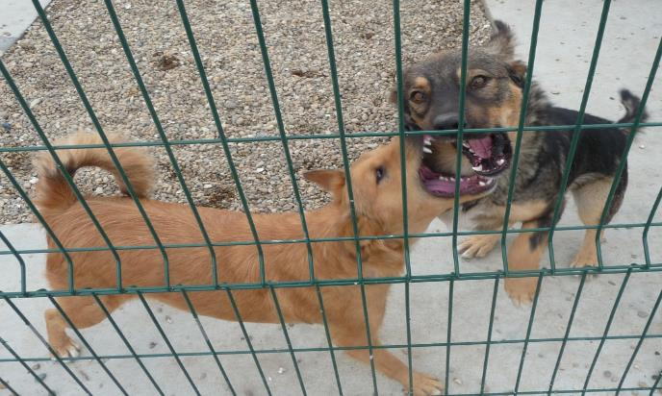
Good feeding
Good housing
Welfare Quality®
principles
Good health
Appropriate behaviour

Slide 8
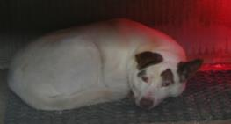
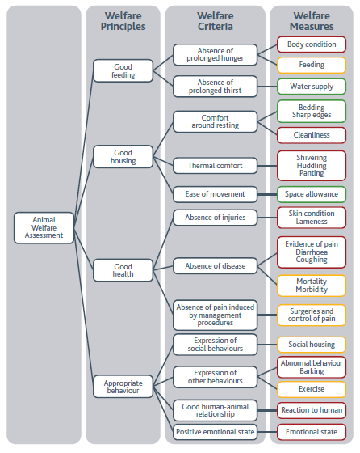

Summary of SQ protocol measures
shelterquality@izs.it

Slide 9
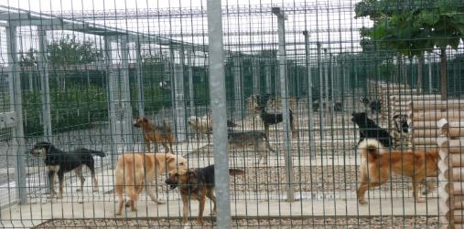
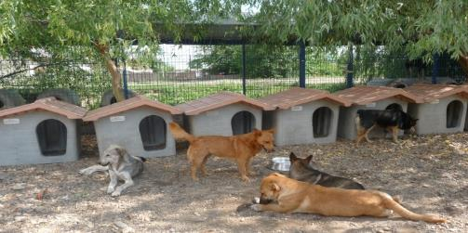
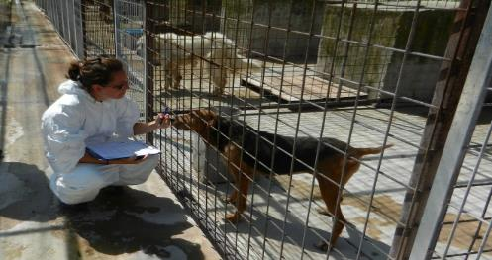
Assessment units
• Shelter: measures recorded evaluating the shelter as a unit (e.g. feeding).
• Pen: measures recorded evaluating each pen as a unit and observing all the animals confined in it (e.g. space allowance)
• Animal: measures recorded evaluating each animal as a unit (e.g. BCS)

Slide 10
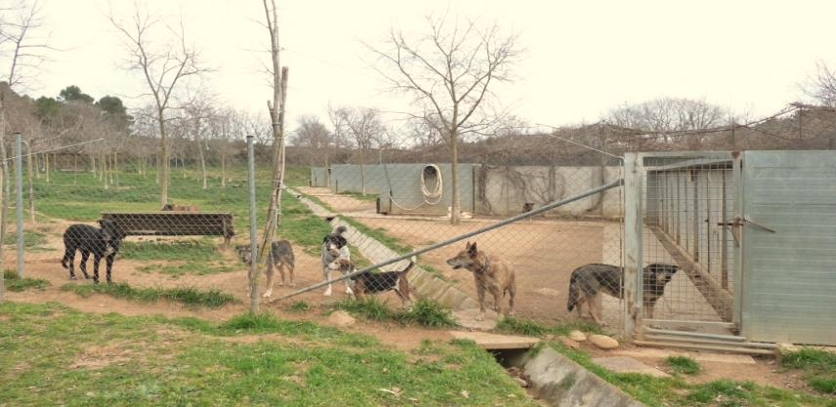
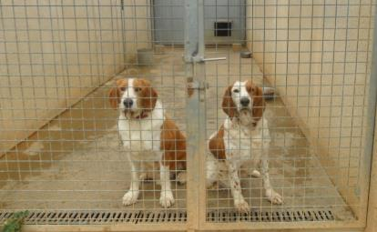

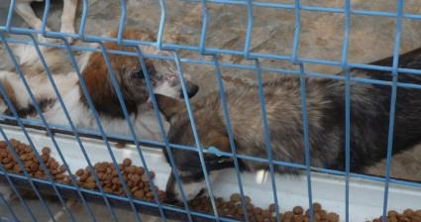
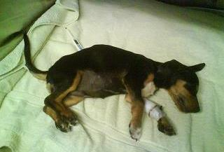
SHELTER unit measures
Shelter population size
Exercise
Social housing
Mortality
Morbidity
Feeding
Surgeries/pain control
Emotional state profile
\
e.g. Playful

Slide 11
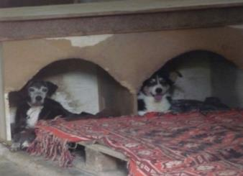
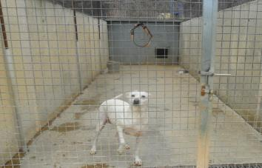
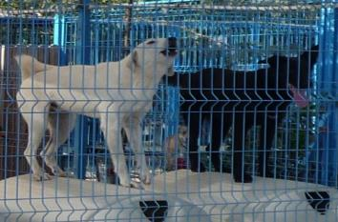
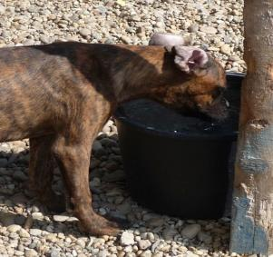
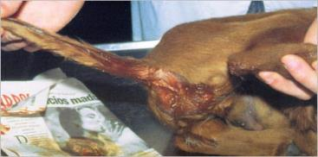
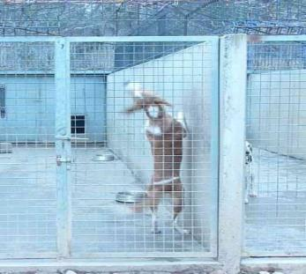
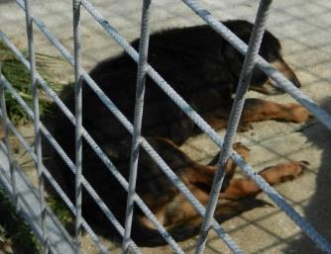

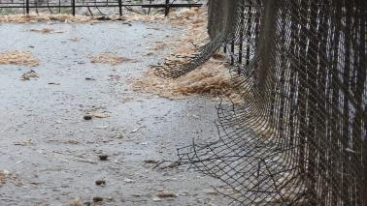
PEN unit measures
Bedding
Space allowance
Barking level
Diarrohea
Abnormal behaviour
Water supply
Sharp edges
Evidence of pain
Panting/shivering/huddling

Slide 12
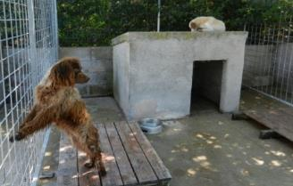
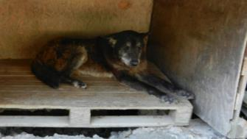
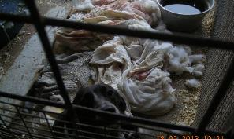
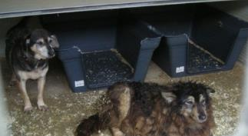
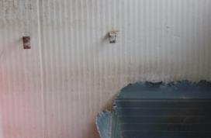
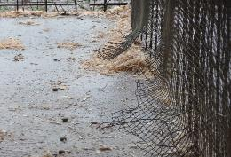
Bedding
Type of bedding (shelter, basket, other)
Adequacy
Presence of at least a bed per dog
No harmful edges or ingestible parts
bedding material dry and free from faeces
Sharp edges
Presence of sharp or harmful edges (Y/N)

Slide 13
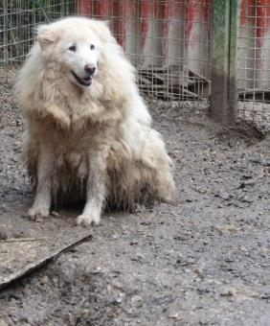
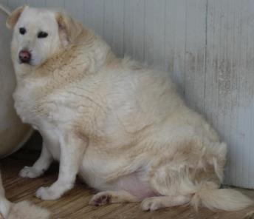
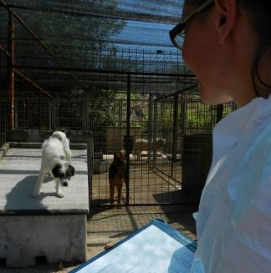
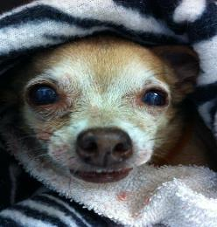
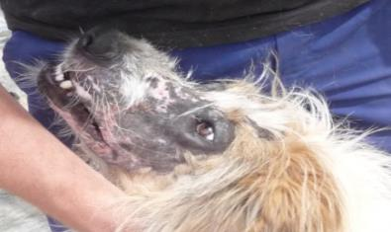
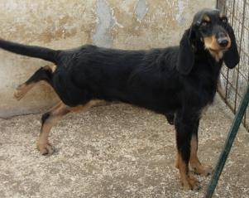
ANIMAL unit measures
Body condition
Reaction to human
Cleanliness
Coughing
Skin condition
Lameness

Slide 14
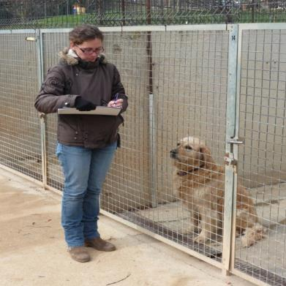
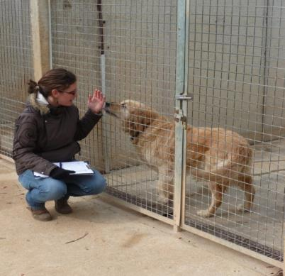
Reaction to human
Fear and aggression are among the most common behavioural problems that impair interaction between dogs and human beings, thereby representing a failure in communication between the two species.
Short test situation
A. Stand still, ignore dog
B. Crouch, talk gently to dog

Slide 15
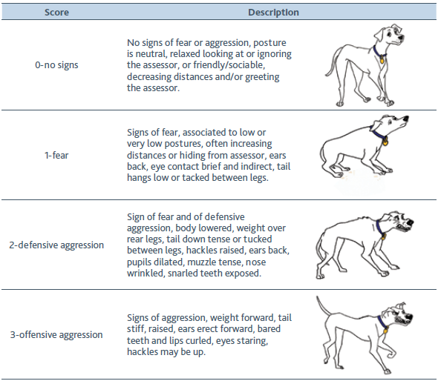
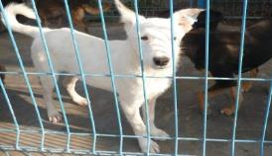
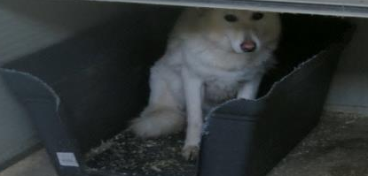

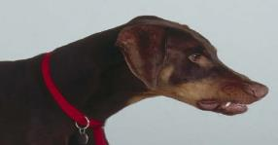
Dog response score to the short test

Slide 16
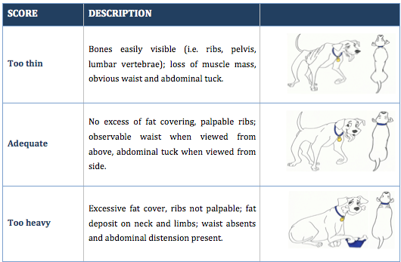
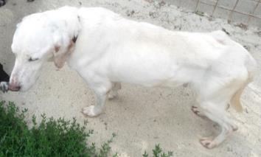
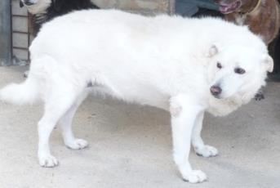

Body Condition

Slide 17

Accuracy and reliability
Assessment of the observers accuracy (compared to a golden standard)
Assessment of measures' reliability (i.e. agreement between different observers)
Almost perfect
(k = 0.81-0.99)
BCS
Substantial
(k = 0.61-0.80)
Shivering
Moderate
(k = 0.41-0.60)
Panting
Fair
(k = 0.21-0.40)
-
RTH
Barking
Skin condition

Slide 18



Application of the protocol
Assessment of 29 shelters in 6 European countries
Total animals assessed: 1308
Mean shelter population size 159 ± 89.27 dogs (mean ± SD)
Location:
3
3
1
10
12
1

Slide 19

Assess the quality of the protocol
Feasibility (i.e. the extent to which the protocol is practical to carry out under field conditions)
Validity of measures (i.e. measures scored twice by same assessor, from outside and in contact)
Protocol reproducibility (i.e. same shelters evaluated twice at time interval)

Slide 20
Descriptive statistics
30.4% (n = 237) inadequate amount of space in residence pens
31% (n = 242) inadequate bedding.

Slide 21










Variation in shelter level prevalence of assessed animal-based measures

Slide 22


Cleanliness of the animal
Risk factors predictors of poor welfare?
Dependent variable | Independent variable | Regression coefficient | P-value
Cleanliness | Space allowance: adequate Inadequate | Baseline 0,85 | 0,0003
 | Bedding: adequate inadequate | Baseline 0,61 | 0,01
 | Bedding type: none/dais close shelter plastic basket | Baseline 0,38 -1,58 | ns ns

Slide 23



Risk factors predictors of poor welfare?
Skin condition
Dependent variable | Independent variable | Regression coefficient | P-value
Wounds Swelling Hair loss areas | Space allowance: adequate Inadequate | Baseline 0,64 | 0,003
 | Bedding: adequate inadequate | Baseline 0,67 | 0,002
 | Sharp/harmful edges: absence presence | Baseline 1,11 | 0,002

Slide 24


Body condition
Risk factors predictors of poor welfare?
Dependent variable | Independent variable | Regression coefficient | P-value
Too heavy | Space allowance: adequate inadequate | Baseline -1,09 | 0,059
 | Pen with run area: absence presence | Baseline -0,66 | ns
 | Feeding regimen: at libitum once/day twice/day | Baseline 0,38 -1,58 | ns ns

Slide 25


Application and future steps
A systematic data collection would help creating a large dataset essential to move towards reliable quantitative risk assessment of shelter dogs’ welfare
Today the protocol is a useful tool to collect relevant dog welfare measures and have an overview of the shelter condition and criticalities
New follow-up project: Shelter Quality team is working to develop a scoring system to classify shelters on the basis of the welfare of the animals they host.
The APP

Slide 26






Special thanks to…
Marta Amàt
Deborah Temple
Lindsay Matthews
Elisa Di Fede
Marjiana Vučinić
Katarina Radisavljevic
Tomislav Mikuš
Tatjana Zajec
Alexandra Hammond-Seaman
shelterquality@izs.it
Scientific coordination:
Paolo Dalla Villa
Nicola Ferri
Shanis Barnard: shanis.barnard @gmail.com

