Slide 1
Non-Surgical Contraception/Sterilization in Dogs
Linda Rhodes, VMD, PhD

Slide 2
Toolbox approach
What is available now
What does “regulatory approval” mean?
New research
Barriers and issues
Supporting work – marking, modeling
When?

Slide 3
History
Faulkner LC, Pineda MH, Reimers TJ, Immunization against gonadotropins in dogs, in Immunization With Hormones in Reproduction Research, pp. 199-214, 1975. (40 years – contraception in wildlife; but no dog product)
Mahi-Brown CA, Huang TTF Jr., Yamagimachi R, Infertility in bitches induced by active immunization with porcine zonae pellucidae. J Exp Zool 222: 89-95, 1982. (33 yrs- vaccine for horses, wildlife, but no dog product)
Tremblay Y, Belanger A, Reversible inhibition of gonadal functions by a potent gonadotropin-releasing hormone agonist in the adult dog. Contraception 30: 483-497, 1984. (20 yrs - first product 2004-males, 2006- females, but off the market now)

Slide 4
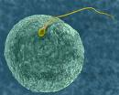
Tool Box
Can a non-surgical sterilant be:
completely safe
100% effective
inexpensive?
No “silver bullet”
Cost compared to what?
Risk/benefit considerations
Notes:
Do some talking here about risk/benefit in different situations
e.g. owned pets, street dogs, truly wild dogs, community considerations, etc.

Slide 5
Contraceptive Targets
Notes:
Use to briefly set up this array of options, both in current availability as well as future exploration

Slide 6
Tool Box: Multiple Approaches for a Range of Needs
Surgery
Males and/or females
Hormone suppression or maintenance
Implants, injectable, oral, intratesticular injections
Permanent/long term/short term
Cats/dogs

Slide 7
Regulatory Approval: What Does it Mean?
Regulatory agencies have standards for:
Manufacturing quality (GMP manufacturing)
Safety and ‘pharmacovigilence”
Effectiveness
Data generated, submitted for review, and approval issued
Approval is for:
Species
Indication
Notes:
Mention different standards in different countries but three major commonalities
Mention that “off label” use means in a different species, or for a different indication, but manufacturing standards still apply
I’m going to review the few products that have regulatory approval, and their use both “on label” and “off label” – these are drugs that are manufactured under controlled GMP manufacturing.
Then I will discuss the use of some products that do not have regulatory approval, but may have some published data that guide their use, and are not available manufactured under GMP, but can be “compounded” in certain situations
And finally I will discuss early stage research underway using cutting edge biotechnology and pharmaceutical drug discovery approaches.

Slide 8
Products on the Market with Regulatory Approval
Female dogs
Delvosterone®, Covinan®
Male dogs
Suprelorin®
Zeuterin™/EsterilSol™

Slide 9
Delvosterone®, Covinan®: Synthetic Progesterone
Proligestone, approved in some countries (UK, Australia)
Injection gives 3-5 months suppression of heat
Narrow margin of safety; significant side effects
Risk/benefits
Marketed by MSD Animal Health

Slide 10
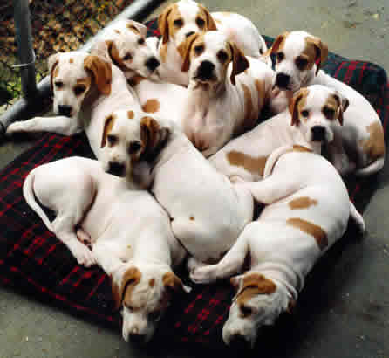
Suprelorin®:GnRH Agonist
Regulatory approval in Europe, Australia and New Zealand
6 or 12 month suppression of fertility in male dogs
1 implant per male dog (no removal needed)
Suppression by ~4 weeks post-implantation
Variable time to return to fertility
Marketed by Virbac

Slide 12
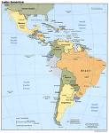
Zeuterin™/EsterilSol™: A Chemical Sterilant
Zinc gluconate with arginine (Neutersol®)
Regulatory approval
US, Mexico, Columbia, Bolivia, Panama, Turkey
Intratesticular injection
Fibrosis of the seminiferous tubules
99.5% effective
Testosterone reduced ~40-60%
Side effect rate similar to surgery
Marketed by Ark Sciences

Slide 13
Zeuterin™
Targeting shelters for sales
Training programs
Light sedation
28’ needle
Slow injection
Careful of scrotal contamination
Sterile product, no preservative; use open vials the same day

Slide 14
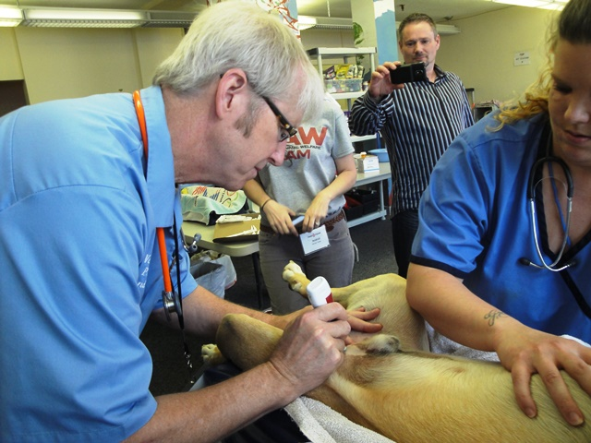
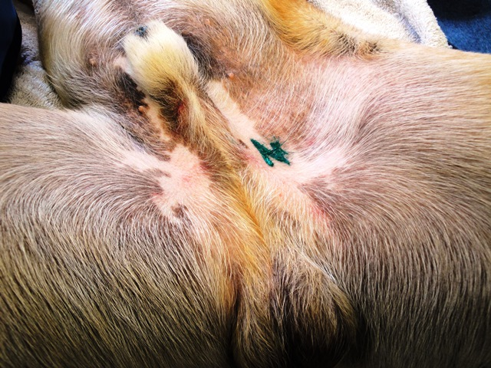
Zeuterin Tattoo

Slide 15
Experimental Approaches “Field” Use/Testing
Products with regulatory approval (in some jurisdiction, for some species) used “off label”
Suprelorin® for female dogs
Gonacon® for female dogs
Product with no regulatory approval
Calcium chloride for male dogs

Slide 16
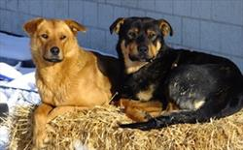
Dogs with No Names Dr. Judith Samson-French
Off label use of Suprelorin in female dogs on First Nation reserves in Alberta, Canada
Suppression of estrus for 6-12 months
Limited data on safety in females, may be issues with induced estrus
Careful evaluation of risk/benefit
Each situation different

Slide 17
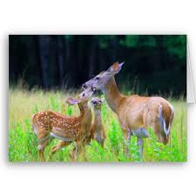
Gonacon™: GnRH Vaccine National Wildlife Research Center United States Department of Agriculture
Control populations of deer, wild horses
1-3 year duration
Regulatory approval (15 years development)

Slide 18
GonaCon™
Dogs
Formulation used in deer causes severe injection site reactions in dogs
Nepal study in 2013
31 of 39 dogs with abscesses
NWRC developing reformulation?
Balance of reactions/efficacy

Slide 19
Intratesticular Calcium Chloride (CaCl₂) Male Dog Sterilant
Experimental field studies in US, Italy, India indicating effectiveness, some safety data
Manufacturing unregulated (compounded)
Formulated with alcohol
Sterilized by syringe filtration
No regulatory approval
Careful evaluation of risk/benefit
Each situation different

Slide 20
We Need More Tools!
Human medicine/biotechnology developing sophisticated tools
Why not for our cause?

Slide 21
50 million US$ available for research grants to develop a non-surgical sterilant for male and female dogs and cats.

Slide 22
Michelson Grant Funding December 2014
Canada -1
Scotland - 1
United States - 14
Australia -1
Argentina - 1
TOTAL since 2009: >30 projects in 7 countries

Slide 23
Goal
Reduction or elimination of deaths of healthy shelter cats and dogs in the United States
Successful product will likely be made available world wide for feral cat and dog control

Slide 24
25 Million US$ Prize
Single-dose, permanent, nonsurgical sterilant
Safe and effective in male and female cats and dogs
Ablates sex steroids and/or their effects
Suitable for administration in a field setting
Viable pathway to regulatory approval
Reasonable manufacturing process and cost

Slide 25
Research Disciplines
Reproductive biology
Gene therapy
Neuroendocrinology
Immunology
Oncology
Bioengineering
Medicinal chemistry…. and more

Slide 26
Safety and Animal Welfare
Specific reproductive targets to optimize safety (limited ‘off target’ side effects)
Animal welfare is a primary concern (see Foundation Guidelines for Research Animals:
http://www.michelsonprizeandgrants.org/resources/animal-welfare-policy
Behavioral enrichment
Dog and cat adoption

Slide 27
The Numbers
319 Letters of intent
109 full grant applications
31 proposals funded
To date, $12.5M of the $50M have been dispersed.

Slide 28
Research Approaches
Immunocontraception
High dose/long term GnRH agonists
Targeted delivery of cytotoxins
Gene silencing/gene therapy

Slide 29
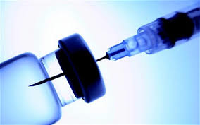
Immunocontraception
GnRH vaccine – new approaches
Unique sperm antigens
Recombinant zona pellucida proteins

Slide 30
GnRH Vaccines: Why a New Approach?
Longer duration (3-10 years)
Eliminate need for boosters
Eliminate injection site reactions

Slide 31
GnRH Vaccines – VLPs
Virus like particle (VLP) vaccines “decorated” with GnRH protein
Bachmann-Zinkernagel hypothesis
B cells recognize as foreign particulate antigens with epitope spacing of 50-100 angstroms
VLP display augments the antibody response to self antigens (Cytos Biotechnology)

Slide 32
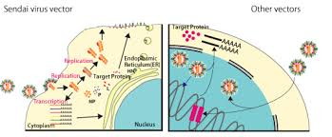
Immunocontraception New Delivery of Antigen
Matrix for long term exposure
Self boosting strategies
Viral vector delivery

Slide 33
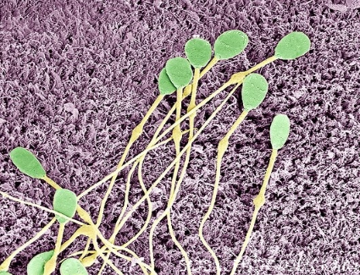
Immunocontraception New Targets
Sperm, egg specific proteins
Find protein that:
Is involved in generation or maintenance of primordial follicles in females
OR
Is involved in spermatogenesis

Slide 34
Immunocontraception New Targets
Combine GnRH and MATER (maternal antigen the embryos require)
MATER is a protein expressed in ovulated eggs and needed for embryogenesis
Put antigens in non-infectious canine parvo-virus VLPs
(S. Coonrad, Baker Institute, Cornell University)

Slide 35
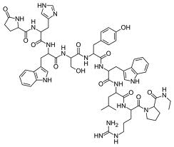
High Dose/Long Term GnRH Agonists
New delivery
Slow release deslorelin for 5+ years
Programmable delivery device (MicroCHIPs)

Slide 36
High Dose/Long Term GnRH Agonists
Pre-pubertal exposure (cats)
Significant delay of onset of puberty (42-91 wks of age compared to about 15 wks in controls) in male and female kittens with a 1.6 mg deslorelin implant within 24 hrs of birth

Slide 37
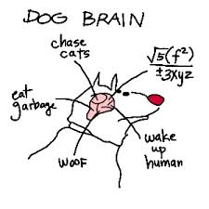
Targeted Delivery of Cytotoxins
3 keys to success
Targeting a cell type involved in reproduction
A potent toxin that causes cell death when delivered to “targeted” cells
A method to get the substance to the specific cells (injection, absorption into the brain, etc.)
Notes:
Mention that the target cell type should not be one that can re-generate (like mature sperm)

Slide 38
Targeted Delivery of Cytotoxins
Can it work? Example from human prostate cancer treatment*
Antibodies to PSA
A cancer chemotherapy that is conjugated (connected) to the PSA antibody
IV injection
Results
Antibody sticks to prostate cancer cells that have PSA
Delivers toxin to those cells, kills the cancer cells
*Olson WC, Israel RJ, Antibody-drug conjugates targeting prostate specific membrane antigen.
Front Biosci 2014; 19:12-33.

Slide 39
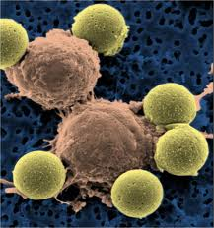
Targeted Delivery of Cytotoxins
Brain neurons that secrete GnRH targeted using kisspeptin + saporin
Gonadotroph cells in the pituitary using GnRH + toxin conjugates
Stem cells in the ovaries and testes using “homing peptides” that can deliver a toxin

Slide 40
Gene Silencing/Gene Therapy
Gene silencing – turning off a gene required for reproduction
Gene therapy – delivering a gene that could produce a protein to interfere with reproduction

Slide 41
Gene Silencing
Small RNA fragments that interfere with gene expression (siRNA)
Delivery by viral vectors

Slide 42
Gene Silencing Grant
siRNA to suppress androgen receptor expression in the testes
siRNA to suppress maturation of ova and sperm, with a target unique to ovaries and testes
Delivery via viral vectors

Slide 43
Gene Silencing Grant
Construction of a viral vector with a siRNA to suppress kisspeptin that can deliver siRNA to the brain
Vector integrated into the target cell and continually produces siRNA for lifetime suppression
Issues with getting material across the blood/brain barrier

Slide 44
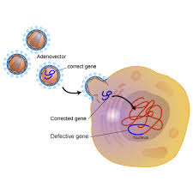
Gene Therapy
Successfully treated hemophilia in dogs for more than 8 years*
Viral vectors can deliver
GnRH antibodies
Gonadotrophin inhibiting hormone
Mullerian inhibiting substance
*Neimeyer et. al. Long-term correction of inhibitor-prone hemophilia B dogs
treated with liver-directed AAV2-mediated factor IX gene therapy. Blood 113(4):797-806, 2009

Slide 45
Yes, But When?
Most research to date with cell cultures, rodent models
Tools and assays have been developed that will accelerate the pace
Basic facts about dog and cat reproduction are being discovered and shared as a foundation for more progress
Results are being published

Slide 46
Yes, But When?
Breakthroughs unpredictable
Let’s look back 10 years
No new therapies (now we have Suprelorin and Zeuterin)
Little research on dog/cat reproduction – no funding (now we have 50M US$)
What doesn’t work brings us closer to what does; we see results quarterly

Slide 47
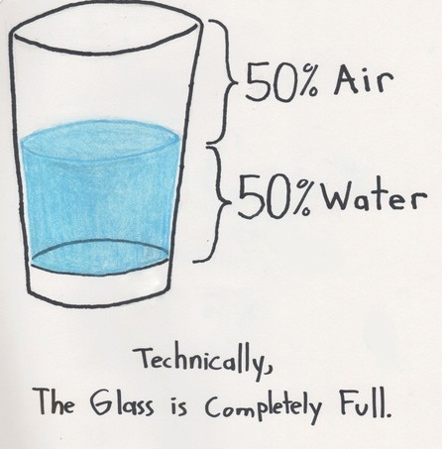

Slide 48
Yes, But When?
Grants continue to be submitted by world class laboratories around the world
Collaborations are forming
Communication and support is building
Ongoing grant supported research helps us learn what has the most potential

Slide 49
Practical Support
High science needs support for real world implementation
Communication (think tanks, symposiums, publications)
Treatment administration – practical challenges
Marking treated animals
Evaluating impact (population modeling)
Notes:
Mention John Boone’s and Valerie’s presentations

Slide 50
Alliance for Contraception in Cats and Dogs
Goal: to promote development of products for non-surgical contraception/sterilzation in cats and dogs for effective population control
www.acc-d.org

Slide 51
Barriers for New Products
“Don’t veterinarians just want to spay/neuter dogs?”
Big pharma not investing
Regulatory hurdles
Technical difficulties
Product development costs

Slide 52
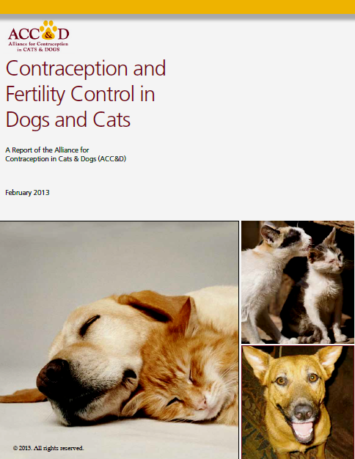
More Information
Free download at www.acc-d.org

Slide 53
Yes, But When?
WE WILL GET THERE….

Slide 54
Thanks
For inviting me
To colleagues who contributed to this information
Joyce Briggs
Wolfgang Jochle
Shirley Johnston
Kevin Morris
Alliance for Contraception in Dogs and Cats
Found Animals Foundation

