Slide 1
Decreasing the relinquishment of owned dogs by implementing behavior modification therapy
Dunja Kovac, DVM
FDF- Farm Development Foundation, Novi Sad, Serbia

Slide 2
Why?
behavior problems- the most frequently given reason for relinquishment of owned dogs.
further understanding of behavioral problems
responsible ownership
reduces conflict between owner and a dog

Slide 3
The study:
At “Pets&Science” educational centre for owners and pets in Novi Sad, Serbia

Slide 4
The data set :

Slide 5
Most common behavioral disorders
aggression towards people
fear of various things
destructiveness in the house
aggression towards animals
biting
excessive vocalization
problems between new pet and other pets
leash aggression
general disobedience

Slide 7
Refusal of treatment :
1. financies
2. unable to find time
3. “not believing” in treatment

Slide 9
In 25 cases, the treatment was fully completed, all with the positive outcome
the owners stuck to the program, and as a result dogs did no longer exhibit problem behavior
the relinquishment was no longer an option.

Slide 10
Cost/benefit analysis
3 important indicators:
1.time
2.finances
3.outcome

Slide 11
1. Time factor
Behavioral modification therapy is often time consuming, it can take up to a six months , to a whole year

Slide 12
2. Financies
The bigger the problem – the bigger the expenses - time factor!

Slide 13
3. Outcome
The more severe problem – the outcome is often uknown

Slide 14
Cost/benefit in this study
cases weren’t difficult - the therapy was conducted in short time span – 2 months
expenses were reasonable
outcome was positive
benefits out weights the costs

Slide 15
1. Conclusion
the relation between cost and benefit depends mostly on the severity of the case, the longer the therapy lasts, the cost out weights the benefit
realistic prognosis

Slide 16
2. Conclusion
giving some advice and explanation of the problem to the owner
animal behavior problems often have detrimental effects on the relationships between pets and their owners
intervention strategy for educating owners and training dogs from the first day in their new home

Slide 17
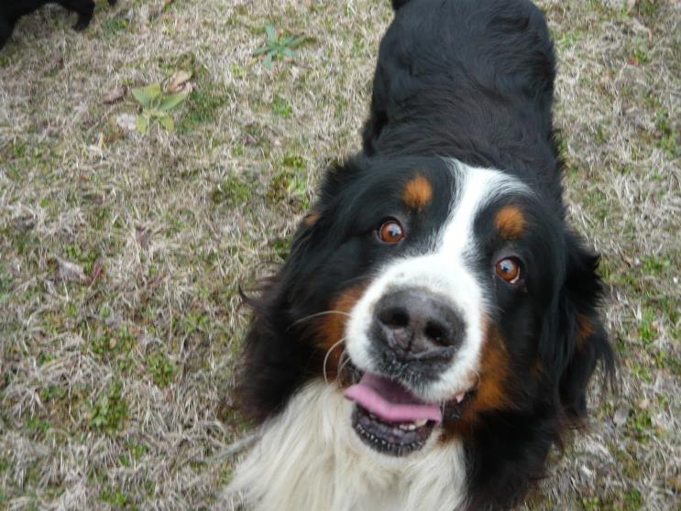
THANK YOU FOR YOUR ATTENTION!

