Slide 1
A People-Centered Approach to Humane Dog Population Management
Presented by Becky Brimley
Co-authors: Kate Atema, Hanna Lentz,
Ellie Milano, and Amielle DeWan
With special thanks to Elzemina Bojicic (UNDP),
Elena Garde and Guillermo Perez (GAAP)

Slide 2
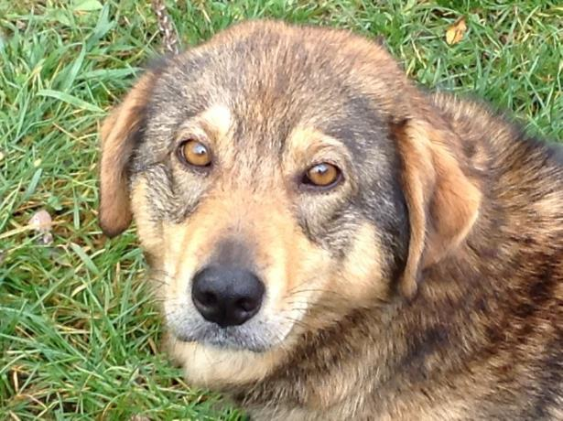
The International NGO Dilemma
How to maximize impact on the largest number of dogs?
Develop a model project and replicate all over the world?
Support the ‘best’ projects and hope others emulate them?
Provide materials, training and build capacity?

Slide 3
Challenges to effective DPM
Efforts undermined or diverted by passionate single-solution advocates
Culture of NGO service provision dependency
Capacity attrition
We can’t afford scanners, but micro-chipping is the answer!!
Yes we want to be self-sufficient, but what are you going to give us?
I can charge more for these new skills

Slide 4
It’s all about the people

Slide 6
A Better World for People and Animals

Slide 7
Our hypothesis
Participation leads to
Appropriate solutions for each community
Community owned initiatives
Resilience

Slide 8
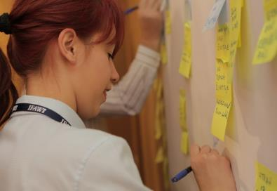
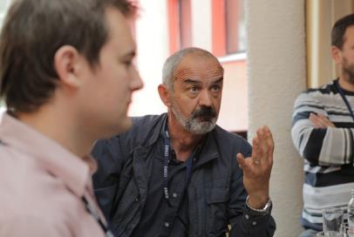
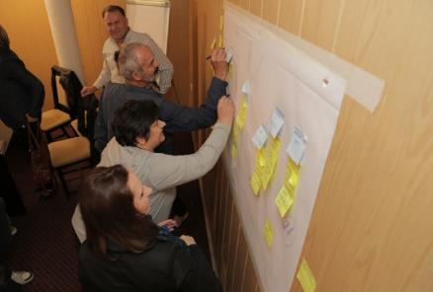
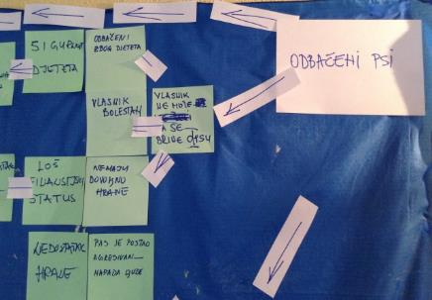
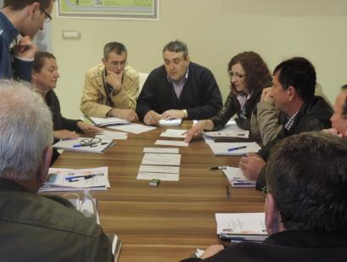
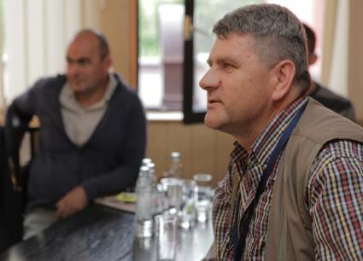
Humane Community Development

Slide 17
Pre-requisites
We must be invited
Partner for:
Coordination
Day to day management
Data collection
Some level of existing resources (inc. people)

Slide 18
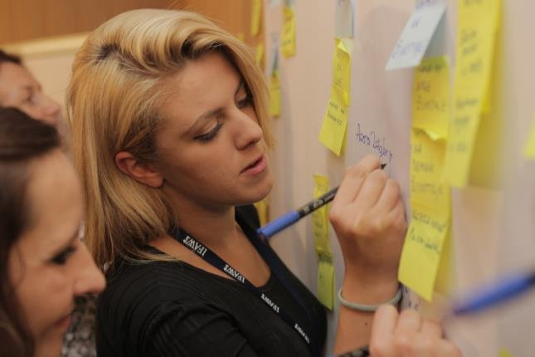
Building A Humane Community Workshop
Diverse stakeholders together
Shared understanding
Stakeholders take a step back so they can be objective
Create a visual map of what’s happening with dogs in their community

Slide 19
Community Data Collection

Slide 20
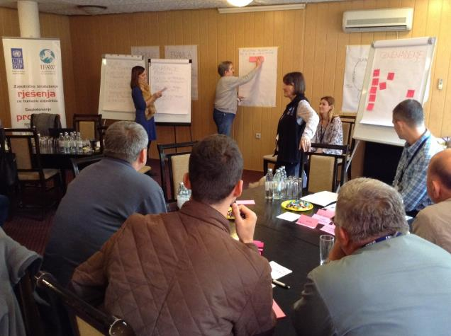
Action Planning Workshop
Review community data
Prioritize problems
Identify shared values
Identify impactful solutions
Map out a plan

Slide 21
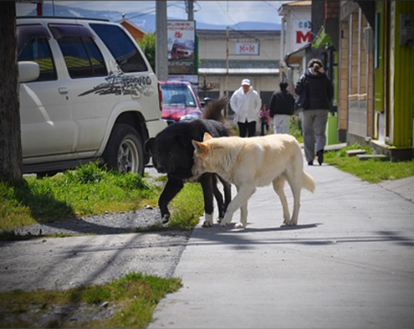
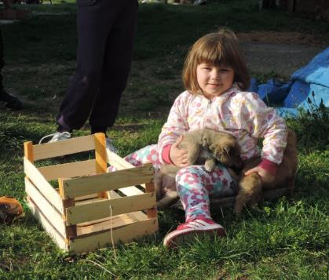
Pilot testing
Sites
Chile
Puerto Natales
Bosnia
Lopare
Sanski Most
Jajce
Gradacac

Slide 22
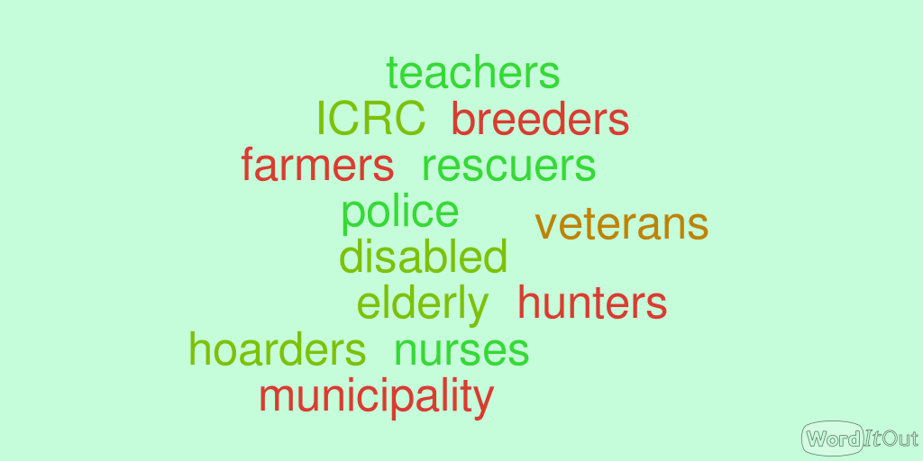
Stakeholder working groups

Slide 23
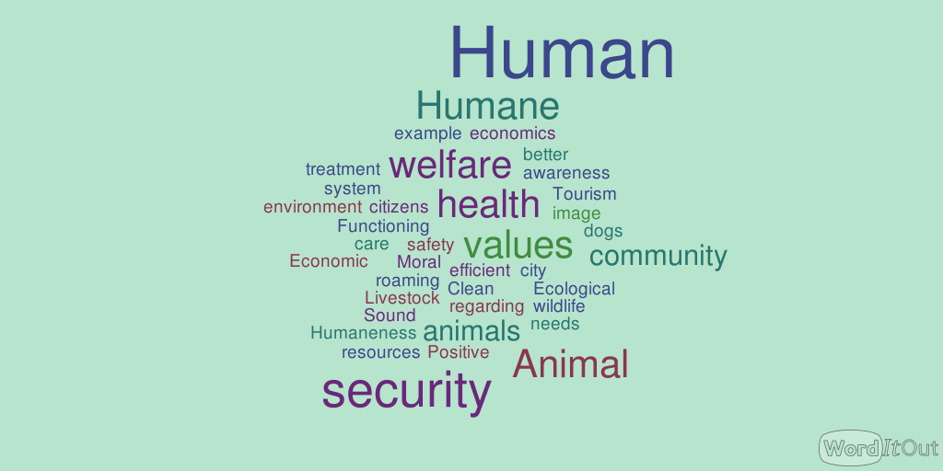
Results: Values

Slide 24
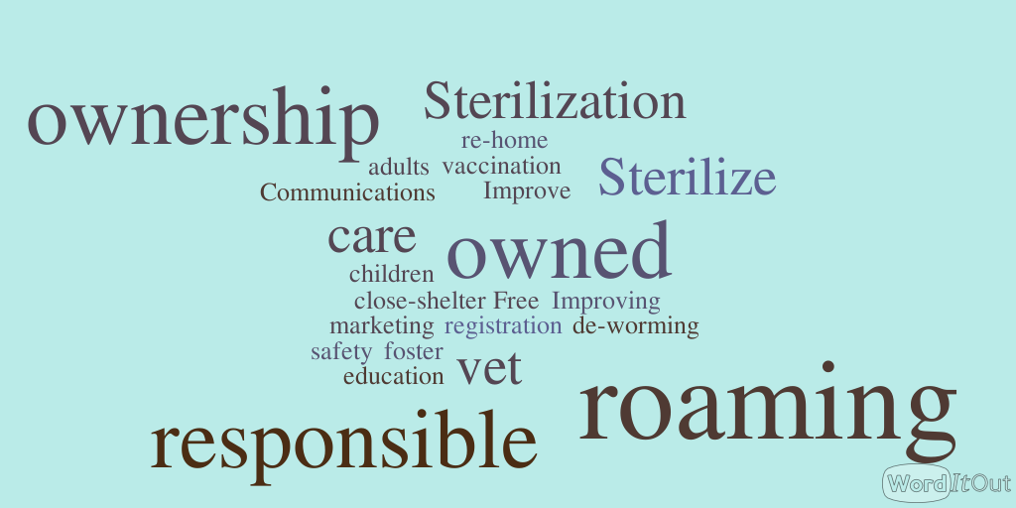
Results: Strategies

Slide 25
Key markers for sustainability
Ownership
Commitment
Optimism

Slide 26
Compared to before the workshop, how have your ideas changed about the problems with dogs? (n=83)

Slide 27
Compared to before the workshop, how have your ideas changed about what needs to be done? (n=83)

Slide 28
Comparison of self-reported current vs future activities (n=103)

Slide 29
How much confidence do you have that that the community will be able to improve the situation with dogs? (n=108)

Slide 30
Results
The groups :
Develop humane solutions
Create plans with a very good chance of being locally sustainable
Are confident they have chosen the right solutions
Are personally committed
Feel optimistic

Slide 31
Bring dogs together over a snack

