Slide 1
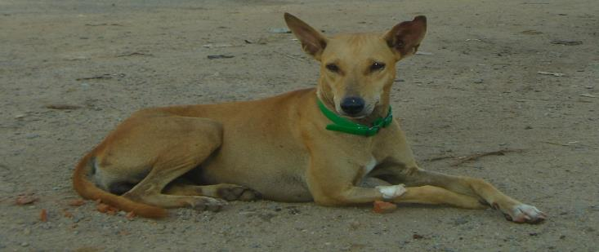
Implications of sterilizing 80% of female dog population
Dr. Ganga de Silva
Blue Paw Trust
Sri Lanka

Slide 2
Significance of the study
To know if 80% sterilization is effective
Effect of nuisance for rabies control and impact of sterilization.
poor animal welfare
culling
Impact of sterilization on achieving herd immunity
large dog populations
limited man power

Slide 3
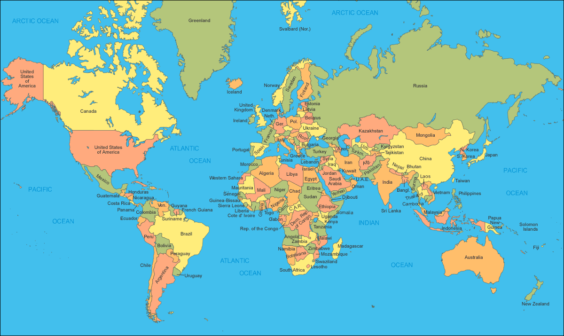
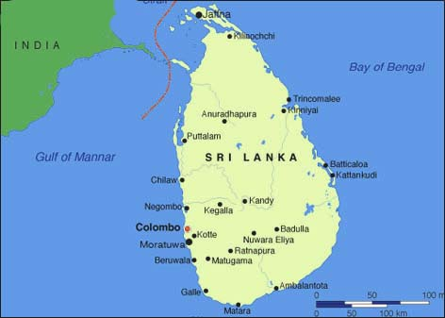
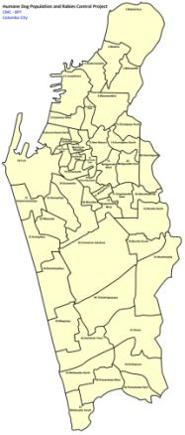
Introduction
Sri Lanka
65,610 km²
Colombo
37 km²

Slide 4
Introduction cont.
Roaming dog population control in Colombo
Before 2006
From 2007 to 2012
After 2012

Slide 5
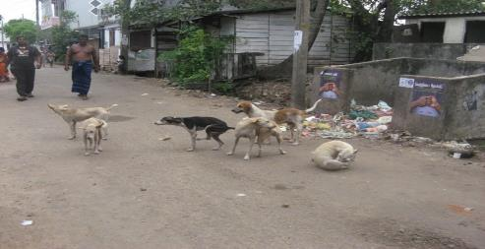
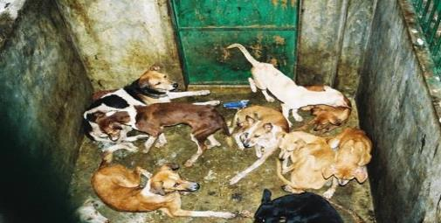
Introduction cont.
Before 2006
Mass culling (nooses + gas) for > 100 years
“No-kill Policy” introduced in 2006 by H.E. President

Slide 6
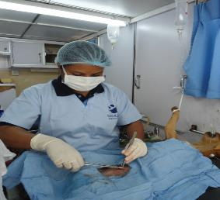
Introduction cont.
From 2007 to 2012
Humane Dog Population & Rabies Management Project
By December 2012
More than 80% of females sterilized in all 47 wards
Population that was increasing at 18% in 2007
was declining at a rate of 09% in 2012
MoU ended
WSPA stopped funding + interest
New Chief Vet at CMC
BPT lacks jurisdiction to continue

Slide 8
Introduction cont.
After 2012
Intervention Influenced by ward
Important wards (Economic Hub)
Dogs disappear as part of “City Beautification”
Convenient wards (Close proximity to CMC & BPT)
CMC catch and sterilize to continue Colombo Project
BPT catch and sterilize to teach students
Unimportant wards (Distant and under privileged)
No disappearance, no sterilization
Considered as left alone

Slide 9
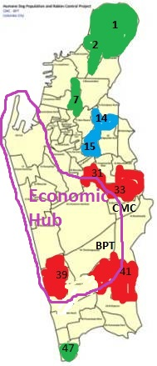
Sample Wards
Ward 01
Ward 02
Ward 07
Ward 47
Ward 14
Ward 15
Ward 31
Ward 33
Ward 39
Ward 41
Left alone
(Unimportant wards)
Limited sterilization by CMC + BPT
(Convenient wards)
Removal &
Limited sterilization
(Important wards)

Slide 12
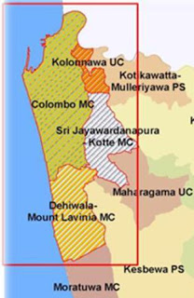
Discussion
Left alone wards - Evidence of dumping
Limited sterilization - Good population control
Removal & limited sterilization - Migrating from adjoining MC

Slide 13
Conclusion
80% sterilization
Breeding
Migrating
Dumping
Removing
After 2 years
Effective in reducing total population
Reduced sterilized %
Increased lactating %
Increased pup%
???

Slide 14
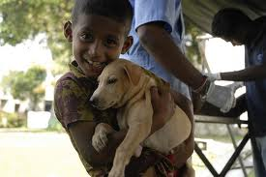
Thank you!
gangadesilva@hotmail.com

Slide 15
Acknowledgement
IFAW for sponsoring my participation at this conference; specially Dr. Kate Atema
Colombo community and its dogs
Blue Paw Trust, specially Dr. Nalinika Obeyesekere
All others who have helped through out

