Slide 1
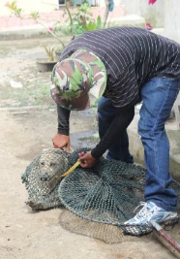
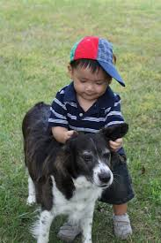
Dog population management
in Vietnam
Dr. Van Dang Ky - National rabies consultant
Dr. Scott Newman- Senior Technical Coordinator
Ms. Hang NguyenThuy - National communications consultant
FAO ECTAD Viet Nam

Slide 2
Contents
Overview of dog management in Vietnam
Rabies situation
Activities prevent and control rabies in Viet Nam
Support by intentional organizations in rabies prevention and control
Lessons learned

Slide 3
Dog management in Vietnam
Domestic dogs population distributed in North, Central & South VN
Higher densities in lowland provinces, cities, towns and townships
Majority of dogs are native & raised for protecting homes or property, and for consumption (dog meat)
A smaller number of dogs are imported & raised in urban cities
Normally, a family keeps one dog, but somtimes 3 or 4 and up to 8 in more rural locations - many families have both dog and cat.
Dog population in VN estimated to be approximately 8- 9 million but a more accurate population count is needed

Slide 4
Dog management in Vietnam
The management of dog population is quite poor at all levels
Most dogs are free-ranging & roaming, not kept on chains or leashes
Roaming dogs do not have muzzles
Most dogs are not vaccinated against rabies
Most dogs are not registered with local veterinary services resulting in the dog census not obtaining accurate dog population numbers
Some big cities (HCMC, Hanoi and Hai Phong) have conducted dog census, and made efforts to have most dogs registered so they have more accurate and updated figures for dog (and cat) populations

Slide 5
Situation of Rabies in Viet Nam
Figure: Rabies incidence risk in Viet Nam
Rabies has existed and circulated in Vietnam for many years. It occurs at any time in the year.
In 1990s- rabies declining; 2004 - today rabies increasing
Rabies in people is almost exclusively caused by dog bites
According to the Ministry of Health report from the rabies prevention and control committee:
>300,000 people suffered dog bites & are given vaccine yearly
Human deaths from rabid dog bites is on the rise (average per year of about 100 people die of rabies)

Slide 6
The Document of Government and MARD
Dog management is regulated in:
Decree 05 /2007/NĐ – CP/ on rabies control and prevention of rabies in animals issued by Prime Minister on 9 January 2007 (Article 6 provides for management of dog)
Ministry of Agriculture and Rural Development issued Circular guidelines on rabies prevention No:48/2009/TT-BNNPTNT dated 04/08/2009 (Article 4 of the guidelines on the management of dogs)
Animal Health Law will be signed in May, 2015

Slide 7
Rabies situation in Vietnam from 2008 to present
Year | Infected Provinces | Infected Districts | Infected Communes | Rabies cases
2008 | 5 | 7 | 28 | 110
2009 | 4 | 8 | 10 | 25
2010 | 6 | 14 | 42 | 150
2011 | 7 | 9 | 14 | 100
2012 | 8 | 19 | 34 | 268
2013 | 11 | 15 | 36 | 272
2014 | 12 | 18 | 42 | 128
Source: Epidemiology Division, Department of Animal Health, 2014

Slide 8
Situation of Rabies in Viet Nam
Most cases occur in the northern mountainous provinces
Most outbreaks were detected in humans before dogs
Since dogs are not managed carefully, numbers of dog cases may not be accurately counted
2 rabies vaccination rounds annually: April-May and Sept-October
In urban areas, more than 80% of pets was vaccinated while in rural and remote areas, vaccination percentage was less than 50%.
Most Important Feature in Viet Nam: People not fully aware of the dangerous nature of rabies nor proper dog management practices including dog vaccination

Slide 9
Main challenges for controlling human & canine cases in Viet Nam
People do not think it is important to vaccinate their dogs
Difficult to reach desired 70% vaccination rate of dog population
As most dogs roam in large numbers with other dogs, one infected dog can easily spread disease to other dogs in the group
Rabies vaccination too expensive for some families to treat their dogs
People do not get post-exposure vaccination if they are bitten because: a) they do not think it is necessary, b) they do not have access to medical facilities with the vaccine, or c) it is too expensive

Slide 10
National Program on Rabies prevention & control (2011-2015)
Overall: National Program - Minster of MARD
Government budget: $11.6 million USD ( 233.114 billion VND)
Central Government: $1.3 million USD of which MARD 0.8 million USD & MOH: 0.5 million USD
Local Government: $10.3 millions USD of which MARD 6.5 million USD & MOH 3.8 million USD
Privates/dogs owners: vaccine and vaccination fees
MOET (education), MIC (communication); MPS (Pub. Security), MARD & MOH Institutions

Slide 11
The National Program: Objectives
Increase public awareness of the risk of rabies and methods for rabies control & prevention
Improve MARD & MOH rabies monitoring & surveillance systems
80% of dog population will be managed
80% of dog population will be vaccinated against rabies
70% of Provinces will be free from rabies
The rabies case fatility rate (CFR) will decrease about 30% compared to the average CFR in period 2006-2010

Slide 12
Major Support Provided by International Organizations on Rabies Prevention & Control
ASEAN countries nominated Vietnam as lead for South-East Asia Rabies Strategy (SEARS) to control & eliminate rabies by 2020
In 2012, FAO funded Knowledge-Attitude-Practices project aiming to better understand the ecological characteristics of dogs and minimize the risk rabies in humans and animals
Identify difficulties and gaps in the rabies policies - Phu Tho province – the pilot province
Evaluate two models for improved dog registration at local - village level

Slide 13
Key findings of KAP research
Knowledge and Attitude vs Practices for prevention
96% are aware of rabies
90% are aware that dogs are the main reservoir of rabies transmission to humans
94 % know that dog rabies can be prevented by vaccination
83 % know that human rabies can be prevented by vaccinating dogs
Most people leave their dogs roaming & unchained increasing risk of exposure
Only 8 % report dog bites or suspected rabid dogs
Only 24 % vaccinate their dogs for rabies
Only 32.2% register their dogs

Slide 14
Dog registration trial
Model 1: Village leader go dog owners to collect data for dog population and provide the registration certificate for the dog owners.
In Cat Tru commune : 396 / 607 dog households (65.24 %) registered
518 dogs were registered ( 39 households / day).
In Huong Lung commune : 665 / 865 dog households (78.9 %)
1280 dogs were registered (67 households / day)
Summary : 1.061 (72.8 %) dog household registered
1.798 dogs (81.6 %) were registered
Model 2 Dog owners go to register for dog keeping with Village header.
Village header provide the registration certificate to the dog owners.
Bến Gót commune: 11/193 dog households ( 5,70% ) registered
11 dogs were registered (01 household /day).
Van Phu commune: 306/995 dog households (24,82% ) registered
527 dogs were registered ( 31 household /day)
Sumary Việt Tri city : 317 (28.9%) dog household registered
538 (32.2%) were registered

Slide 15
Major Support Provided by International Organizations on Rabies Prevention & Control
May 2013: FAO CMC-AH mission team deployed to support the Government of Viet Nam to respond to the rabies situation in the country and recommend interventions for improved rabies prevention and control
In 2014: Memorandum of Understanding (MOU) signed between the MARD, MOH and WSPA to foster & further strengthen the cooperation through exchange of information, exchange of expertise & coordinate a program to build the overall prevention of rabies at national level

Slide 16
Major Support Provided by International Organizations on Rabies Prevention & Control
2013-2015: FAO TCP Project to “Strengthening institutional capacity for and Improving inter-sectoral collaboration, coordination, and communication for effective prevention and control rabies in Vietnam” - US$ 386,000 + in kind + complimentary donor (WSPA) funding
2013 & 2014: OIE donated 200,000 & 500,000 doses of rabies vaccine for emergency use

Slide 17
FAO Project
Participants from FAO, Ministry of Health, Ministry of Agriculture and Rural Development, Provincial Departments of Agriculture and Rural Development, and Department of Health in Son La, Yen Bai, Phu Tho and Thai Nguyen province
1. An instructor showing how to capture, vaccinate and put a collar mark on a dog

Slide 18
Activities of the FAO TCP Rabies Project
3 Training of trainers (TOT) courses for dog catching, vaccination, and rabies prevention & control - 75 Participants
Trainings coordinated between DAH and FAO
6 policy advocacy meetings in the 6 District models in two pilot project provinces (Phu Tho and Thai Nguyen)
13 communes levels advocacy meetings in the 6 districts in model of 2 provinces (Phu Tho and Thai Nguyen province).
Cross-sectoral Communication materials produced via collaboration amongst FAO, OIE, WSPA, DAH, GDPM, WHO
Posters, leaflets, world rabies day fact sheets and materials

Slide 19
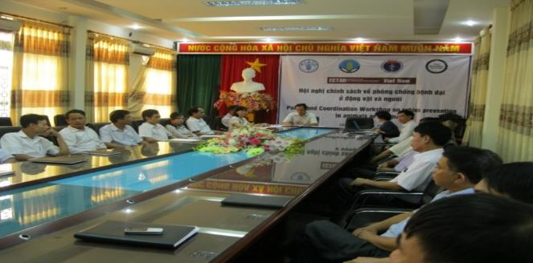
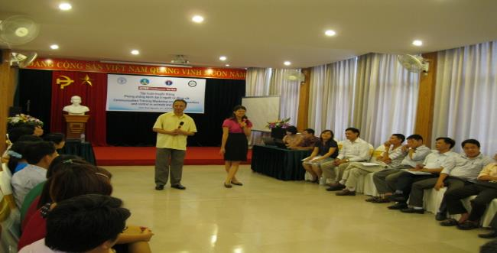
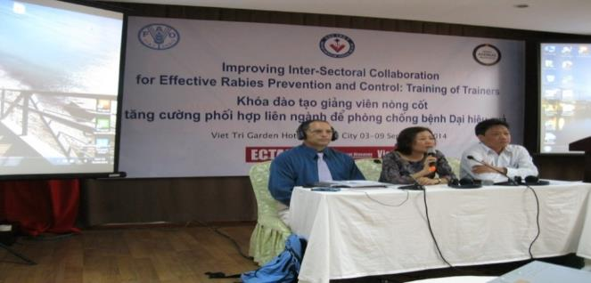
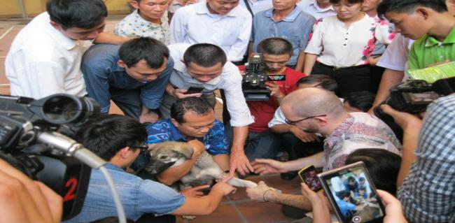
Policy and Coordination Workshop | Communication Workshop
Training of Trainers (TOT) | Guideline for trainers

Slide 20
Recent Dog Management Improvements
35 Provinces have improved management practices:
dogs chained up & annual registration & vaccinations
22 Provinces implemented free roaming dog captures
Ongoing pilot approach to focused dog registration & vaccination program with increased public awareness in 18 communes in 6 districts of the two provinces models (Phu Tho and Thai Nguyen province)
Pilot grade school rabies communication training ongoing
Rabies surveillance in Phu Tho & Dong Nai province-CDC

Slide 21
Lessons Learned
KAP survey necessary to understand what decsions people make and why
Central, Provincial and Local government support (human & financial) and committment is necessary to succeed
Behavior Change Communication for proper dog management is important
Local enforcement of legislation & regulations is important
An effective rabies prevention, control, and response program requires close collaboration among MARD & MOH & MOET

Slide 22
ONE HEALTH the World Rabies Day in Hoa Binh province

Slide 23
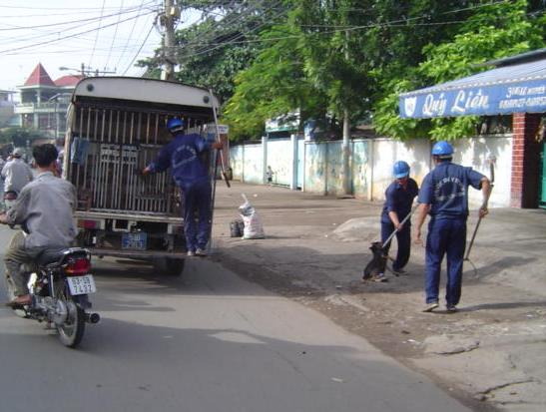
THANK YOU FOR YOU ATTENTION!

